Slide 1
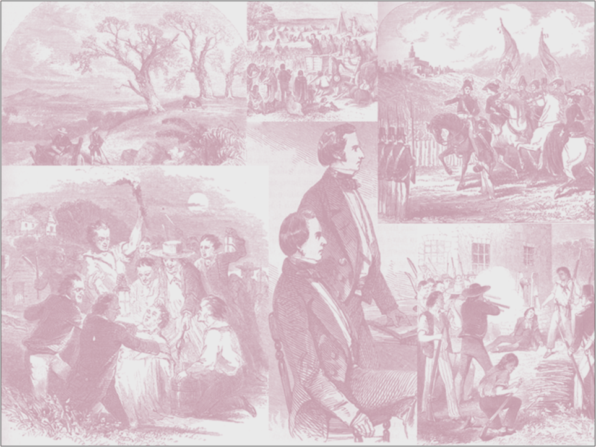
The Faith of a Polygamy Researcher
Mormon Stories
With John Dehlin
Interviewing Brian C. Hales

Slide 2
During our second interview, your questions demonstrated to me that, despite the new evidences and observations regarding Joseph Smith’s polygamy…

Slide 3
Faith is still required

Slide 4
Don Bradley pointed out at one of our book signings that my faith in Joseph Smith that he was a true prophet, separated me from other authors who had published on this topic.

Slide 5
I realized Don was right, because in the 1990s, as I investigated Mormon fundamentalism, I immersed myself in Joseph Smith’s teachings.

Slide 6
Having studied the Book of Mormon, Doctrine and Covenants, and Pearl of Great Price in depth, I came to believe Joseph was a true prophet of God.

Slide 7
So when I approached Joseph’s plural marriage practices and teachings historically,
I believed the history would correlate to the theology, which I already embraced.

Slide 8
Not surprisingly,
I discovered a history
that was consistent with
my a priori beliefs…
In some ways, my
books represent a
self-fulfilling prophesy.

Slide 9
I believe my view is more useful because it emulates that of the Nauvoo polygamists who first believed Joseph was a prophet, before addressing his teachings of polygamy.

Slide 10
The good news for everyone is that I don’t tell my biased story, sprinkling it with supportive documents while ignoring contradictory interpretations and evidences.

Slide 11
Virtually all known documents are included from all sources so readers may decide for themselves.

Slide 12
My books contain a previously unpublished story, of Nauvoo polygamy as seen through the eyes of those who lived it.
It is told by those participants through numerous recollections.

Slide 13
Finding what an author
expects to find when
reconstructing history
is common.

Slide 14
It might be argued that all other authors who have written on this topic have done the same thing.

Slide 15
For example, Fawn Brodie believed Joseph was a libertine, and what did she find? What did she portray?

Slide 16
Why is it common for authors to find what they expect to find when reconstructing history?

Slide 17
One big reason lies in the limitations and ambiguities in the historical documents.

Slide 18
Observers must fill in the gaps based upon their own beliefs.

Slide 19
In addition, Joseph Smith was not perfect and writers must decide what to do with those documented imperfections.

Slide 20
Brigham Young: "He [Joseph Smith] had all the weaknesses a man could have when the vision was not upon him, when he was left to himself. He was constituted like other men, and would have required years and years longer in the flesh to become a Moses in all things. For the length of time he lived, he was as good a man as ever lived in the flesh, Jesus excepted."

Slide 21
Should authors highlight the mistakes and weaknesses, or ignore or minimize them?

Slide 22
A spectrum of beliefs exists among observers,
from the naturalist
(no God involved)
to that of the believer (Joseph was a true prophet of a living God)

Slide 23
These a priori beliefs will influence writers as they interpret the silence and ambiguities in the historical record and in portraying Joseph Smith’s weaknesses.

Slide 24
Historical evidence regarding:
CHARGE OF ADULTERY
William Law, former Second Counselor in the First Presidency, accused Joseph Smith of adultery in 1844.

Slide 25
NATURALIST
Joseph Smith’s counselor and polygamy insider told the truth.

Slide 26
BELIEVER
The relationship in question was a plural marriage performed by proper authority.

Slide 27
BELIEVER
Historical documents demonstrate that Joseph Smith was imperfect, but he was not guilty of any egregious transgression including
sexual impropriety.

Slide 28
Historical evidence regarding
POLYANDRY
Joseph Smith was sealed to fourteen women who were already legally married.

Slide 29
NATURALIST
Joseph Smith simply wanted to expand his sexual opportunities.

Slide 30
BELIEVER
Plural wife Lucy Walker explained: “A woman would have her choice, this was a privilege that could not be denied her.” These fourteen women chose Joseph Smith as their eternal husband.

Slide 31
BELIEVER
Most polyandrous sealings were for “eternity only.” Regarding the “time and eternity” marriages, the women were physically separated from their legal husbands because sealings supersede civil covenants.

Slide 32
Historical evidence regarding:
MARINDA NANCY JOHNSON
Joseph Smith was apparently sealed to Marinda in April 1842 while Orson was on his mission.

Slide 33
NATURALIST
Joseph Smith sought to have sexual relations with Marinda so he married her for “time and eternity” to accomplish that goal, with no regard for Orson’s feelings.

Slide 34
BELIEVER
Since there are two dates and the May 1843 is clearly more reliable, the April 1842 date may be in error. Second possibility, Marinda may have learned of eternal marriage and chose Joseph Smith over Orson as her eternal husband. The Prophet acquiesced and allowed an
“eternity only” sealing.

Slide 35
Historical evidence regarding:
SARAH PRATT
Joseph Smith makes an “offer” to Sarah Pratt in early 1841 while Orson is on a mission.

Slide 36
NATURALIST
Joseph Smith wanted to have sex with Sarah but she turned him down.

Slide 37
BELIEVER
Joseph Smith learned that Sarah was sexually involved with John C. Bennett and intervened, offering her to be sealed to him if she didn’t want to be with Orson.

Slide 38
Historical evidence regarding:
POLYANDRY
Joseph Smith’s “Polyandrous” Wives | Legal Husband | Eternity Only Sealing | Sealing with “Front” Husband
1. Ruth Vose | Edward Sayers | Yes | No
2. Esther Dutcher | Albert Smith
3. Mary Elizabeth Rollins | Adam Lightner
4. Presendia L. Huntington | Norman Buell
5. Sarah Kingsley | John Cleveland
6. Patty Bartlett | David Sessions | Probable | Unlikely
7. Elizabeth Davis | Jabez Durfee
8. Lucinda Pendleton | George Harris
9. Elvira Annie Cowles | Jonathan Holmes | Probable | Possible
10. Marinda Nancy Johnson | Orson Hyde
11. Zina Diantha Huntington | Henry B. Jacobs
12. Sylvia Sessions | Windsor Lyon | No | Yes
13. Sarah Ann Whitney | Joseph C. Kingsbury
14. Mary Heron | John Snider |  | Probable

Slide 39
NATURALIST
Joseph Smith sought sexual relations with married women so he incorporated sexual polyandry.

Slide 40
BELIEVER
Joseph Smith taught that sexual polyandry was adultery and he never practiced it.

Slide 41
Historical evidence regarding:
PUBLIC DENIALS
Joseph Smith publicly denied polygamy when privately he was practicing it.

Slide 42
NATURALIST
Joseph Smith willingly lied to conceal his debaucheries.

Slide 43
BELIEVER
Like Abraham interacting with the king of Egypt, Joseph Smith was forced to conceal important facts that, if disclosed, would have prevented him from obeying other important commandments.

Slide 44
Historical evidence regarding:
Emma and Polygamy (1)
Joseph Smith married plural wives without telling Emma he was doing so.

Slide 45
NATURALIST
Joseph Smith was insensitive to Emma as explored his libidinous desires.

Slide 46
BELIEVER
Joseph Smith withheld plural marriage teachings from Emma until she was ready to believe, because once instructed, to reject them would bring condemnation.

Slide 47
Historical evidence regarding:
Emma and Polygamy (2)
Joseph Smith experienced sexual relations with some of his plural wives without telling Emma he
was doing so.

Slide 48
NATURALIST
Joseph Smith simply sought extra-marital trysts disguising them as polygamy.

Slide 49
BELIEVER
Joseph Smith was commanded by an angel to practice plural marriage independent of informing Emma.

Slide 50
Historical evidence regarding:
Sexual Relations with 14-year-olds
Two of Joseph Smith sealed wives were 14 years old.

Slide 51
NATURALIST
Joseph Smith was attracted to young teenagers and sought sexual relations with them.

Slide 52
BELIEVER
There is no credible evidence of sexual relations in Joseph Smith’s sealings to 14-year-olds. Later documents support these were not consummated,
which is consistent with later Utah policies.

Slide 53
Faith is required because the historical documentation does not allow for an irrefutable conclusion.

Slide 54
The believer’s interpretation is based upon faith that theology drove the process.

Slide 55
Joseph taught a complicated theology to explain the need for plural marriage, but he did not need to do so.
All he had to say is that he was restoring Old Testament polygamy

Slide 56
The naturalist’s interpretation is based upon faith that libido was the primary motivator.

Slide 57
Historical evidence indicates that Joseph Smith consummated twelve of the plural marriages, but that sexual relations were not a common occurrence.

Slide 58
Evidence Sexual Relations
were Less Common
Only two children known to have been born to all plural wives
Hiding from Emma, Hyrum, and William Law would have been difficult
Spies commissioned by Emma
Church members not sympathetic (e.g. Clara Marvel)
Travels and hiding from Missourians

Slide 59
So why are so many people willing to make the assumption that Joseph Smith’s plural marriages were libido driven?

Slide 60
It seems that the only people who can believe it wasn’t libido, in other words, that God commanded Joseph Smith to practice plural marriage are those who believe God was talking to him in the first place.

Slide 61
Everyone else will readily dismiss God and theology as possible motivators leaving only one obvious choice – libido – believing that consciously or un-consciously Joseph Smith wanted to expand
his sexual license.

Slide 62
In addition, Richard L. Bushman observed: “Polygamy is an interesting thing because it serves as a Rorschach test. People project onto Joseph Smith and polygamists their own sense about human nature.”

Slide 63
The 115 men and women who had entered into plural marriages by the time of the martyrdom reflect the faith of believers, not naturalists.

Slide 64
It appears that if the Nauvoo polygamists had thought Joseph Smith was driven by libido (the naturalists’ interpretation), they would have immediately dumped him and his religion.

Slide 65
No publication to date
has described the establishment of plural marriages through the eyes of the Nauvoo polygamists.

Slide 66
That they were not the gullible men and women, even comic book characters, portrayed by the Fawn Brodies of the world will be obvious to many readers.

Slide 67
The accounts from the Nauvoo polygamists themselves indicate they were sincere and devout and just as discerning and skeptical as we are today.

Slide 68
Their accounts support that Nauvoo polygamists would not have tolerated duplicity and hypocrisy in the prophet-leader.

Slide 69
REGARDING SEXUAL POLYANDRY IN NAUVOO:
Joseph Smith did not explicate or defend it.
No polyandrous wives personally reported it, defended it, or complained.
No polyandrous husbands reported it, defended it, or complained.
None of the officiators or witnesses reported it, defended it, or complained.
Anti-Mormons did not complain until 1850, nine years after it reportedly began.

Slide 70
The position of naturalists, like Fawn Brodie, is somewhat paradoxical. She (and men and women like her), who did not know Joseph Smith, express their confidence that libido was the primary motivator.

Slide 71
And that Nauvoo polygamists, men and women who knew Joseph Smith personally, just couldn’t figure it out.

Slide 72
In other words, those who knew him best could not see what those who know him least claim to know.

Slide 73
Joseph Smith shortly before the martyrdom:
“They accuse me of polygamy, and of being a false Prophet, and many other things which I do not remember; but I am no false Prophet; I am no impostor; I have had no dark revelations; I have had no revelations from the devil; I made no revelations; I have got nothing up of myself. The same God that has thus far dictated me and directed me and strengthened me in this work, gave me this revelation and commandment on celestial and plural marriage and the same God commanded me to obey it. He said to me that unless I accepted it and introduced it, and practiced it, I, together with my people would be damned and cut off from this time henceforth. And they say if I do so, they will kill me! Oh, what shall I do? If I do not practice it, I shall be damned with my people. If I do teach it, and practice it, and urge it, they say they will kill me, and I know they will. But,” said he, “we have got to observed it. It is an eternal principle and was given by way of commandment and not by way of instruction.”

