Slide 1
A Response to Grant Palmer’s Claims of Sexual Allegations Against
Joseph Smith
Dr. Brian C. Hales
February 20, 2013

Slide 2
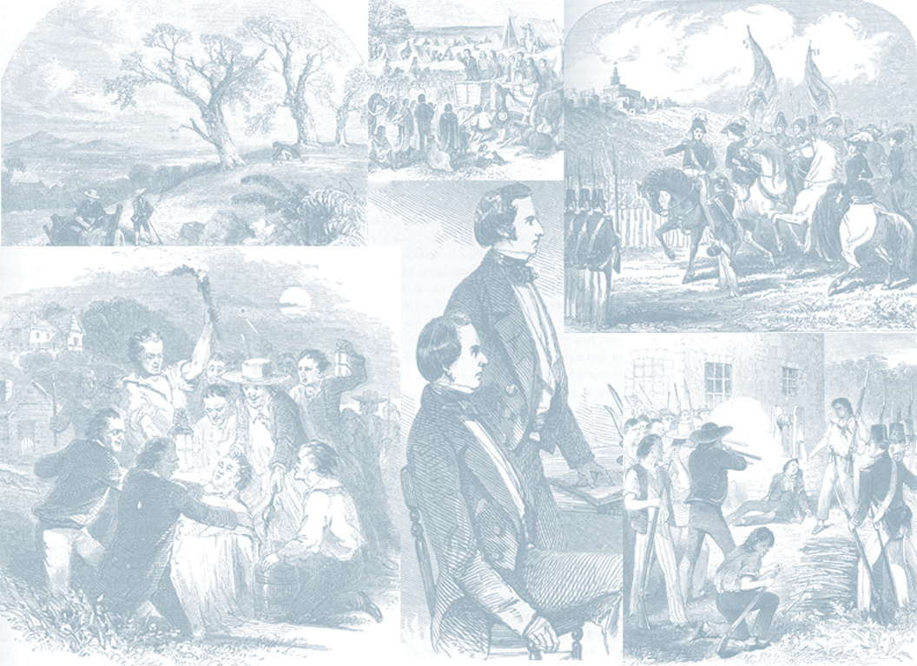
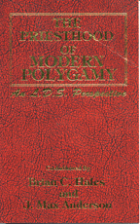
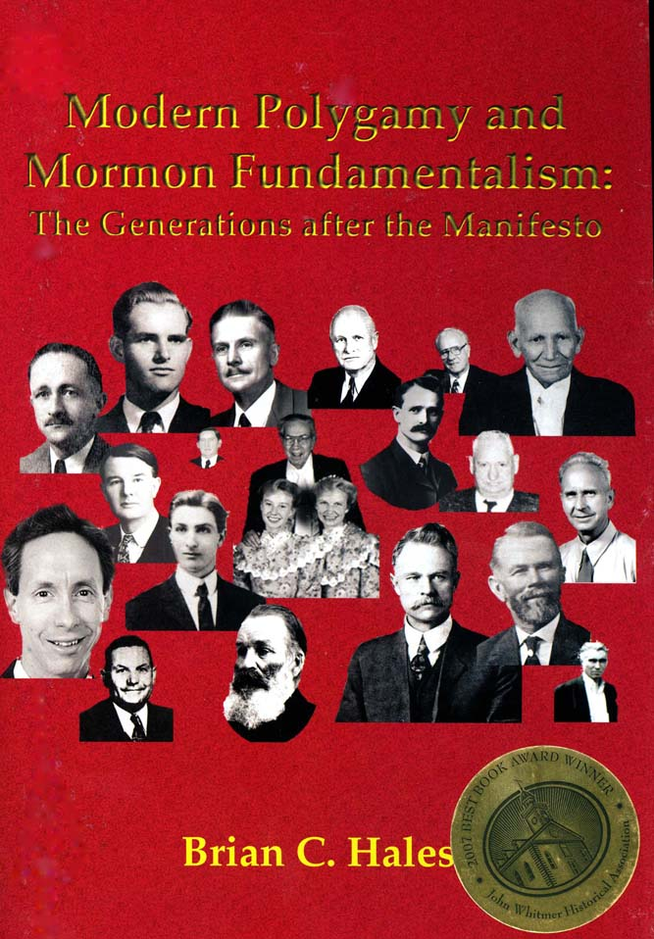

1992
2006
2008

Slide 3
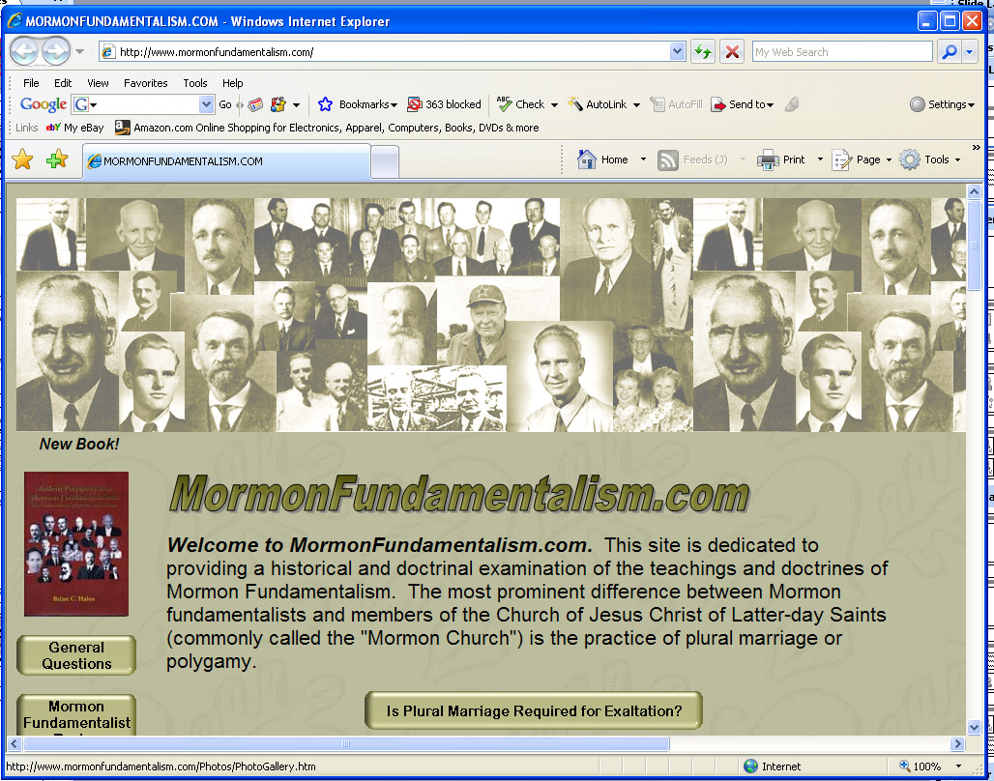
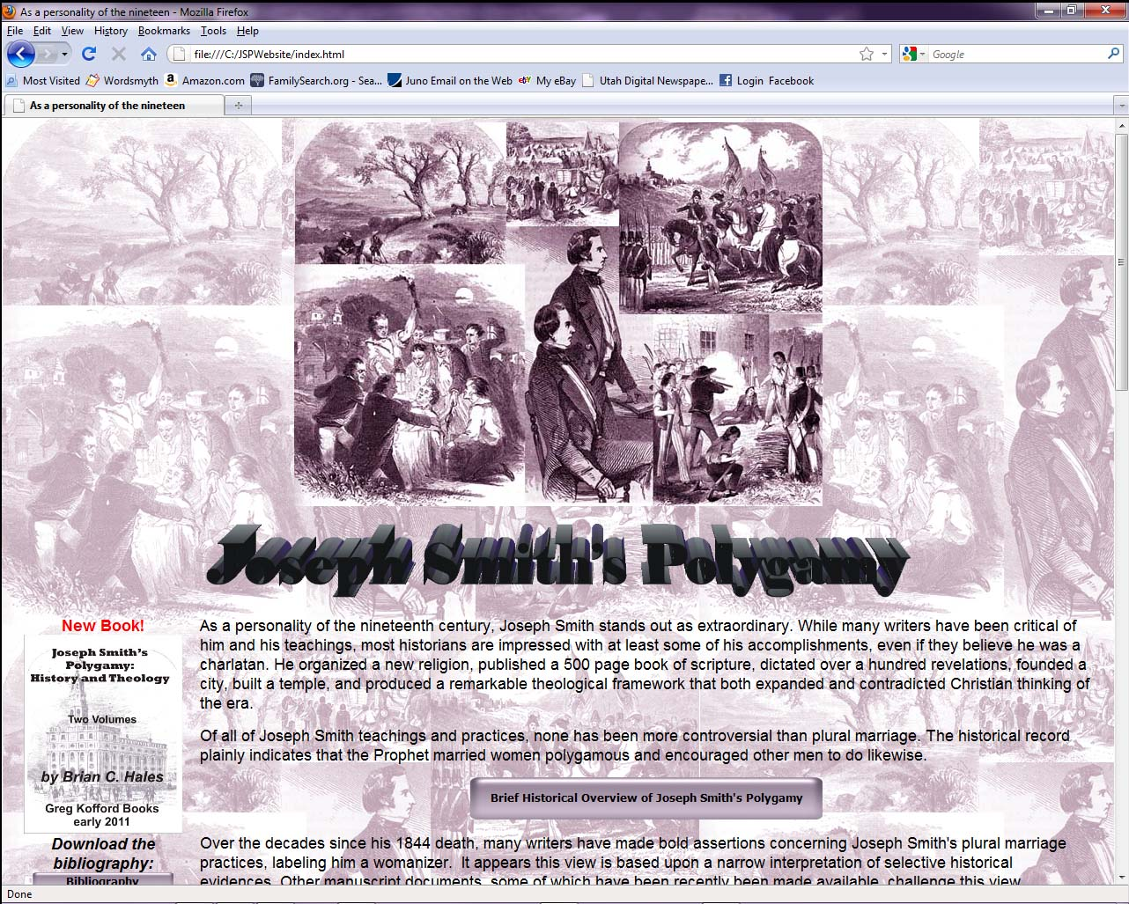
MormonFundamentalism.com
www.JosephSmithsPolygamy.com

Slide 4

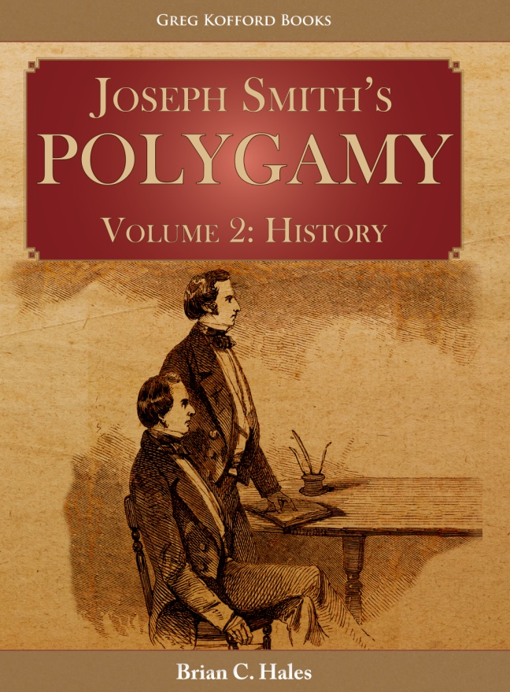

February 26th 2013
release date
Benchmark, Kofford, Amazon

Slide 5
Four Part Series
http://athoughtfulfaith.org
A deep dive into Joseph Smith’s polygamy
http://mormonstories.org
Response to Grant Palmer
Top 12 myths about Joseph Smith’s polygamy
Reconciling polygamy with faith

Slide 6
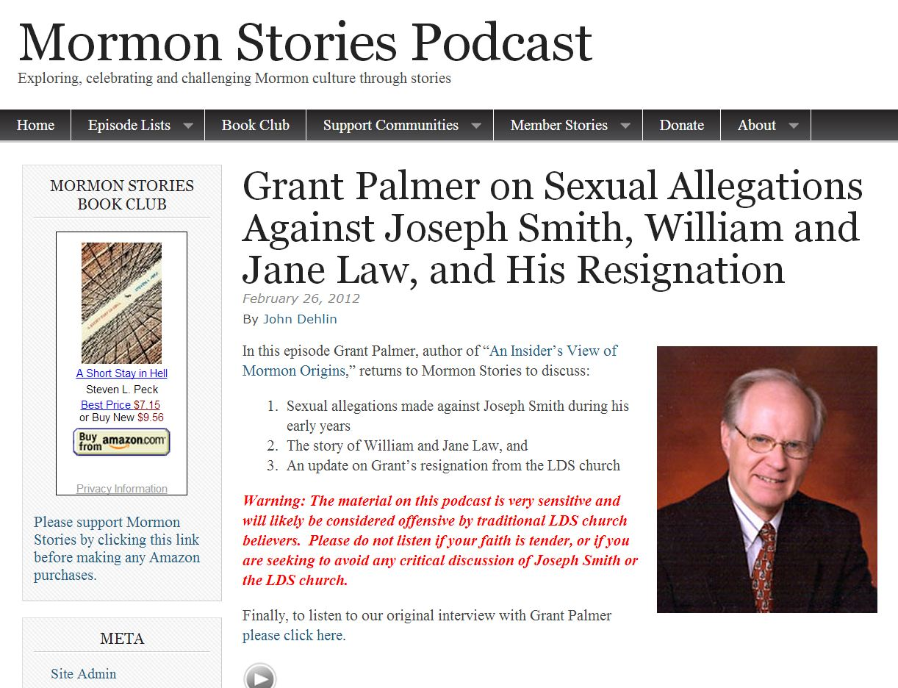

Slide 7
15:49 "Six allegations in a three state period over a five year period… Joseph Smith must have been mortified to be accused of sexually improper conduct by at least four women during a six year period in three states…“
25:44 “All I say is that I would be mortified and I am sure any person would if they were accused over a six year period of having unwanted sexual advances against four or five teenage girls in three different states. That is a mortifying thing.”
52:06 “As a married man Joseph Smith must have been mortified of being accused of improper sexual conduct with at least four young women during this six year period.”
ARTICLE “…it is generally unknown that he was accused of illicit sexual conduct with six young women from 1829 -1835.”

Slide 8
Brian C. Hales, "Fanny Alger and Joseph Smith's Pre-Nauvoo Reputation," Journal of Mormon History, 35 (Fall 2009) 112-90.

Slide 9
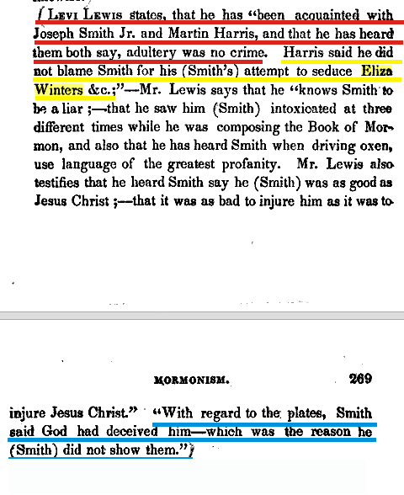
Eliza Winters

Slide 10
Miriam and Rhoda Stowell
[No evidence]

Slide 11
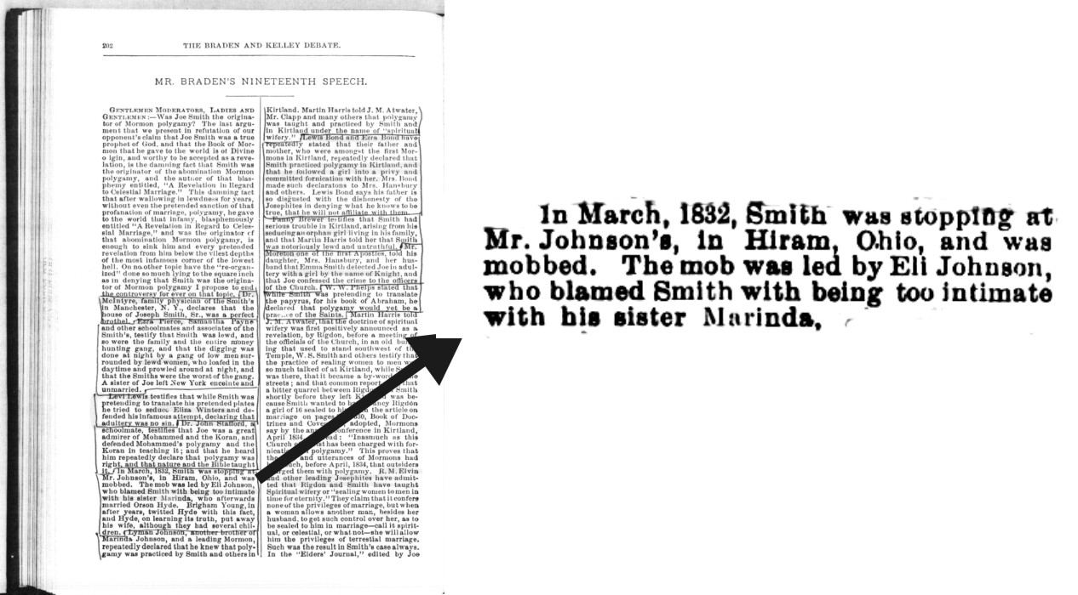
Miranda Nancy Johnson

Slide 12
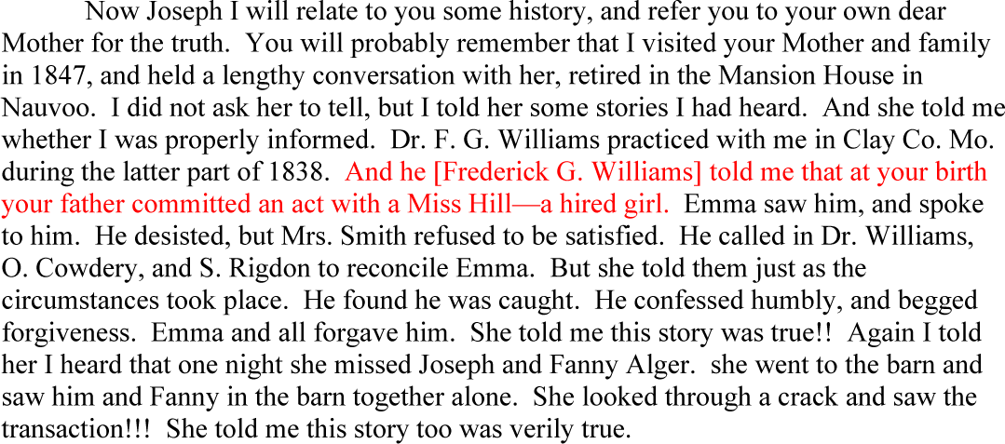
“Miss Hill”

Slide 13

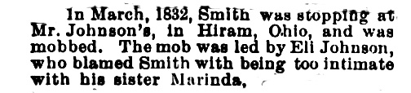

Total Evidence for 4/5 allegations involving 5/6 women:
Woman
Reporter
Evidence
Eliza
Winters
Levi Lewis allegedly quoting
Martin Harris - published 1834
Miriam and
Rhoda Stowell
[None]
[No Evidence]
Miranda
Nancy
Johnson
Clark Braden quoting unknown
source - reported 1884
William McLellin allegedly
Quoting Emma Smith
written 1872
“Miss Hill”

Slide 14
27:42 If I only have one source on something I generally do not use it. And if one of them is an unsavory source, I try to use that as just a back up.

Slide 15
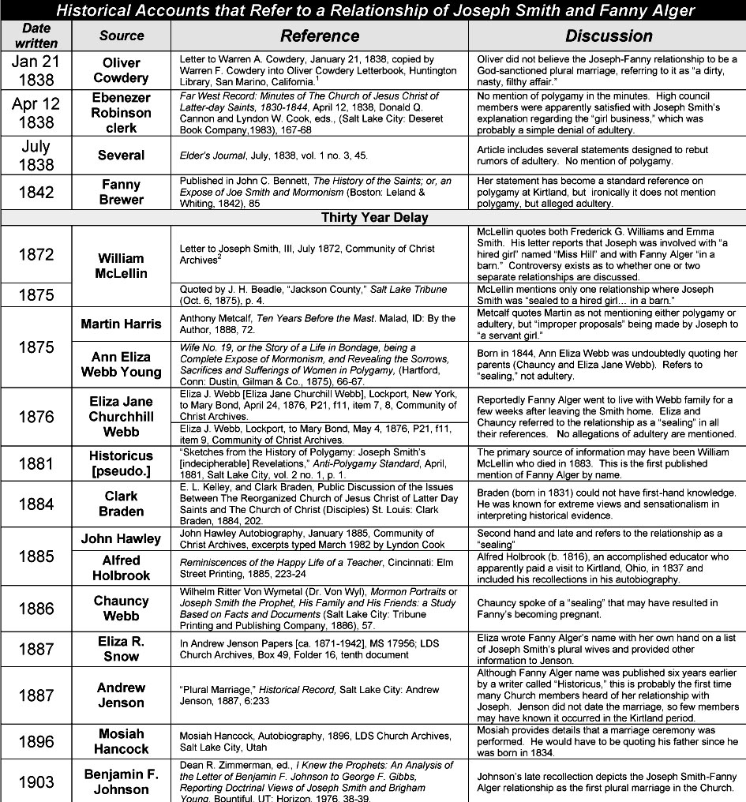
Fanny Alger

Slide 16
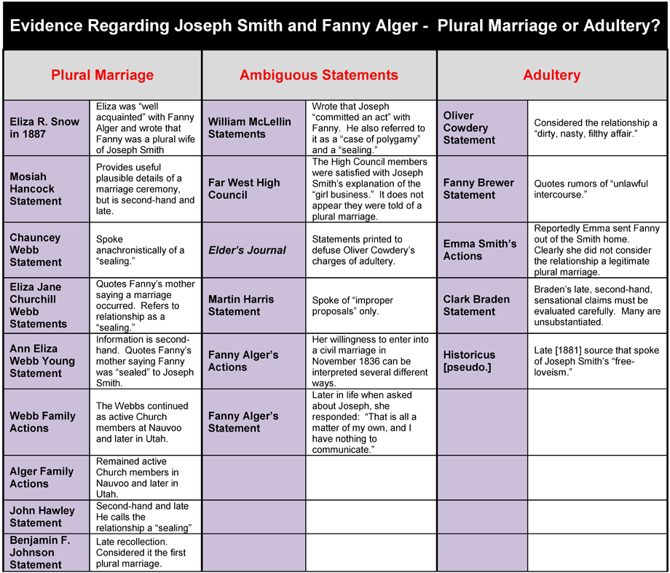
Fann

Slide 17
Eliza R. Snow, who was “well acquainted” with Fanny Alger in Kirtland in 1836, lists her as a plural wife of Joseph Smith in her own handwriting in 1887

Slide 18
15:49 "Six allegations in a three state period over a five year period… Joseph Smith must have been mortified to be accused of sexually improper conduct by at least four women during a six year period in three states…“
25:44 “All I say is that I would be mortified and I am sure any person would if they were accused over a six year period of having unwanted sexual advances against four or five teenage girls in three different states. That is a mortifying thing.”
52:06 “As a married man Joseph Smith must have been mortified of being accused of improper sexual conduct with at least four young women during this six year period.”
ARTICLE “…it is generally unknown that he was accused of illicit sexual conduct with six young women from 1829 -1835.”

Slide 19
If this is the best evidence Grant Palmer can find to show that Joseph Smith was accused of “sexually improper conduct,” how likely is it that such behavior actually occurred?

