Slide 1
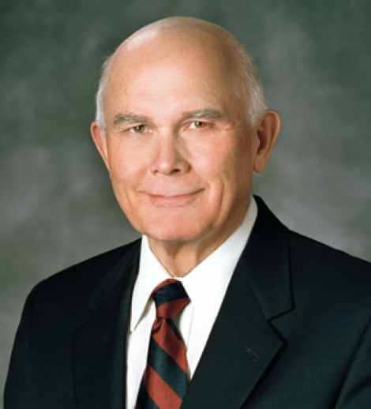
Cognitive Dissonance
“A testimony is to be found in the bearing of it.” - Boyd K. Packer (1982)
“We gain or strengthen a testimony by bearing it.” - Dallin H. Oaks (2008)
In other words, we gain a belief by expressing our belief.
Notes:
These quotes have a special place in my heart. When telling people that I did not really believe in the reality of the Church, people frequently tried to get me to just pretend like I believed anyway so that “the Spirit” would work his magic in my heart after the fact. Under any other circumstances, this sort of tactic would be almost considered fraudulent. My ROTC incident especially taught me to watch out for this.
It was not until many years later that I realized what was going on. This tactic is a textbook example of psychological manipulation via cognitive dissonance. It even has a name: INSUFFICIENT JUSTIFICATION EFFECT.

Slide 2
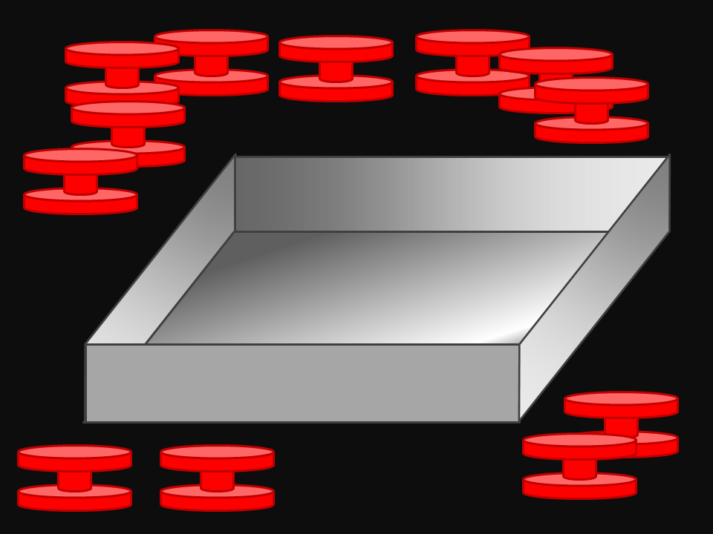
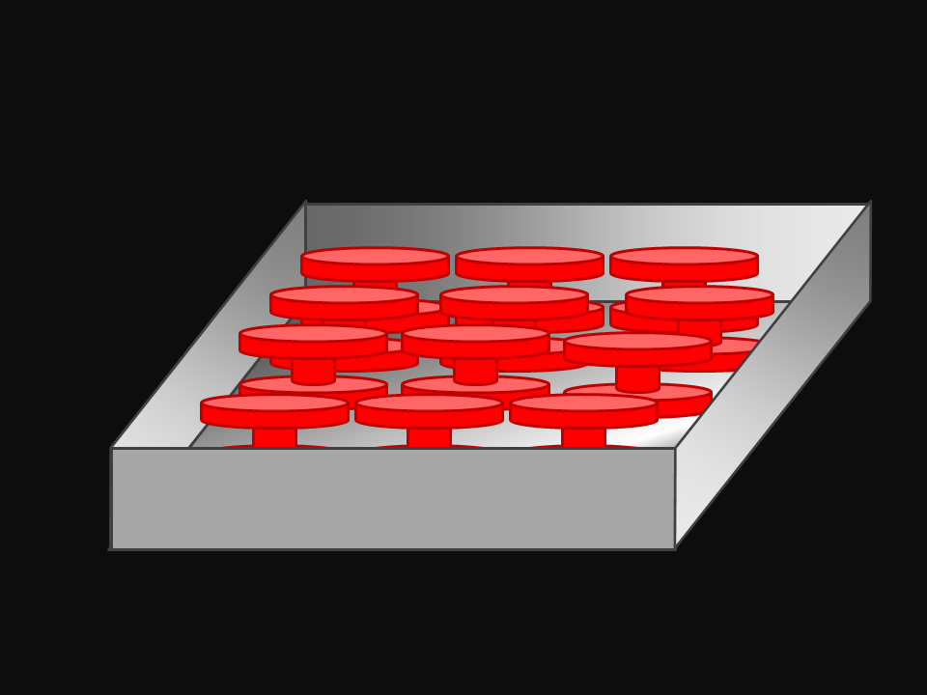
Festinger and Carlsmith
Using only one hand, insert all spools into the box
Great! Now take them all out again
Repeat for 30 minutes
Festinger, L, and Carlsmith, J. M, “Cognitive consequences of forced compliance,” Journal of Abnormal and Social Psychology, 58, 2 (1959).
Notes:
I absolutely LOVE this experiment!
“Thinking processes.”
All the while, some guy in a lab coat watches you work and scribbles notes. This gives you the distinct impression that what you are doing has some legitimate scientific value.

Slide 3
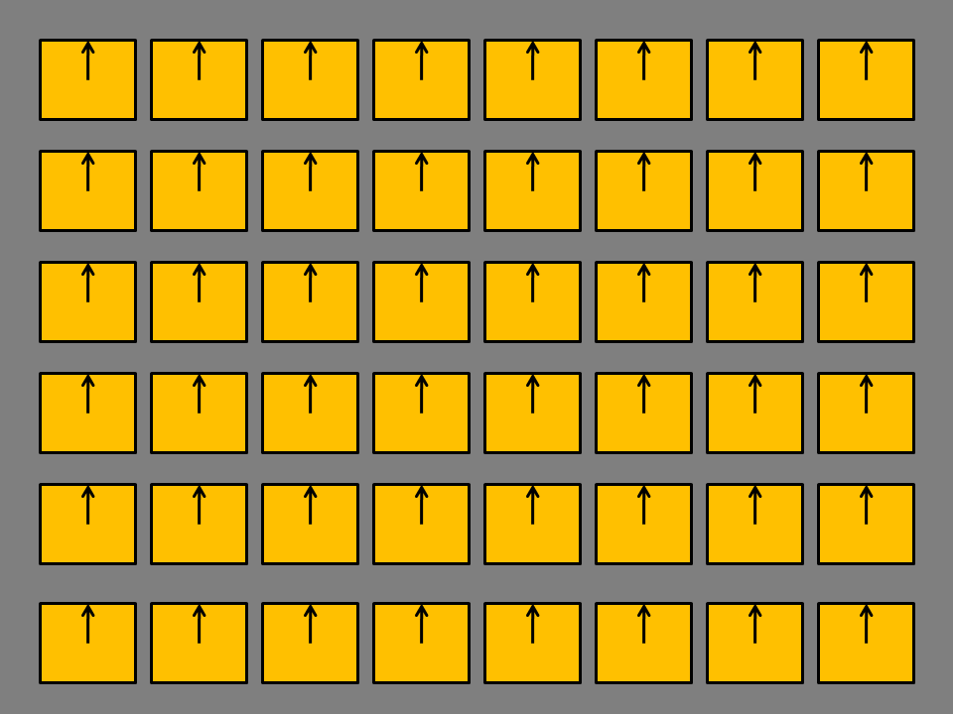
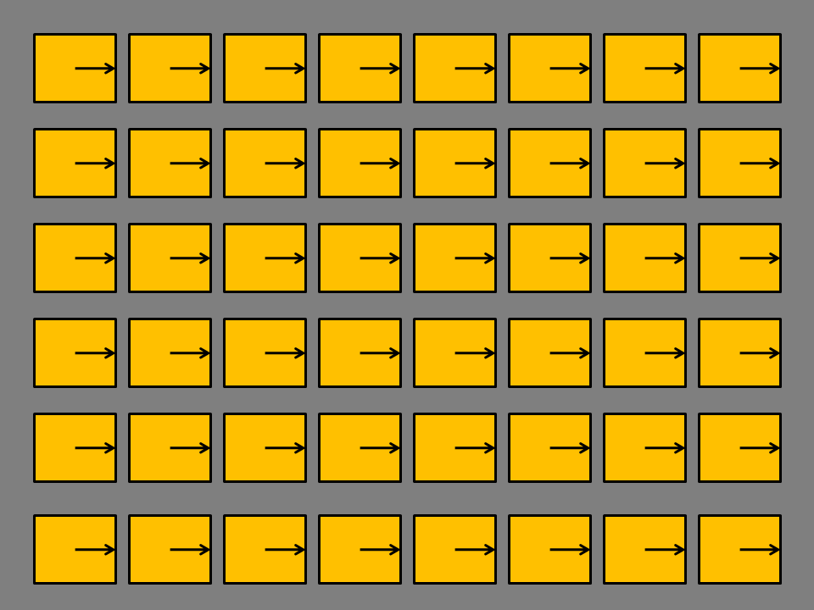
Bored Yet?
Using only one hand, rotate the pegs by 90 degrees
Great! Now do it again
Repeat for 30 minutes
Notes:
“The hour which the S spent working on the repetitive, monotonous tasks was intended to provide, for each S uniformly, an experience about which he
would have a somewhat negative opinion.”

Slide 4
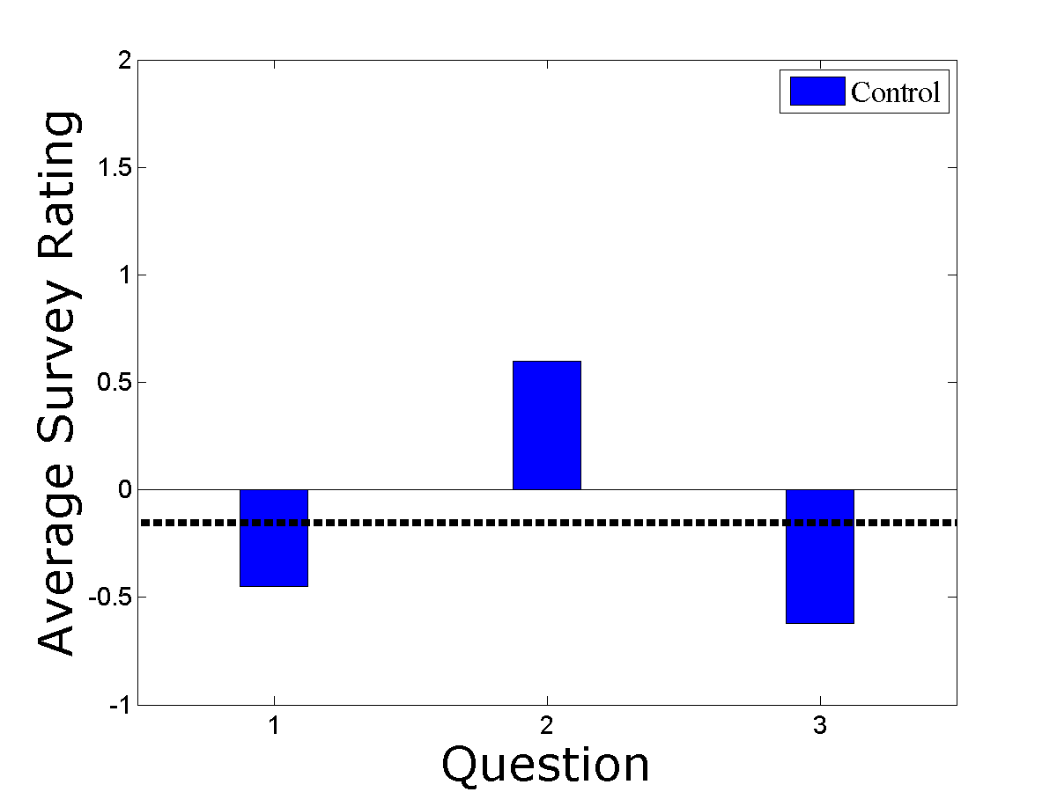
Rate Your Experience
Rate on a scale from [-5,5]:
1) Were the tasks interesting and enjoyable?
2) Do you think the results may have scientific value?
3) Would you have any desire to participate in another similar experiment?
Average = -0.16
Notes:
On a scale of -5 to 5, please rate the following questions...
Obviously the tasks were horribly dull. It therefore makes perfect sense that people give answers in the [-1,1] range.

Slide 5
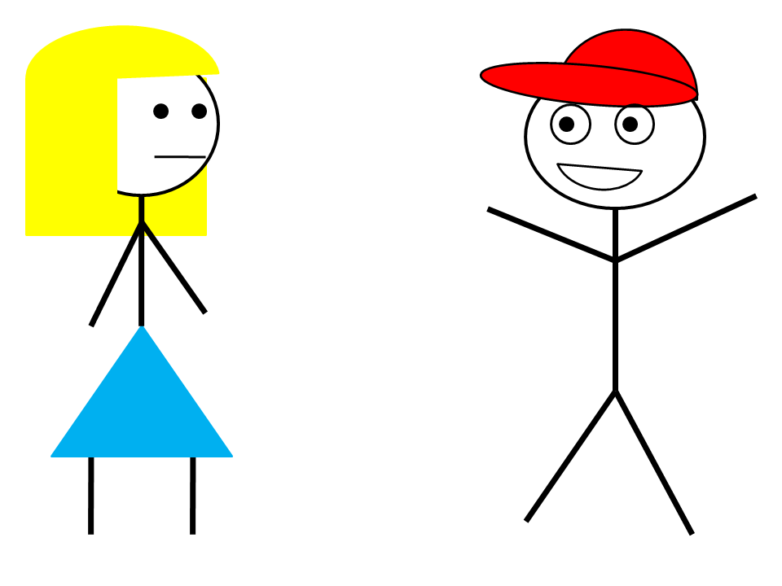
“Motivation”
Subjects are asked to help “fill in” for a missing employee.
Your job is to “motivate” the next subject before she begins the experimental tasks.
You absolutely must describe the tasks in positive terms.
“It was very enjoyable, I had a lot of fun, I enjoyed myself, it was very interesting, it was intriguing, it was exciting.”
Notes:
Experimental conditions:
This is the part where the experiment gets really weird. The subjects are put through an elaborate song and dance about how they need to introduce the experiment to the next subject. Normally, there’s a guy that helps us with this stuff but here’s not here today.
All you need to do is make a few key points about how awesome the experiment was. You know this is not true, but here you are saying otherwise.
In short, the subjects are being asked to LIE!

Slide 6
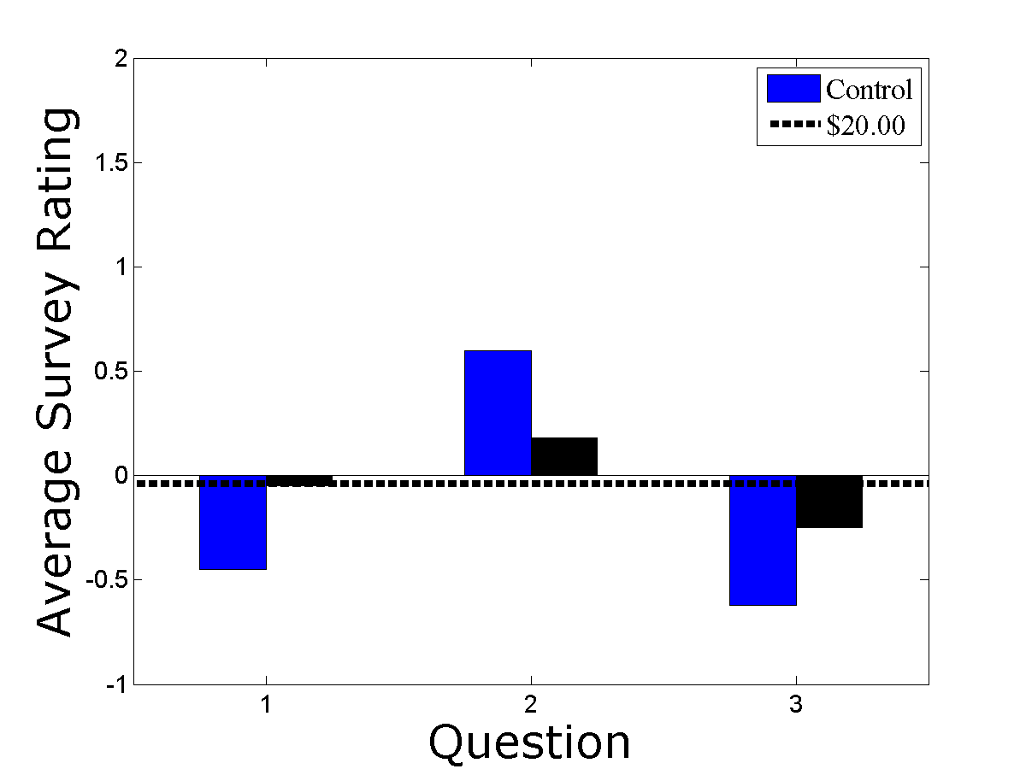
Group A: Sufficient Justification
Two experimental groups. First group is offered $20.00.
That’s nearly $100-150 by today’s standards!
Is this kind of money worth a little white lie?
Actually, yes!
Sufficient justification
Average = -0.04
Notes:
Group A is offered 20 dollars for their services. Remember, this is 1959! Twenty bucks back then was practically a hundred bucks by today’s standards.
Offering a huge payment does little to affect final scores.

Slide 7
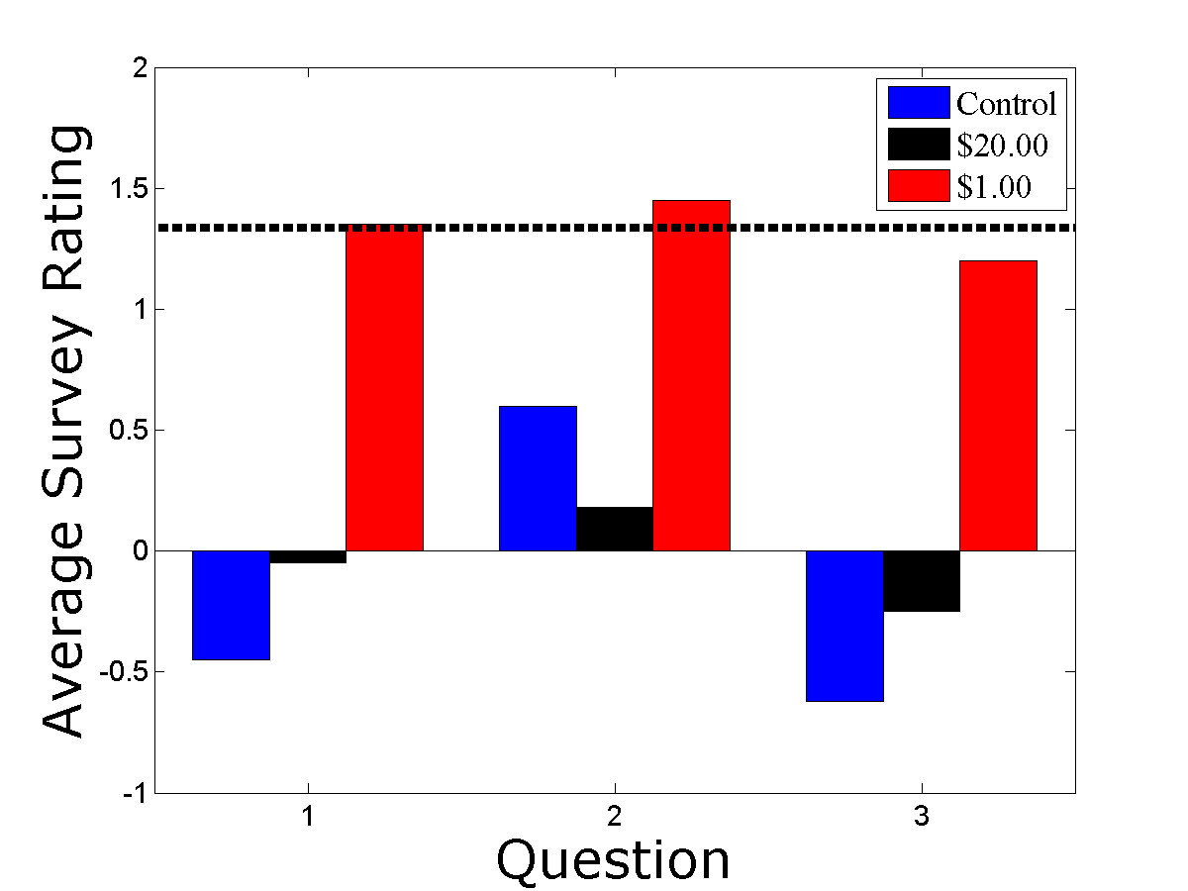
Group B: Insufficient Justification
How about $1.00?
Only $5-10 by today’s standards.
Cognitive dissonance due to conflict between actions and beliefs.
Insufficient justification for stretching the truth.
Beliefs shift to conform with the lie.
Average = +1.33
Notes:
Group B is offered one dollar for their services. Remember, they are basically lying to the girl. How do you come to terms with your knowledge that the experiment was boring, yet here you are saying otherwise?
Answer: You convince yourself that it must not have actually been that dull!

Slide 8
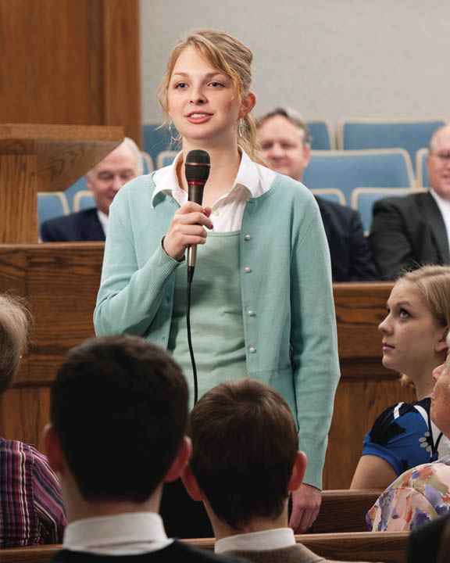
Applications to Religion: Testimonies
Manifestations of the Holy Spirit or basic cognitive dissonance?
* mormonmatters.org
Notes:
Once again, this has huge consequences for religion and faith. Why are members of all faiths encouraged so often to “testify?” No one ever bears testimony of the reality of thermodynamics. You just look at the evidence. If we are all so confident and sure of our beliefs, why do we feel this perpetual need to keep reminding ourselves and each other?
None of this makes any sense unless we view the process as a form of psychological manipulation.

Slide 9
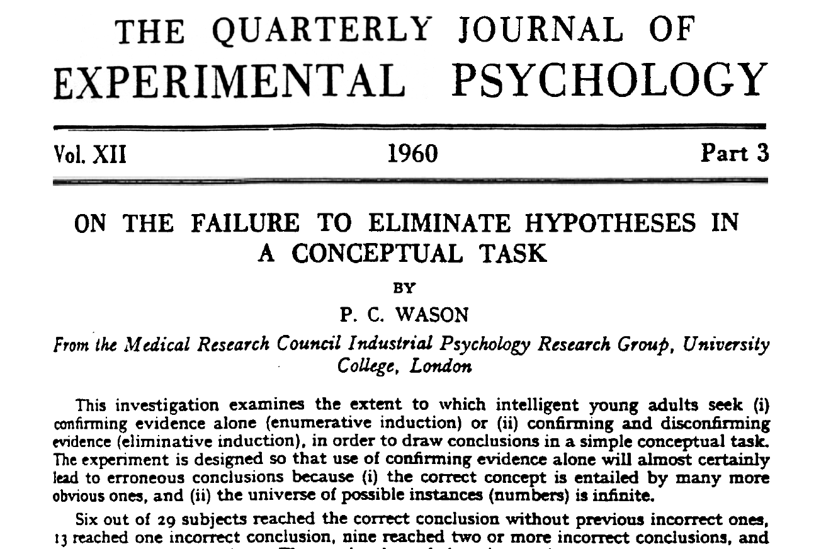
Confirmation Bias
People have a strong tendency to only seek out evidence that confirms what they already believe rather than potentially disprove.
This bias is one of the most pervasive in all of human reasoning.
Wason, P. C., “On the failure to eliminate hypotheses in a conceptual task,” Quarterly Journal of Experimental Psychology, 12 , 3 (1960).
Notes:
Confirmation bias is one of the most ubiquitous phenomena in social and cognitive psychology. People have an annoying habit of only looking for evidence that confirms their expectations rather than examining alternatives or attempting to disprove their beliefs.

Slide 10
Guess My Rule
I am thinking of a mathematical rule. See if you can guess it.
Pick any three numbers.
If they conform to my rule, you get a smiley. If not, you get a frownie.
When you are absolutely sure you have found the rule, finish the game.
Notes:
Keep guessing numbers until you are sure you’re right.

Slide 11
Example
2, 4, 6
“Even numbers incrementing by two.”
8, 10, 12
22, 24, 26
100, 102, 104
Notes:
Try the obvious case. Does it work? Apparently, because we’re three for three! The rule must be “even numbers incrementing by two.”

Slide 12
Actual Rule
“Any three increasing numbers.”
22/28 subjects wrong in guessing the rule
Notes:
If confirmation bias is this profound in a piddley number game, how much worse is it in everyday life?

Slide 13
Thinking with Falsification
4, 8, 16
“Multiples of four”
3, 12, 21
“Multiples of three”
12, 3, 21
“In any order”
21, 12, 3
“Decreasing only”
1/2, 6/5, 7/3
“Increasing rationals”
Notes:
The correct rule was “three numbers of increasing order of magnitude.” However, you cannot arrive at this conclusion unless you test ALTERNATIVES to what you already believe.
*** don’t actually walk through the numbers. It’s boring. ***
TAKE HOME POINT: Unless you are willing to be wrong, you can never be right.

Slide 14
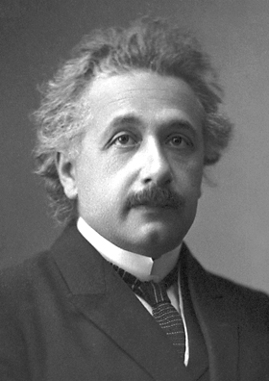
Falsifiability and Science
“No amount of experimentation can ever prove me right; a single experiment can prove me wrong.”
– Albert Einstein
In science, we do not believe things because they are “true” in any direct philosophical sense. We believe them because they are able to withstand a continuous barrage of attempts at falsification.
Unless we are willing to be wrong, we can never figure out what is right.
Notes:
This is why falsification is so important in science. Unless we are willing to be wrong about things, then we cannot make any progress. Science is a relentless pursuit of figuring out things that are WRONG. This is how progress is made. We do not believe things because they are “true” in any epistemological sense. We believe them because they are able to withstand a continuous barrage of attempts at falsification.
If you cannot theoretically “falsify” something, then it is unscientific. That is, it is untestable. There is no way to tell the difference between something you made up out of nothing versus something that actually reflects reality.

Slide 15
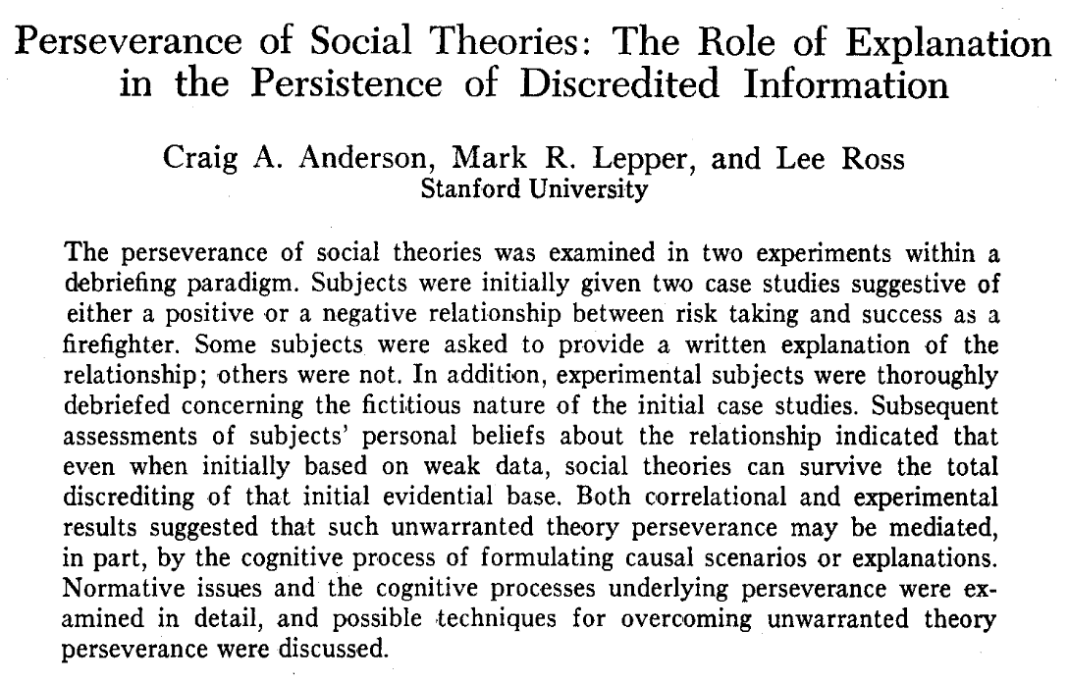
Belief Perseverance
Even after supporting evidence for a belief has been discredited, the belief still tends to linger.
Generating belief is much easier than debunking it.
Anderson, C. A., Lepper, M. R., and Ross, L., “Perseverance of social theories: the role of explanation in the persistence of discredited information,” Journal of Personality and Social Psychology, 39 , 6 (1980).
Notes:
Belief perseverance is a really neat phenomenon. Show someone evidence and they’ll form an opinion. Debunk that evidence, and they’ll still hang on to the original opinion.

Slide 16
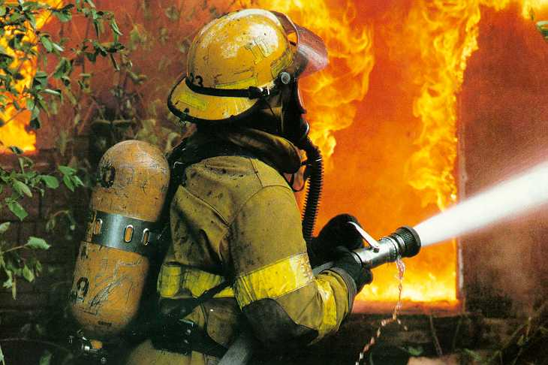
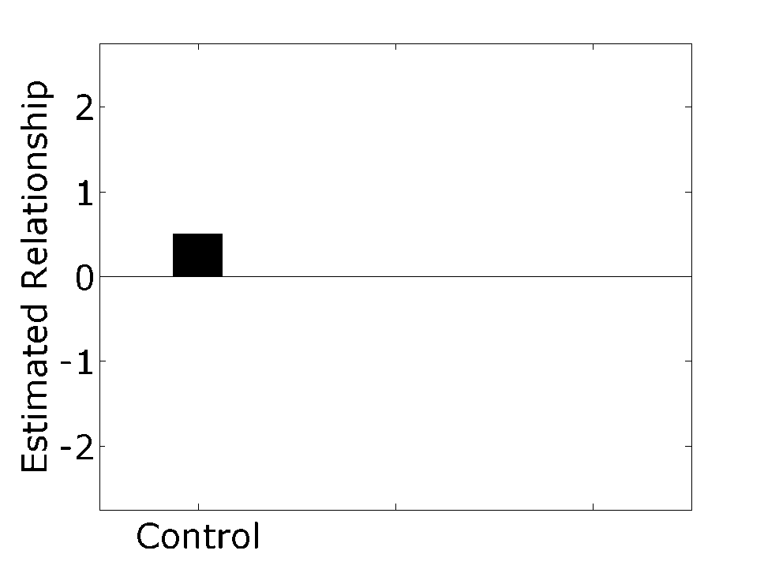
Firefighters
Who do you think makes a better firefighter?
Risky gung-ho maverick? (+5)
Cautious, by-the-book conservative? (-5)
All things being equal, the default answer is “No preference.”
Notes:
Begin by asking yourself who makes the better firefighter. A risky, gung-ho maverick? Or a cautious, by-the-book conservative? Few people have any serious firefighting experience, so the correct answer for most of us should be “I don’t know.”
Subjects ranked the perceived relationship on a scale [-100,+100]. Other questions included extrapolations to predicted success or failure between firefighters of various risky/conservative traits. The final score here is a complicated mixing and averaging of all the various scores on the questionnaires. By default, subjects tended to slightly prefer the risky position (positive values). This is our baseline.
NOTE: I recreated this image myself for aesthetic purposes and so that I could flow it better in the discussion piece by piece. The actual graph of data is on page 1042 of the paper.

Slide 17
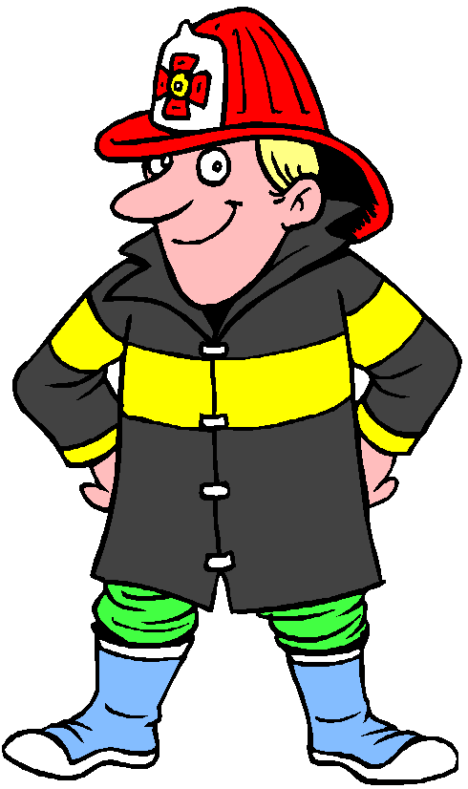
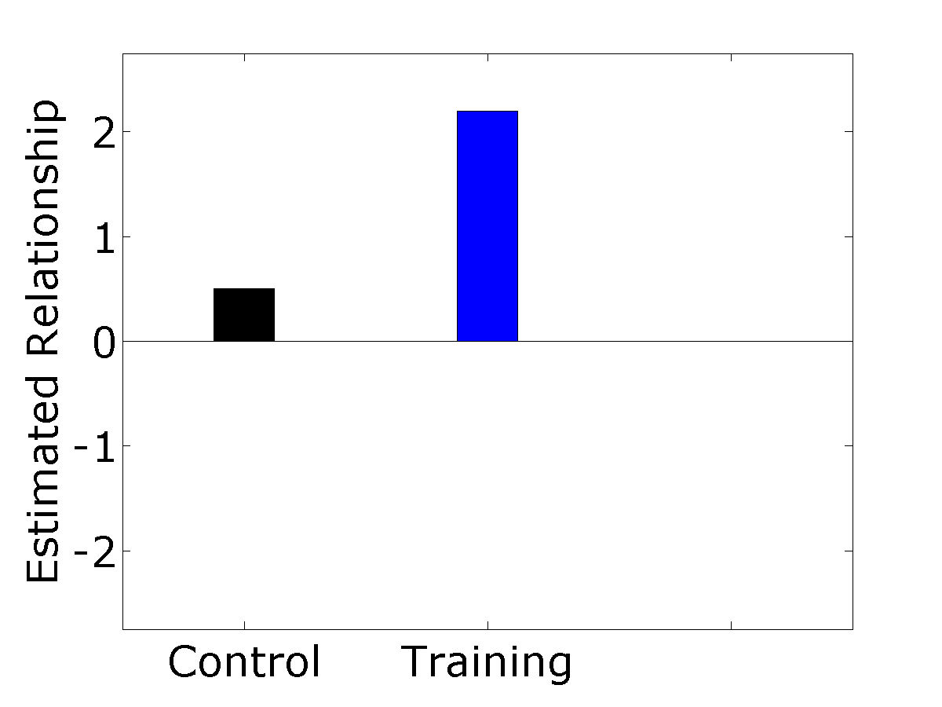
Training
Expert opinion from actual firefighters leads to a marked shift in position.
Notes:
Now give subjects an essay written by an actual fireman. Explain to them why risk-taking firefighters are awesome. This is a perfectly reasonable standard of evidence, so it is no surprise that subjects naturally lean on the side of the “expert.”

Slide 18
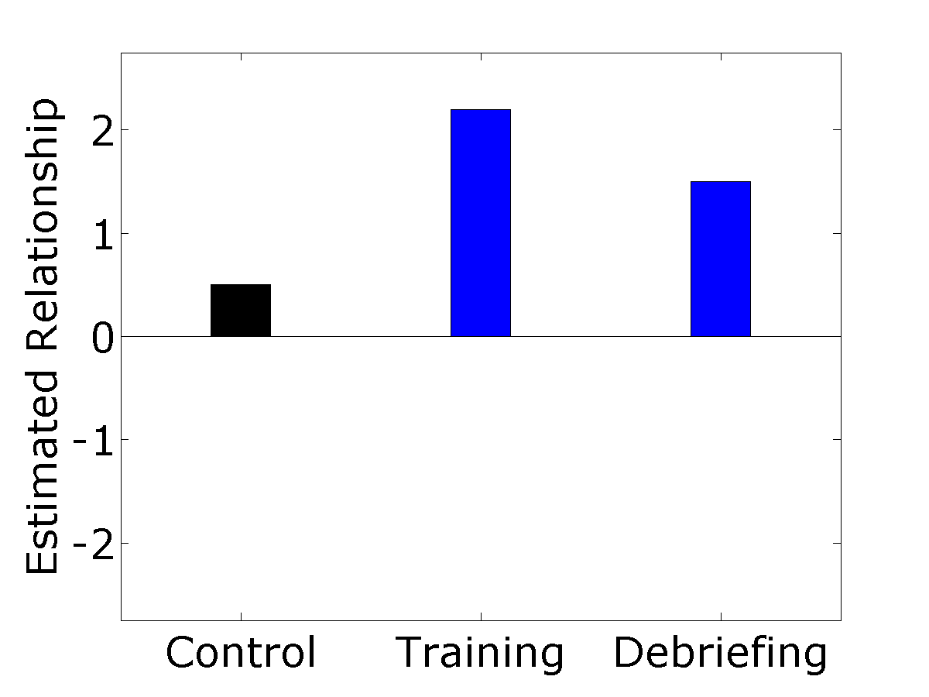
Debriefing
Oh by the way, we made it all up…
Confess to subjects that the data is fabricated and the essay is bogus.
All supporting evidence is now wholly discredited.
Rational beliefs should now revert back to default values.
Subjects still “persevere” in their beliefs.
Notes:
First “train” the subjects to believe a given opinion. Have them spend a little while thinking about it and writing a short paragraph or two about it. When done, “debrief” the subjects on the study. Tell them that the information they read was all just made up for the express purpose of getting them to believe either the positive or negative condition. Make it very clear that the experimenters have no idea what the true relationship is, or if one even exists.
Now have them repeat all the questionnaires again and report on their perceived relationship between the risky/conservative scale. In principle, subjects should revert back to their initial “I don’t know” positions. After all, we just completely discredited the very standard on which they built their position! But this does not happen. Subjects still tend to retain their initial training.

Slide 19
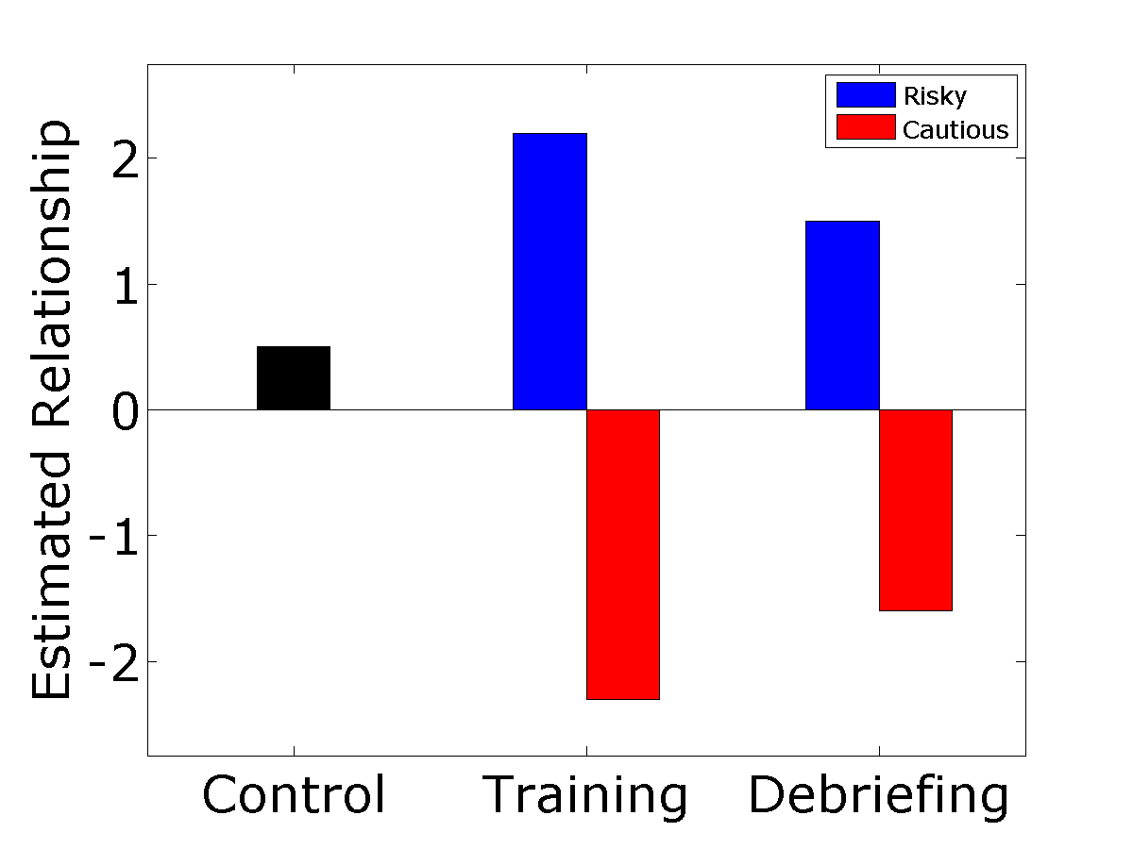
Working both Ways
Belief perseverance still manifests when subjects are trained to the opposite position!
Notes:
The same is true even for students who were trained to believe the OPPOSITE position!
Remember now that this belief is COMPLETELY ARBITRARY! Yet once you get people to buy in to it, they cannot help but linger in that belief.
I call this “engineering belief.”

Slide 20
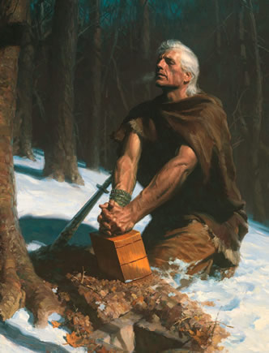
Applications to Religion
“The Lord offers us the opportunity to let him confirm truth already in our hearts. But in order to confirm religious truth, one must at least have the idea, or the thought, or the belief (however small) that he has found something true, and then pray to receive the Lord’s confirmation.”
- Elder Gene R. Cook
Cook, G. R., “Moroni’s Promise,” Ensign, April, 1994

Slide 21
Take Home Points
Human brains are very good at generating beliefs, but not very good at erasing beliefs.
Religious doctrine works very hard to generate beliefs without evidence
John 20:29 - Because you have seen me, you have believed; blessed are those who have not seen and yet have believed.
Hebrews 11:1 - Now faith is the substance of things hoped for, the evidence of things not seen
Once a belief is generated, the natural tendency is to seek out evidence that only confirms the belief
However wrong you are at the outset is however wrong you shall forever remain
Science works around this by seeking out errors in our understanding and correcting them; being wrong is a virtue
Notes:
Ever meet someone who was absolutely closed-minded? There is a reason why such people exist. We all suffer from it to various degrees.
Science works very hard to circumvent this tendency in human reason. Being wrong is a virtue, because being wrong means the opportunity to learn and grow. One of the core doctrines of science is that all conclusions are TENTATIVE AT BEST. This prevents us from getting locked into dogmatic positions.

Slide 22
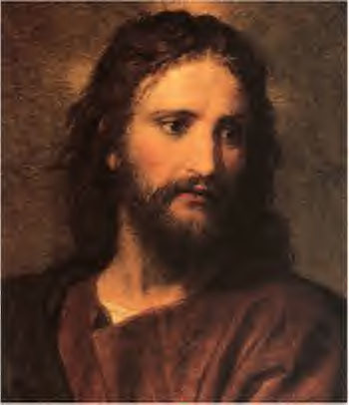
Eyewitness Testimony
Many religious beliefs and scriptures rely heavily on hearsay and eyewitness testimony.
How much can we trust this standard of evidence?
Notes:
Let’s talk about personal testimonies. The LDS church loves this stuff, and even has a monthly ritual where people get up and “bear their testimonies.” This always seemed bizarre to me. You never have people bearing their testimony about Newtonian gravitation or punctuated equilibrium. You just learn it, study it, and apply it. Why does the church place so much emphasis on this stuff? Even the front matter of the BoM has eyewitness testimonies.
Related story: I remember chatting once with some missionaries at my front door. They probed me about any experiences in my life where I have ever felt at peace with life and my fellow man. I told them “sure,” at which point they jumped in and started saying things like “that was the holy spirit!”

Slide 23
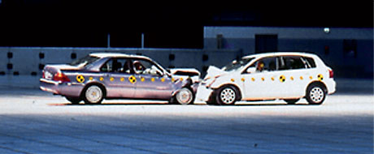
“Hit” versus “Smashed”
Watch a video of a car crash (25 mph).
How fast were the cars going when they “hit” each other?
How fast were the cars going when they “smashed” each other?
Hit
Smashed
Collided
Bumped
Contacted
= 34.0 mph
= 40.5 mph
= 39.3 mph
= 38.1 mph
= 31.8 mph
Loftus, E. F. and Palmer, J. C., “Reconstruction of automobile destruction: an example of the interaction between language and memory,” Journal of Verbal Learning and Verbal Behavior, 13, 5 (1974).
Notes:
Show subjects a video of two cars colliding with each other. Have them estimate how fast they think the cars were traveling. The first question is “About
how fast were the cars going when they hit each other?” The second is “About how fast were the cars going when they smashed into each other?”
The control group (hit) estimated around 34 mph. Other variations included a series of more or less severe verbs. “Smashed” came in highest while “contacted” came in lowest. Actual speed was 25 mph, which makes for an interesting sidebar: We human beings suck at visually estimating speeds.
Take home point: The words used when asking a question have a significant effect on the answer.

Slide 24
Misinformation Effect
“Did you see any broken glass?” (there was none)
Primed questions cause memories to be rewritten.
Notes:
The question asked by the researchers is this: Did the memory of the subject really change? Or did the subject simply use the question as a verbal cue that the cars really were moving faster than normal?
Show subjects another auto accident. Have them write an essay and fill out a questionnaire. Condition them again with “hit” and “smashed.” Also include a control group with no conditioning. Wait a week and then have them come back for follow-up questions. Buried in the Q&A is another test condition: “did you see any broken glass?” Subjects conditioned by “smashed” were over twice as likely to say “yes” than the other two groups.
Take home point: Leading questions will literally generate false memories in subjects’ perception!

Slide 25
Memory and Social Pressure
Study this image for two minutes. You will be tested
Allan, K, and Gabbert, F., “I still think it was a banana: Memorable ‘lies’ and forgettable ‘truths’,” Acta Psychologica, 127, 2 (2008).
Notes:
Social pressure has an interesting influence on memory. We already demonstrated this earlier with Baron, et al (1996). This is another experiment that specifically tried to test memory.

Slide 26
Did you see a banana?
Yes, I absolutely saw a banana!
Accuracy drops due to social pressure towards erroneous images.
Baseline = 70 %, Confederate = 50 %
Notes:
Remember that fruit bowl? Did you see a banana in there? I know I did. What about you?
RESULT: Social pressure will skew memory responses, even 24 hours after the social conditioning. That means memory itself was rewritten by the confederate.

Slide 27
The Transfiguration of Brigham Young
Auguest 8, 1844 - Brigham Young and Sidney Rigdon compete for presidency after Joseph Smith’s death.
Diaries and journals written at the time record nothing more than speeches given at a prayer meeting.
Decades later, people report on a transfiguration of Brigham Young into the spirit of Joseph Smith.
Some people (John D. Lee, Orson Hyde) report these experiences despite having never even been there to witness it.
Van Wagoner, R. S., “The Making of a Mormon Myth: The 1844 Transfiguration of Brigham Young,” Dialogue, 28, 4 (1995).

Slide 28
Take Home Points
Human memory is embarrassingly fallible
Human beings tend to subconsciously rely on each other when constructing memories.
Personal eyewitness testimony is one of the least reliable forms of evidence
Implications:
Prophets Experiencing God
New Testament Gospels
Book of Mormon Witnesses
Testimony meetings
Our own experiences
Notes:
People tend to think of memory as a tape recorder that can be played back with genuine reliability. This is absolutely NOT TRUE.
Why are we so hell-bent on bearing our testimonies?
How reliable are the four Gospels in terms of historical accuracy for the life of Jesus?
How much can we trust the front matter of the Book of Mormon? Is this really the best that God can do?

