Slide 1
Mormon Stories: Psychology of Belief and Religion
Dr James Nagel

Slide 2
Overview
Background:
Education, Qualifications, Personal History
Classic Experiments in Social Psychology
Social Influence, Cognitive Bias, and Hallucinations
Cognitive Theories of Natural Religion
Agenticity, Culture, and Group Selection
Notes:
Talk a little bit about the flow of the discussion and where we’ll be going.

Slide 3
Credentials
BS/MS/PhD in Electrical Engineering
Focus in applied electromagnetics
Numerous publications in peer-reviewed journals
Informal Education in Social Psychology
Textbooks and academic journals
Notes:
Talk over my education. Bear in mind that I am an electrical engineer by training. Psychology is really just a passionate hobby for me. So do not think of me as an “expert” in the strictest sense. However, I do have practical knowledge on the subject. I have read plenty of the standard college-level literature and I have access to a massive pool of original research papers. So at the end of the day, science is science, and it is not that difficult to draw practical conclusions from the data.
The information I will be presenting here is going to consist primarily of actual scientific data. So do not trust me, but TRUST THE SCIENCE. Verify it yourself. Read some the papers yourself, even. Hopefully there will be a clear divide between legitimate facts and my own personal theories based on those facts.

Slide 4
Some Personal History
Born in California under Mormon upbringing
Moved to Utah at age 16
Attended BYU for BS/MS educations in electrical engineering
Formal religious study in BoM, D&C, and Bible
Attended UofU for PhD
Skeptical, empirical, rationalist
Notes:
Just some background on me

Slide 5
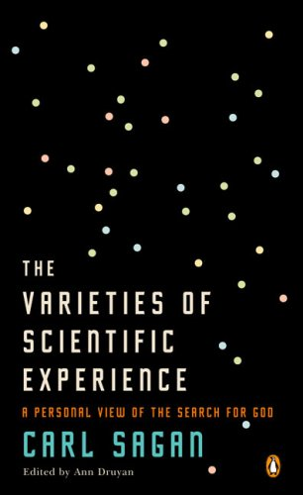
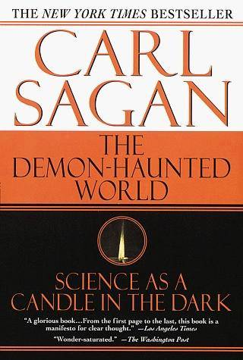
Recommended Reading
Notes:
Two books that hugely influenced my life and my search for truth. Everything you need to know about critical thinking and scientific method was already written long ago by Carl Sagan. It was as if he reached into my brain and cobbled my thoughts together into a single, coherent narrative. All you need is a burning desire to learn the truth, an unwavering appreciation for the facts, and a disciplined standard of empirical evidence.

Slide 6
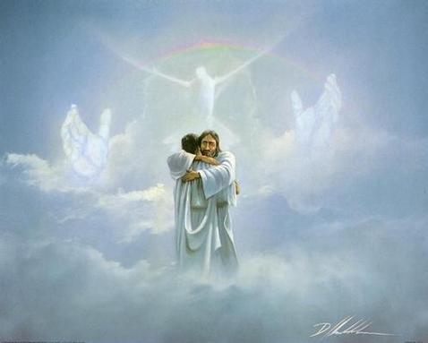
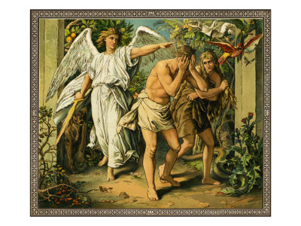
Religious Stakes
Heaven
Hell
"It seems to me that there is only one conceivable approach to these matters. If we have such an emotional stake in the answers, if we want badly to believe, and if it is important to know the truth, then nothing other than a committed, skeptical scrutiny is required."
- Carl Sagan
Notes:
Religious belief deals with ideas of the most fundamental importance about our existence. If you are correct, your rewards are great. If you pick the wrong faith, and your punishment might be eternal.
CONCLUSION: MAKE ABSOLUTELY SURE THAT THE FAITH YOU CHOOSE TO BELIEVE IS THE RIGHT ONE, OR YOUR IMMORTAL SOUL MIGHT GET TOTALLY SCREWED.

Slide 7
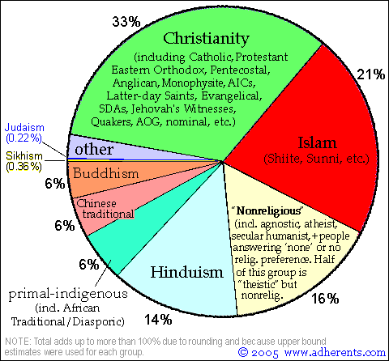
So Many Billions
Billions of people around the world possess absolute convictions in mutually inconsistent and incompatible ideas about God.
They cannot all be right, but they can all be wrong.
Whatever faith (or lack thereof) one may hold, we are inevitably faced with the issue of where all these theologies come from.
Notes:
They cannot all be right, but they certainly can all be wrong. However, the “nonreligious” category is the logical default position. Even so, this makes a profound statement. To paraphrase Carl Sagan, billions of people can have experiences that are both profound and compelling, yet still not have anything to do with an external reality.

Slide 8
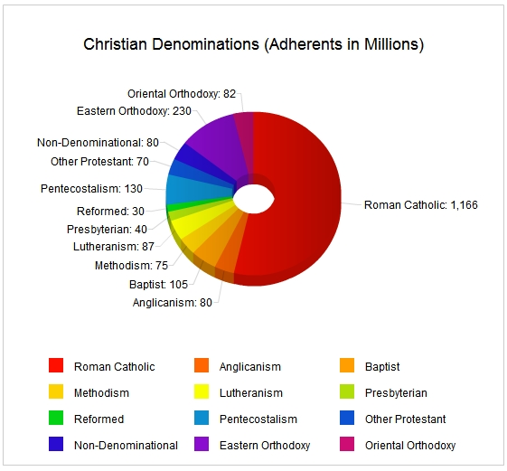
Christian Denominations
Even Christianity itself is split between numerous subgroups.
LDS Church doesn’t make the list.
How can we explain this behavior?
What criteria determine the validity or error of any particular belief?
Notes:
They cannot all be right, but they certainly can all be wrong. However, the “nonreligious” category is the logical default position. Even so, this makes a profound statement. To paraphrase Carl Sagan, billions of people can have experiences that are both profound and compelling, yet still not have anything to do with an external reality.

Slide 9
Methodological Naturalism in a Nutshell
Time, gravitation, and motion are all intertwined. Sound crazy?
We need a tool to differentiate between real knowledge versus made-up beliefs.
It is okay to believe strange things, but that belief comes with a price.
Belief is not a choice in the face of rigorous empirical evidence.
Hafele, J. C. and Keating, R. E., “Around-the-World Atomic Clocks: Predicted Relativistic Time Gains,” Science, 177, 4044, (1972)
Hafele, J. C. and Keating, R. E., “Around-the-World Atomic Clocks: Observed Relativistic Time Gains,” Science, 177, 4044, (1972)
Notes:
I do not wish to go on a long philosophical discussion, but this absolutely needs to be addressed. The only form of epistemology I know of with a proven track record is methodological naturalism based on scientific method. All other forms of epistemology inevitably seem to fail at producing real knowledge or weeding out errors.
TAKE HOME POINT: It is okay to believe in weird and crazy things, but the price of that belief is a rigorous standard of empirical evidence. How else am I supposed to differentiate between ideas that genuinely reflect reality versus ideas that someone just pulled out of his imagination?

Slide 10
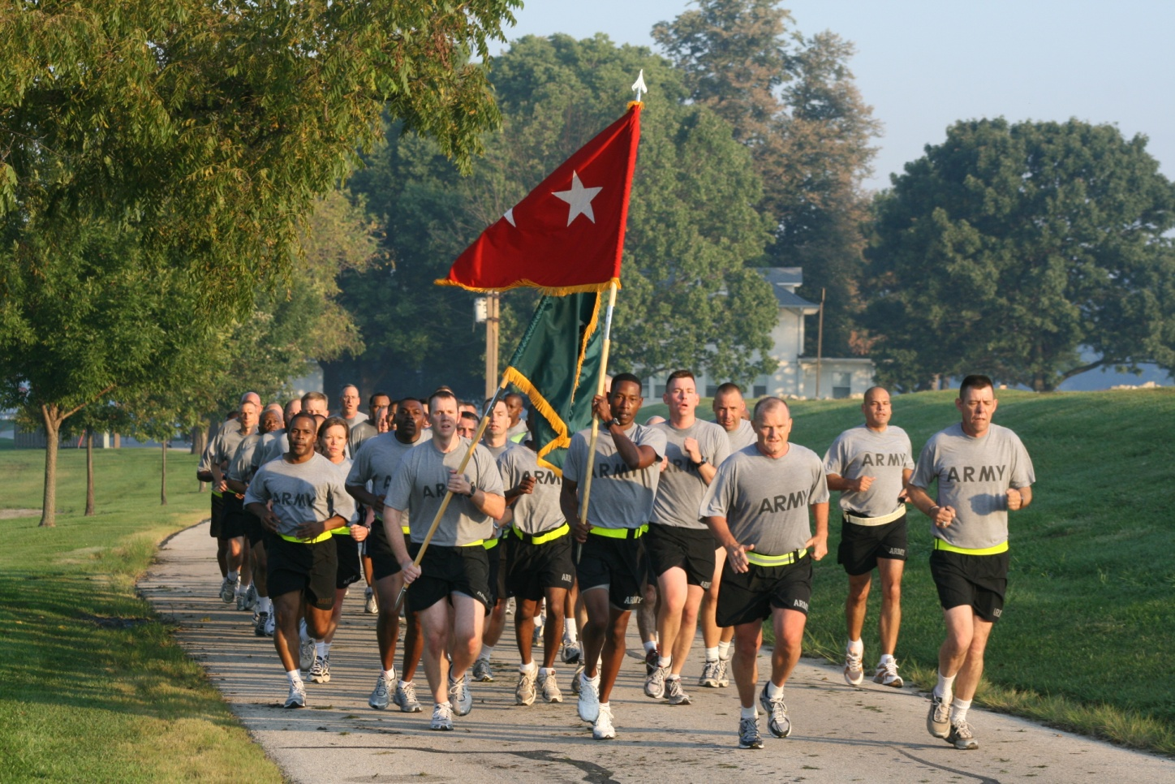
ROTC
Notes:
Early morning PT with the BYU Army ROTC. Tired, sweaty, miserable. Yet we sing about how much fun we’re having and how we could do this all day. Let yourself believe it, and suddenly it becomes true! Valuable life lesson learned that day. Promise to self: do not let subjective convictions determine important beliefs about the world. Demand evidence first before coming to belief; NEVER THE OTHER WAY AROUND!

Slide 11
Introduction to Social Psychology
People are not nearly as intuitive or rational as we like to think we are.
Social pressure and cognitive bias hugely influence our decisions and beliefs.
These techniques used everywhere: sales, military, politics, religion, etc.
Scientific method works very hard to neutralize these deficits in human judgment.
Knowing these techniques and pitfalls can help protect you and your family.
Kassin, S, Fein, S, and Markus, H. R., Social Psychology, 7th Ed, Houghton Mifflin (2007)
Notes:
2006 - Discount book at bookstore. Five bucks for a 95 dollar book. WOW! Suddenly I had more answers than I ever dreamed.
Key points: Human cognition is riddled with pitfalls and biases. Our brains do a lot of things very well, but they are extremely effective at generating beliefs without any basis in reality. We are adrift in a sea of misinformation, lies, scams, ambiguities, and uncertainties. Understanding our nature is important to recognizing where we so frequently go wrong. Scientific method is especially important for training us to overcome our own carnal nature and thinking critically. It is a tool that helps us sift through the compost of data and uncover the occasional nuggets of reality.

Slide 12
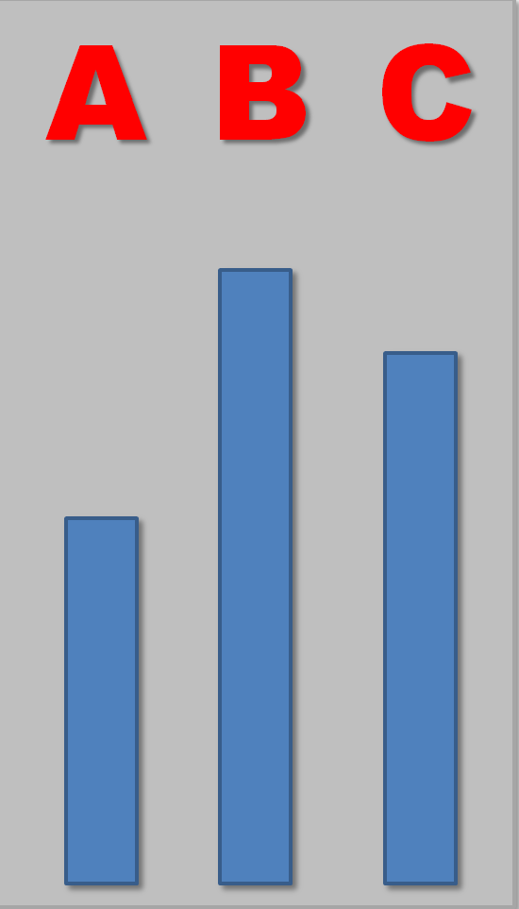
Asch Conformity Experiment
Which bar is the same height as the reference?
Control group = 98 %
Asch, S. E., “Effects of group pressure upon the modification and distortion of judgments.” In H. Guetzkow (ed.) Groups, Leadership, and Men, Carnegie Press: Pittsburg, PA (1951).
Notes:
One of my favorite social psychological experiments of all time and the first video in my series. Bring people in for an experiment on “visual acuity” (or whatever) and ask them which bar is the same height as the reference. All things being equal, people naturally give accurate results. After all, the bars are right there in front of your face!

Slide 13
Normative Influence
Must first listen to six other responses before giving your answer.
What happens if they all unanimously pick the WRONG bar?
18 tests total, 12 unanimously wrong decisions
YOU
Notes:
Now shake things up a bit. Place another 6-7 people in the room next to you. Repeat the experiment. Every now and then, have the confederates unanimously pick the WRONG BAR! What do you do? Are they crazy? Are YOU crazy?

Slide 14
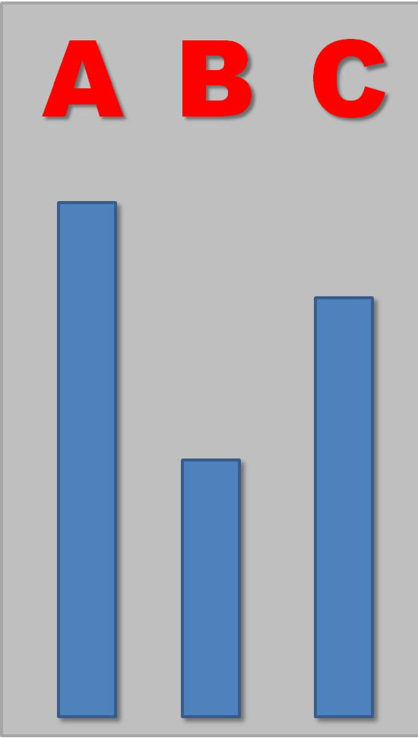
Results
Average conformity rate: 37 %
Individuals who conformed at least half of the time: 30 %
Refusal to agree with any incorrect majority: 25 %
B
B
B
B
B
B
?
Notes:
VERY surprising results.
The truth is literally right there IN FRONT OF YOUR FACE. Yet most people still have a hard time standing up for what is real when faced with nothing more than social pressure. What does this say about us? What does it say about religious institutions?
Funny quirk: Asch actually tried varying the disparity in the lines. In one experiment, the lines were off by a full SEVEN INCHES, and some subjects still conformed to the marjority!

Slide 15
Uncertainty and Task Importance
Identify a culprit in a lineup
You may view the culprit for
5 seconds (easy)
0.5 seconds (hard)
Baseline accuracy:
Easy = 97 %
Hard = 72 %
If you do well, you will be rewarded
Low importance = $0.0
High importance = $20.00
Baron, R. S., Vandello, J. A., and Brunsman, B., “The forgotten variable in conformity research: impact of task importance on social influence,” Journal of Personality and Social Psychology, 71, 5 (1996).
Notes:
Now let’s make things even more interesting. Make the task difficult and add a reward for accurate results.
You must identify a culprit from a line up. The make things difficult, the culprit is only shown for 0.5 seconds. To make things easy, the culprit is shown for 10 seconds. To add a level of importance to the test, accurate results could also be rewarded by offering $20 for correct answers.

Slide 16
Conformity Testing
Two confederates speak first
For 7/13 trials, the confederates unanimously pick the WRONG guy!
How would you respond?
B
B
?
Notes:
You have two confederates that offer their opinions before you can answer the question. Sometimes they give the correct answer. Sometimes they unanimously pick the wrong guy. You must either trust the consensus or trust your own perception, which is now horribly uncertain.

Slide 17
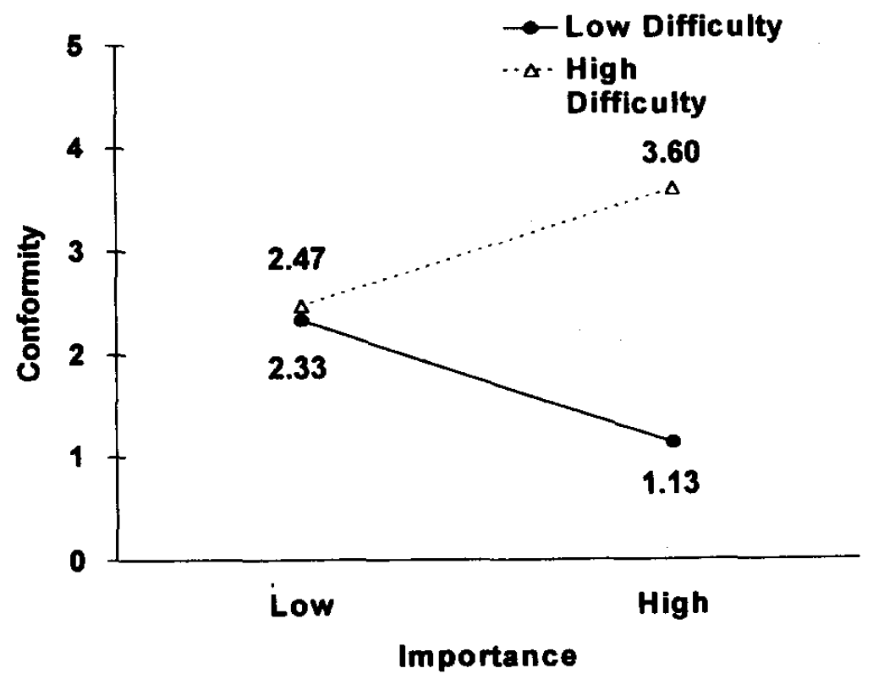
Results
Uncertainty + high stakes = CONFORMITY
Certainty + high stakes = DEFIANCE
Mean number of conforming trials.
Notes:
Uncertainty plus cost equals increased social influence. WOW!

Slide 18
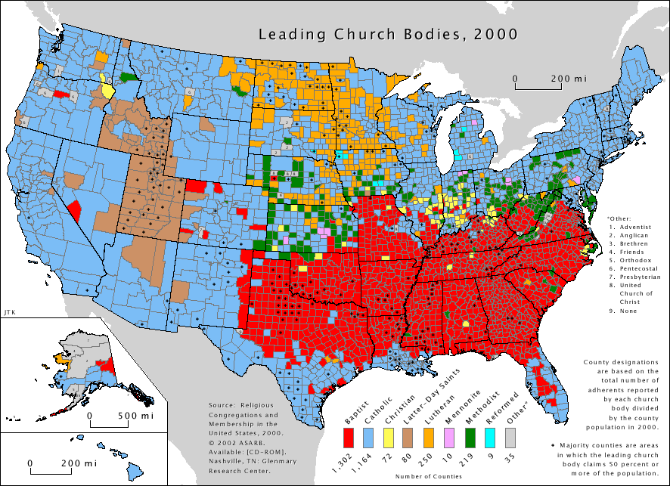
Applications to Religion
Heaven/hell are important
God is uncertain
Social pressure is high
Upbringing is single greatest predictor of faith in adulthood.
Notes:
How does this relate to matters of faith?
Think about it. Heaven and hell represent VERY important consequences of our beliefs and actions. The nature of God is also not a very obvious thing. The guy is practically invisible, yet ubiquitous. Do you believe in him or not? Go to church or not?
Conclusion: All things being equal, the natural human tendency is to follow the faith of everyone around you. Even when reality is staring you in the face!

Slide 19
Dissent
A single dissenting ally tends to massively reduce conformity
Ally
Solo
Asch, S. E., “Opinions and Social Pressure.” Scientific American, 193, 5 PA (1955).

Slide 20
Take-Home Points
People experience subtle, yet profound behavioral pressure from social groups.
Conformity with false ideas can still occur even when the truth is literally sitting right in front of your face.
Uncertainty plus importance leads to greater conformity.
Dissent is key to keeping people honest and critical.

