Slide 1
Utility vs. Validity:
A Practical Approach to Faith-Related Psychological Problems
David Christian, Ph.D.
Licensed Psychologist
Logan, Utah

Slide 2

Self-Introduction
Born/raised in the church. Multi-generational Mormon.
Served a Spanish-speaking mission in Sydney, Australia.
Shortly post-mission, a review of historical, philosophical, and ethical issues led me to dig deeper.
Current orientation: Ethical pragmatist (do good, practice wisdom)
Professor of psychology for 6 years at U. of Idaho.
Licensed Psychologist.
Clinical practice, coaching, consulting for the last 13 years.
Most clients are LDS.
Married to Marianne (Seeker: former CS, SOM, now a Buddhist/Hindu).
Three kids (18, 15, 11).
Pretty fetchin’ happy.

Slide 3

Presentation Objectives
Consider how faith (esp. LDS) can help or hinder psychological wellbeing.
Present a practical approach to dealing with faith-related psychological problems.
Look at how this approach has worked for a number of LDS clients.
Learn something that might help you deal with your own faith-related challenges.

Slide 4
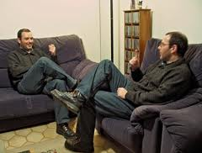

Current Work: Therapy and Coaching
Therapy
Coaching
Focus: clinical problems, e.g., anxiety, depression, OCD, etc.
Goal: restore normal function.
Covered by insurance.
Requires licensure.
Conducted face to face.
Focus: achieving goals, e.g. career, parenting, etc.
Goal: achieve personal goals.
Not covered by insurance.
Doesn’t require licensure.
Telephonic or face to face.

Slide 5
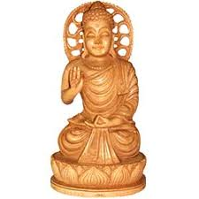
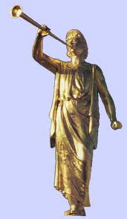


What is Faith?
Confident belief in a transcendent reality, supreme being, or religious dogma.
Belief which does not rest on logical proof or material evidence.
A religious practice.

Slide 6
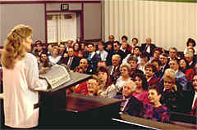

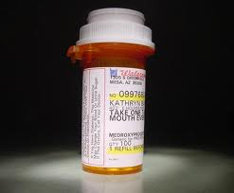
Faith Touches Many Aspects My Work
Depression, Anxiety
Gender Roles
Health Behaviors
Social Support
Self-Concept/Esteem
Attitudes about Meds
View of Psychology
Parenting
Meaning of Life
Time Demands
Sexuality
Forgiveness

Slide 7
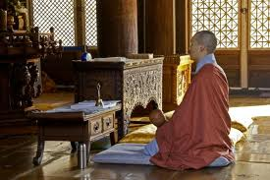
Two Approaches to Faith
Validity vs. Utility

Slide 8
Two Approaches to Faith
Validity approach asks: “Is faith true?”
  - This is unhelpful if the necessary truth tests are unclear.
  And, even if something is objectively false it can be helpful.
    E.g., People of different (incompatible) faiths experience wellness and longevity benefits. Not all those faiths can be technically “true.”

Slide 9
Two Approaches to Faith
Utility (Practical) approach asks: “Is faith helpful?”
  In other words, “How well is a particular person’s practice of faith promoting…
    Their own wellbeing
    That of others
    The environment on which we depend

Slide 10
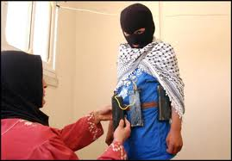

Slide 11
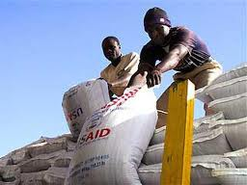

Slide 12


Slide 13


Utility’s Goodness Test
Scriptural Basis:
  Bible: Ye shall know them by their fruits. Do men gather grapes of thorns, or figs of thistles? (Matt. 7:16)
  B of M: “And whatsoever thing persuadeth men to do good is of me; for good cometh of none save it be of me. I am the same that leadeth men to all good.” (Ether 4:12)

Slide 14
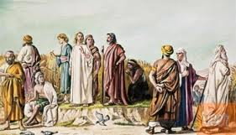
The Utility Approach is Based on the “Spirit of the Law”
Jesus routinely rebuked the Pharisees for their legalistic rigidity (letter of the law).
When they accused him of breaking he Sabbath for gathering grain he said:
  “The Sabbath was made for man, and not man for the Sabbath.” (Mark 2:27)

Slide 15
Contrasting the Validity and Utility Approaches to Faith
Question: If your loved one believes something that you believe is false but it helps them and causes little or no harm, what should you do?
  Validity: Confront and convert them to the “truth”.
  Utility: Let them believe it. You may even want to support their beliefs.

Slide 16
Contrasting the Validity and Utility Approaches to Faith
Question: Many faith ideas are about what is useful in an otherworldly sense (e.g., “Doing X will get you to heaven”). How do you deal with these beliefs?
  Validity: You must ascertain the validity of the ideas using “correct” scriptures, authority, prayer, revelation, etc.
  Utility: Focus on this-worldly consequences of faith, i.e., consequences that can be evaluated here and now.

Slide 17
Contrasting the Validity and Utility Approaches to Faith
Question: But what if there is a god who is testing our faith in this way?
  Validity: We need to figure out which faith is the right one and believe it.
  Utility: The only moral god that makes sense would be one who expects us to learn what is good and do it. A god who expects us to harm ourselves or others in this world on the chance that it may be moral in another world, is not worthy of respect.

Slide 18
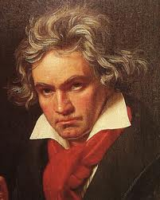
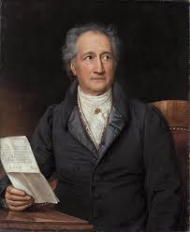
Utility vs. Validity: Depressive Realism
Truth (Validity) is not always helpful.
  Goethe said of Beethoven, “He is not wrong for finding fault with the world, but it makes him miserable.”
Depressive Realism:
  Depressed people appear to have a more realistic perception of:
    Their Importance
    Their Reputation
    What can be controlled
    Personal abilities
    Risks
The utility approach favors usefulness over validity.
Beethoven
Goethe

Slide 19
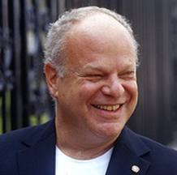

Utility vs. Validity: Learned Optimism
Martin Seligman’s research shows that optimists achieve more and have better overall health. But optimistic thinking is somewhat irrational:
  Optimists see bad events as transient.
  Optimists compartmentalize bad events and generalize good events.
  Optimists externalize bad events and internalize good events.

Slide 20
The “Skillful Mean”
Daniel Goleman: Vital Lies, Simple Truths
The mind can protect itself against anxiety by diminishing awareness.
This mechanism creates a blind spot: a zone of blocked attention and self-deception
Such blind spots occur at each major level of behavior from the psychological to the social.
  Somewhere between the two poles- living a life of vital lies and speaking simple truths- there lies a skillful mean, a path to sanity and survival.

Slide 21

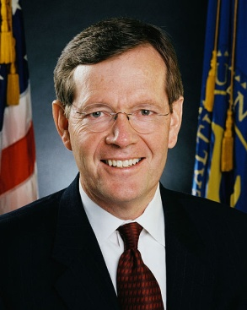
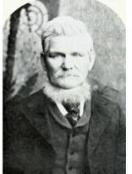

Some Pros and Cons of Faith
Sometimes faith can…
Provide meaning
Create social support
Aid ethical behavior
Provide joy/pleasure
Aid parenting
Promote healthy behavior
Might get you to heaven
Faith can also…
Create confusion
Create peer pressure
Aid unethical behavior
Create guilt/anxiety
Hinder parenting
Hinder healthy behavior
Distract from this life
but…

Slide 22
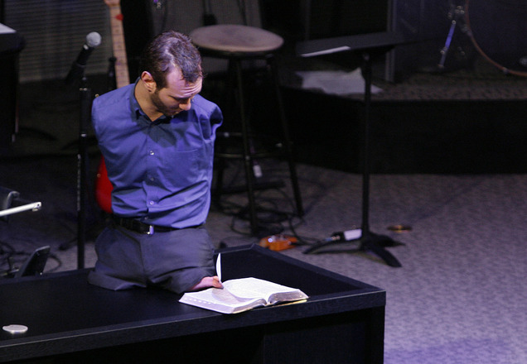
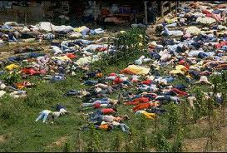
Faith Is Clearly Powerful
Nick Vujicic was born without arms or legs as a result of a rare disorder called Tetra-amelia. He tried to drown himself at age 10. After a conversion experience he became a motivational preacher.
November 18, 1978. Following instructions from their spiritual leader, Jim Jones, 918 people commit suicide by drinking cyanide in Jonestown, Guyana.

Slide 23
The Dose-Response Relationship for Faith May be Curved
Happiness
None
Some
A Lot
Religious Involvement
Who Benefits from Religion? Daniel Mochon, Michael I. Norton and Dan Ariely
Social Indicators Research, Volume 101, Number 1, 1-15, (March, 2011)
  Abstract: … “While fervent believers benefit from their involvement, those with weaker beliefs are actually less happy than those who do not ascribe to any religion—atheists and agnostics. These results may help explain why—in spite of the well-documented benefits of religion—an increasing number of people are abandoning their faith. As commitment wanes, religious involvement may become detrimental to well-being, and individuals may be better off seeking new affiliations.”

Slide 24
The Existential Cycle
“Got it Together”
Questioning
Doubt, Rejection of Worldview
Construction of a More Authentic Worldview
Stable Worldview
Chaos, Disorientation, Depression,
World Falls Apart
Striving for Meaning
Synthesis
Phase
Analysis
Phase
The “Dark Night of the Soul”
The existential cycle describes the process many go through as they progressively refine their worldview.

Slide 25
A Utility Approach to Faith-Related Problems:
Combined CBT and ACT
When people come into my office, their religious beliefs do not wait outside.
Many psychological problems are intimately connected to a person’s faith beliefs.
It is best not to get between a person and their god.
I use a mix of CBT, the most common type of therapy used in the US, and ACT, a newer approach that covers areas not well-addressed by CBT. Both are listed by the United States Substance Abuse and Mental Health Services Administration (SAMHSA) as empirically supported methods.
A combined CBT and ACT approach has worked well for most of my LDS clients.

Slide 26
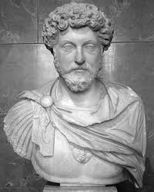
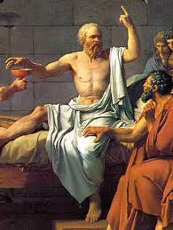
Cognitive-Behavioral Therapy (CBT)
Thoughts
Biology
Emotions
Situation
Behavior
CBT helps people change thoughts and behaviors in ways that create positive changes in emotions, biology, and their situations.
  - E.g., Depression study comparing CBT with Antidepressant.

Slide 27
Basic CBT Methods
Recognize thoughts, assumptions, and beliefs that are interfering with values.
Replace dysfunctional thoughts with more workable ones.
Gradually increase valued activities which have been avoided.
Try out new ways of behaving and reacting.
Practice collaborative empiricism. (Experiment)

Slide 28
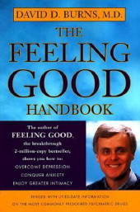
An Example of CBT
Identify Thinking Errors
All or Nothing Thinking
Overgeneralization
Mental Filter
Discounting Positives
Jumping to Conclusions
Magnification or Minimization
Emotional Reasoning
Shoulds
Labeling
Personalization and Blame
Ten Types of Twisted Thinking
Adapted from “The Feeling Good Handbook” by David Burns.

Slide 29
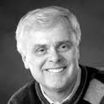
Ten Ways to Untwist Your Thinking
Identify the Distortion
Examine the Evidence
The Double-Standard Method
The Experimental Technique
Thinking In Shades of Gray
The Survey Method
Define Terms
The Semantic Method
Re-attribution
Cost-Benefit Analysis
Adapted from “The Feeling Good Handbook” by David Burns.

Slide 30
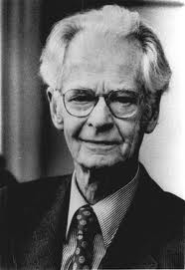
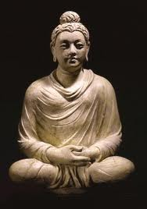
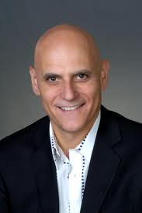
Acceptance and Commitment Therapy (ACT)
Integrates Hard Science and Spirituality
Making Sense of Spirituality. Steven Hayes, Behaviorism, 12, 99-110, (1984)

Slide 31
The Six Core ACT Skills
Identify what you are willing to stand for (your values).
Build commitment to serving those values.
Learn to accept what can’t be changed rather than wasting energy in useless struggles.
Detach (defuse) from interfering thoughts and feelings.
Act from the observing (transcendent) self.
Stay mindful of the present moment and what is workable (serving your values).

Slide 32
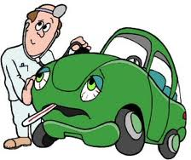
A Utility Approach To Therapy
Requires That You
Work Like a Good Mechanic
Recognize that every vehicle is unique.
Goal: maximize vehicle performance.
Don’t try to sell a new vehicle.
If clients conclude it’s not practical to repair their vehicle, help them find workable alternatives.

Slide 33

Recognize That
You Are Not
Your Car (or Faith)
This is an example of what ACT calls the “transcendent or observing self.”
You have a car, but you are not your car.
You have a faith, but you are not your faith.
You have (feelings, thoughts, urges, pain, etc.,) but you are not those things.
“You” are the one that has those things without being those things.
This “spiritual” experience of self transcends “things” and creates many more options. It enhances free agency.

Slide 34
Case Examples of a Utility Approach
When Issues of Faith are Involved
Names/Pictures changed for confidentiality.
Note the focus on utility/workability.
CBT and ACT methods will be illustrated.
Note the diversity of LDS styles.
Where possible, intervention is made using LDS-compatible terms and concepts.

Slide 35

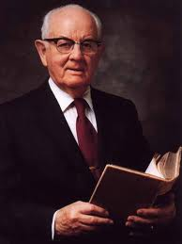
“Utah No. 1 In Online Porn Subscriptions, Report Says.”
- Deseret News, March 3, 2009
  “Eternal life hangs in the balance awaiting the works of men. This process toward eternal life is a matter of achieving perfection. Living all the commandments guarantees total forgiveness of sins and assures one of exaltation through the perfection which comes by complying with the formula the Lord gave us... Being perfect means to triumph over sin. This is a mandate from the Lord. He is just and wise and kind. He would never require anything from his children which was not for their benefit and which was not attainable. Perfection therefore is an achievable goal." (p. 208, The Miracle of Forgiveness, Spencer W. Kimball

Slide 36
The Abstinence Violation Effect (AVE)
A Common Pitfall For LDS Clients
The AVE occurs when:
  There is a rigid rule to abstain from a particular behavior.
  All or Nothing (Perfectionistic) thinking is present.
  A slip (lapse) is defined as a serious failure.
  Lapses are seen as the result of a personal (internal) flaw.
Example: “Virginity Thinking”
  I’m no less of a virgin if I sleep with 10 people.
  LDS people who do drink have a higher risk of alcoholism.
  Cultures who normalize drinking have lower rates of alcoholism.

Slide 37
The AVE is an Example of a Basic “Catastrophe”
Pressure to
Resist
Bifurcation
Zone
(Snapping)
Discontinuous (snapping) behavior occurs when two or more orthogonal forces interact.
Smoother behavior requires reducing the resistance force.
Pressure
to Act
Pressure to
Resist

Slide 38
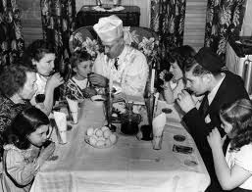
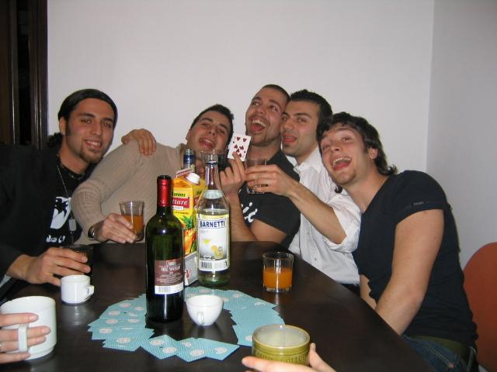
It is notable that the groups with the lowest incidence of alcohol abuse, the Jews and Italians, have (a) the lowest abstinence rates among these groups, and (b) (especially the Italians) the highest consumption rates.
  Cahalan D., and Room, R., Problem Drinking among American Men, Rutgers Center of Alcohol Studies, New Brunswick, NJ, 1974; Greeley, A.M., et al., Ethnic Drinking Subcultures, Praeger, New York, 1980. -http://www.peele.net/lib/sociocul.html#ii
The methods for getting out of quicksand are different from those aimed at avoiding swamps.

Slide 39

Allen: Physician, Serving in High Council
Feeling very guilty about porn habit, masturbation, impure thoughts.
Solution
  Recognized the paradox of control.
    ACT- Let go of thought control.
    Focuses on serving his values.
  Practiced Luskin’s self-forgiveness.
    Exercising compassion for self.
    Relaxed his pharisaical standards.
  CBT: revised all or nothing thinking
    A/N thinking maintains the Abstinence Violation Effect.

Slide 40

Stacey: Open Marriage?
Married with two children. Tech worker.
She and her husband left the church.
She proposed having an open marriage.
Husband was not ready for this.
Solution:
  Living monogamously for now but with Stacey having more freedom to pursue platonic male relationships.
  Husband developed a wider circle of friends/activities outside of marriage.
  She’s feeling less suffocated.
  He’s got a life that doesn’t orbit around/suffocate her.
  He shows a little jealousy without being controlling. She likes this.
  Having regular “couple’s meetings” to review and monitor high-risk situations (e.g., affairs).

Slide 41
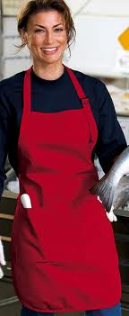
Andrea and Gender Roles:
Too Bright to be a Stay Home Parent?
Both she and husband are returned missionaries.
Husband is an attorney. Very traditional.
She felt compelled to do something with her education but didn’t find anything meaningful.
Became clinically depressed.
Dilemma: Felt “stay home mom” was too confining.
Solution:
  Read Sidetracked Home Executives.
  Reframed her domestic role as challenging, and meaningful.
  Set up her domestic role as a serious job.
    Including structure and measures of success.

Slide 42
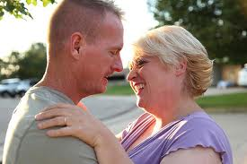
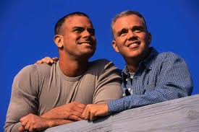
Jane: Priesthood Leaders Advised Her to Marry a Gay Man to “Cure” Him.
Had 2 kids. “Cure” didn’t work.
  Angry at gays, then angry at church.
Solution:
  Left church.
  Found a heterosexual boyfriend.
  Amicably co-parents with “ex.”
  Vacations with “ex” and his partner.
  Provides online support to other LDS women advised to cure gays.

Slide 43

Anna: Depressed about Being Depressed
“If I’m depressed I’m not being worthy.”
  Perfectionism, emotional reasoning.
  Refused medications as sign of poor spirituality.
  (In spite of Utah ranking #1 in antidepressant use, many LDS feel guilty when using them.)
Solutions:
  Redefined perfection as a destination, life is the journey.
  CBT challenge: Just because ___ does not mean ___.
  Revised her medication logic: would you refuse insulin?

Slide 44

John: Guilty and Stressed About His Rebellious Son
Beliefs:
  You can only be as happy as your worst child lets you be.
  It’s my fault. I’m responsible for his bad behavior.
Solutions:
  Recognized the paradox of parent control vs. free agency.
  Take a look: How is God’s parenting going?
  Whose plan was it to make sure all succeed?
  Teach them correct principles and let them govern themselves.
    (Even when you don’t like the results).
    This requires willingness, acceptance, mindful recognition of the difference between the “right” way and the way that works better.

Slide 45
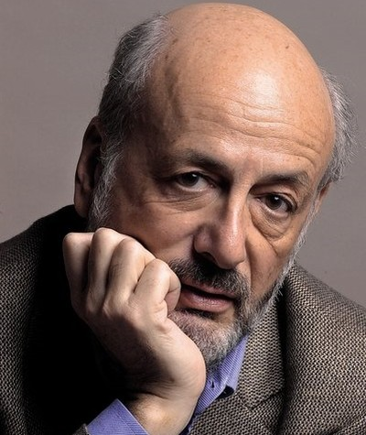
Mike: Bankrupt Again
Mike is now proceeding through his second bankruptcy.
  Continues paying a full tithe: hopes the Lord will help.
  Continues bailing out his children (5)
  Utah usually ranks in the top 5 for bankruptcy.
  In an article: “Five Steps to Financial Wellbeing." March 2004 Ensign: Gordon B. Hinckley counseled: “Some of you have money problems. I know that. You are struggling to get along. What is the cure? The only thing I know is the payment of tithing.“
  Materialism: Material goods are evidence of righteousness.
Solutions:
  Confronting “magical” thinking. Live within your means.
  Stop rescuing adult children who display “entitled” attitudes.
  Look at workability. What has this pattern of behavior produced in the past?
  How happy has spending actually made you?
    Research shows that after breaking out of poverty, happiness and income do not correlate.

Slide 46
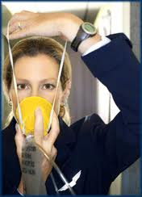

Colleen: Trying to be Supermom
Married, stay-home mom with 4 children,
  Kids are involved in multiple extra-curricular activities.
  Belief: “Acting selflessly means not taking care of yourself.”
  Deeply fatigued.
Solution:
  Confronted workability of her definition of selflessness.
  Used the metaphor of oxygen on the airplane.
  Asked “Would your children want to emulate your life?
  Helped her give greater responsibility to children.
  Helped her get a life (Ladies’ night out, book group, exercise).

Slide 47

Liza and Frank: Sex After Sixty
Sex was infrequent, unpleasant.
  Both had beliefs that sex was naughty.
  Sex had become routine/boring, dysfunctional.
    (performance anxiety was interfering)
Solution:
  Challenged their assumptions about sex.
    “Man is that he might have joy.”
    Sensate focus over performance.
    Try new positions, locations, style.
    Enjoyed field trip to out of town adult shop.
  Very happy with results.

Slide 48
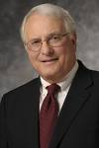
Greg: “Why Won’t Faith and Prayer Relieve my Disabling Anxiety?
Former Bishop, CEO of large co.
  Feeling like a fraud (outwardly successful, inwardly tortured).
  Values had changed over decades.
Solutions:
  Practiced mindfulness of symptoms vs. controlling them.
  Used matrix to clarify values and rate alternative courses of action.
  Enjoying more peace of mind.

Slide 49
Use a Matrix to Clarify and Rate Values
Comparing Greg’s Alternatives
Values | Value Weight 1-5 | Option 1- Keep High Pay High Pressure Job | Option 2- Take Lower Pay, Lower Pressure Job
Income | 2 | 5 (10) | 3 (6)
Prestige | 2 | 5 (10) | 3 (6)
Peace of Mind | 4 | 1 (4) | 4 (16)
Church Work | 4 | 2 (8) | 4 (16)
Time with Family | 4 | 2 (8) | 3 (12)
Marriage | 5 | 1 (5) | 3 (15)
Weighted Rating Totals: |  | 45 | 71

Slide 50

Christa: Feared She Was Homosexual
Confirmed by LDS Social Services
She tried church-promoted thought control methods.
  Boyd K. Packer stated "Delete from the mind any unworthy thought that tries to take root. (Church News, 10/3/2010).
  This made things worse.
Solution:
  Careful diagnosis revealed OCD, not homosexuality.
  Provided proper education about sexual orientation.
  Developed willingness for intrusive thoughts.
  Encouraged focusing on serving her primary values.
  Now in a stable heterosexual relationship.

Slide 51
Summary
Faith-related psychological problems can be addressed using an approach that is:
  Based on a practical commitment to wellbeing.
  This is supported by clarifying and serving values.
  CBT helps change the thoughts, behaviors and feelings that can be changed.
  ACT helps accept, defuse from, and transcend thoughts, behaviors, and feelings that can’t be changed.

