Slide 1
Top 5 Myths and Truths about Why Committed Mormons Leave the Church
John P. Dehlin

Slide 2
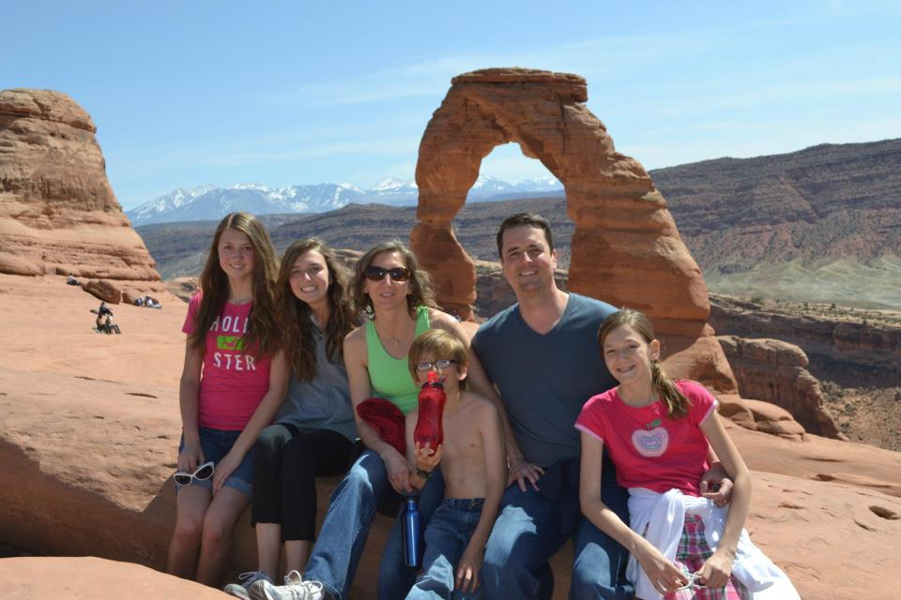
John P. Dehlin

Slide 3
A tiny bit about me…
Have spent the past 8 years speaking with thousands of disaffected Mormons
Almost left the church myself. Recently returned
Attend church weekly with my family
Consider myself to be a “reconstructed believer”

Slide 4
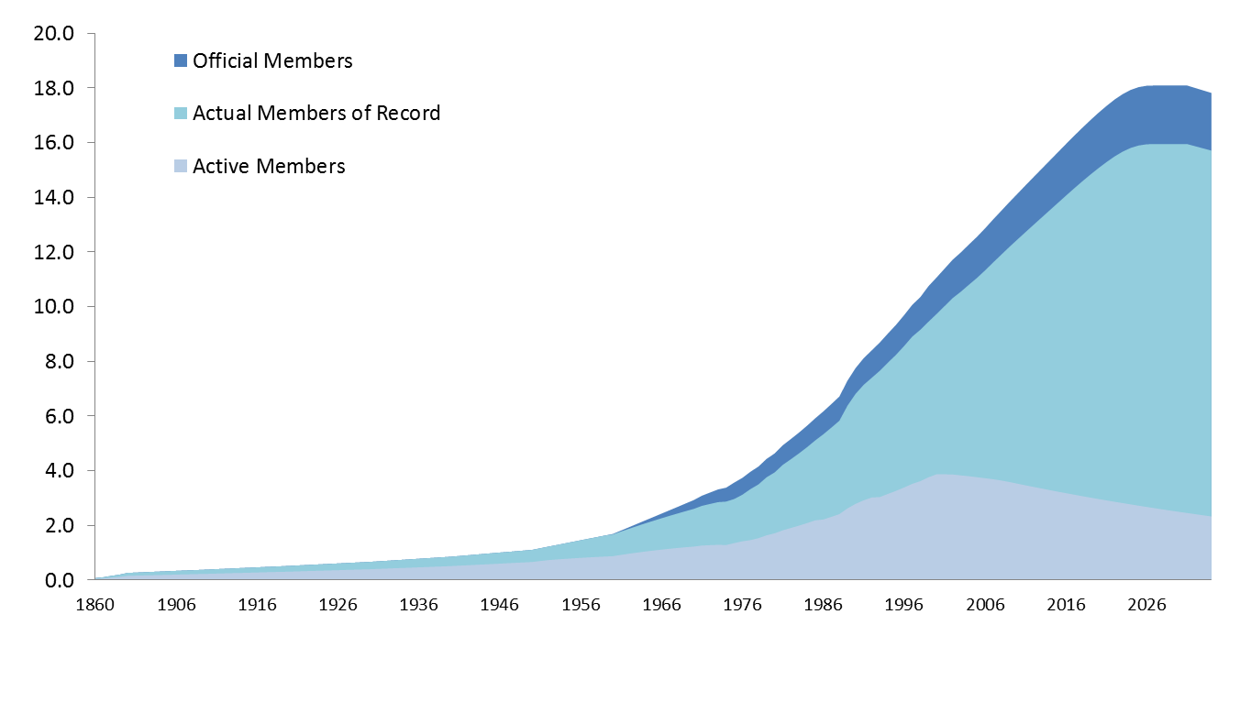
Global Membership and Activity Rate by Year
Historic and Projected (millions)
PRELIMINARY AND INDICATIVE ANALYSIS ONLY
Sources of Internal Analysis: LDS Church Almanac, Pew Foundation, Cumorah Foundation

Slide 5
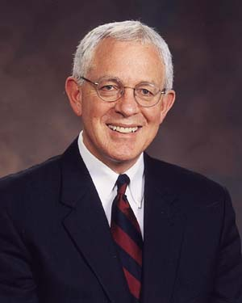
Elder Marlin K. Jensen
"Maybe since Kirtland, we've never had a period of - I'll call it apostasy, like we're having now"

Slide 6
Top 5 Myths
Was offended by someone
Desired to sin
Never had a testimony to begin with
Lazy…or stopped praying and reading the scriptures
Studied anti-Mormon literature

Slide 7
In my experience…
I wasn’t offended by anyone
I wasn’t desiring to sin
I felt like I had a testimony
I was praying and reading the scriptures…as a seminary teacher
I was not studying anti-Mormon literature. For me, it started with the CES curriculum

Slide 8
For me, these allegations felt hurtful
They made a very difficult situation even more difficult

Slide 9
Background
Approached in 2011 by a retired member of the 3rd Quorum of the 70 who was troubled himself by some historical issues
Was asked to prepare a presentation for him and a member of the 1st Quorum of the 70
Administered a survey to over 3,000 disaffected Mormons to find out how/why they lost their testimony
These data have been presented at LDS church headquarters – at some of the highest levels in the church

Slide 10

whymormonsquestion.org

Slide 11
Survey Sample
Over 3,000 respondents
“Sample of convenience” / Snowball sample
Recruited through liberal and former-LDS web sites, forums, blogs, podcasts, etc.
Higher than average income and education
Biased towards Caucasian, middle to upper-class, internet connected U.S. church members

Slide 12
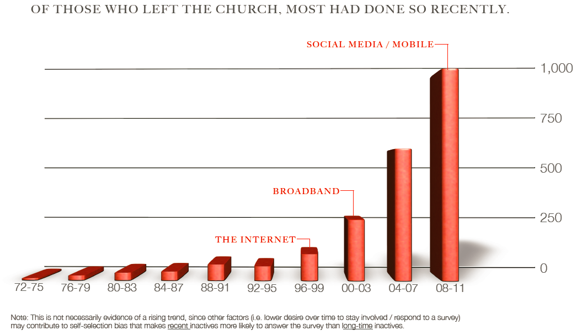
LEAVING THE CHURCH

Slide 13
Myths #1 and 2
Was offended
Desired to sin

Slide 14
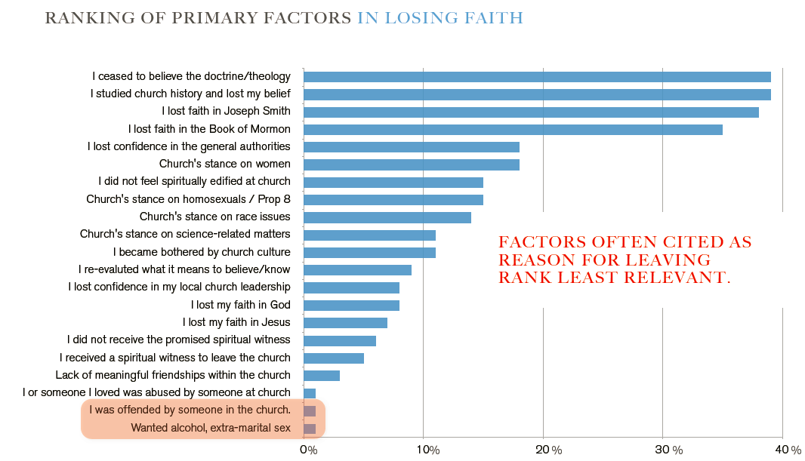
OVERALL ISSUES

Slide 15
4% indicated having been offended and/or a desire to engage in behaviors contrary to church teachings

Slide 16
This makes more sense after addressing Myths 3 & 4

Slide 17
Myths #3 - 4
Never had a testimony to begin with
Lazy…or stopped praying and reading the scriptures

Slide 18
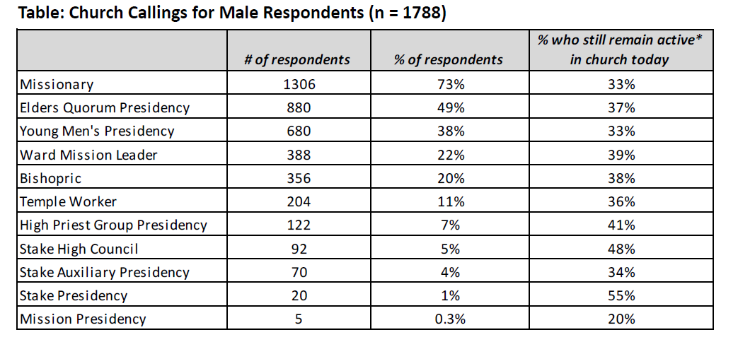
CHURCH INVOLVEMENT - MEN

Slide 19
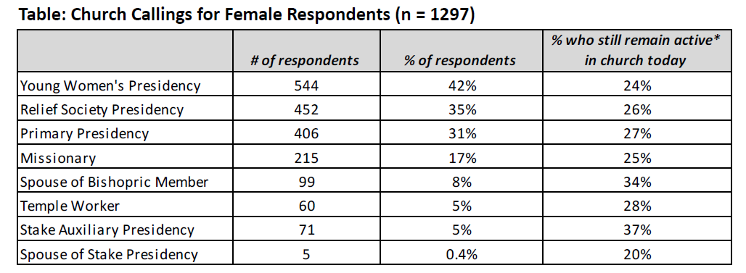
CHURCH INVOLVEMENT - WOMEN

Slide 20
“We are losing our best and our brightest.”

Slide 21
So what were the most common reasons?

Slide 22
Disclaimer – The following issues can be troubling…
…but have been reconciled by some

Slide 23
5 Types of Issues
Historical issues
Scientific issues
Doctrinal and theological issues
Socio-political and cultural issues
Spiritual issues

Slide 24
Historical Issues
Joseph’s credibility as a translator
  Joseph’s history of treasure digging
  Use of a “peep stone in a hat” to translate Book of Mormon
  Book of Abraham, Kinderhook plates
Joseph Smith’s polygamy/polyandry, post-manifesto polygamy
Denial of priesthood to blacks/racism
Masonic influences in the temple ceremony
Multiple accounts of the first vision story
Issues with the credibility of the priesthood restoration
Blood atonement, Adam/God
Mountain Meadows Massacre

Slide 25
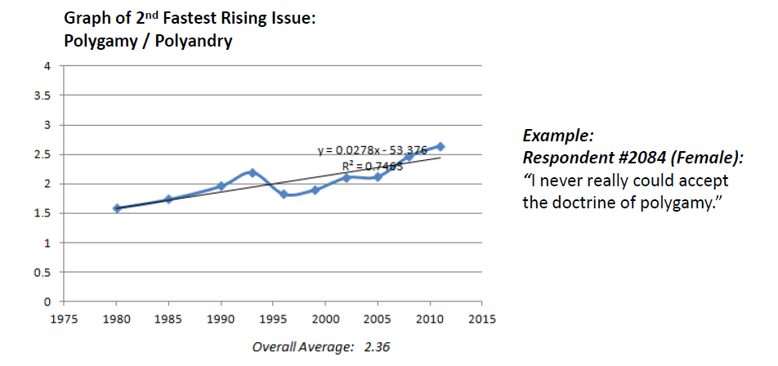
TRENDING ISSUES

Slide 26
MULTIPLE ISSUES
“It’s not any one of these historical issues, but the accumulation of them combined with the Church’s lack of addressing these concerns on their own.”
Respondent #105, Male in his 30’s

Slide 27
Scientific Issues
Age of the earth (6,000 years?)
Adam & Eve
Noah’s ark story, global flood
Evolution
Book of Mormon
  Native Americans having Asiatic DNA
  Anachronisms (e.g. horses, steel)
  Some see it as a fictional work, borrowing heavily from other sources
Book of Abraham text not matching the papyrus

Slide 28
Doctrinal and Theological Issues
Lost belief in God and/or Jesus
Lost belief in scriptures as positive, credible, divine, and/or worthwhile
Lost belief in the idea of “one true church”
Lost belief in the need for exclusive saving ordinances, proxy work for dead
Lost faith in Book of Mormon narrative about dark skin as a curse
Lost faith in church leaders, prophetic authority and credibility

Slide 29
Socio-Political and Cultural Issues
Unequal or unsatisfactory treatment of women and minorities
Church’s stance on homosexuals and same-sex marriage (Proposition 8)
Excessive political conservatism
Church’s lack of financial transparency, decision to build a mall
Culture of control, conformity, anti-intellectual, perfectionism

Slide 30
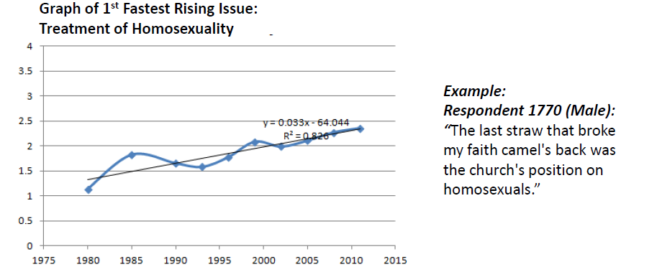
TRENDING ISSUES

Slide 31
Spiritual Issues
Never received the promised spiritual witness (after multiple sincere attempts)
Begin to question or reinterpret past spiritual experiences (e.g. emotions, manipulation)
Do not feel spiritually edified at church
Feeling burned out, not good enough
Feeling bored, uninspired
Felt spiritually inspired to leave the church

Slide 32
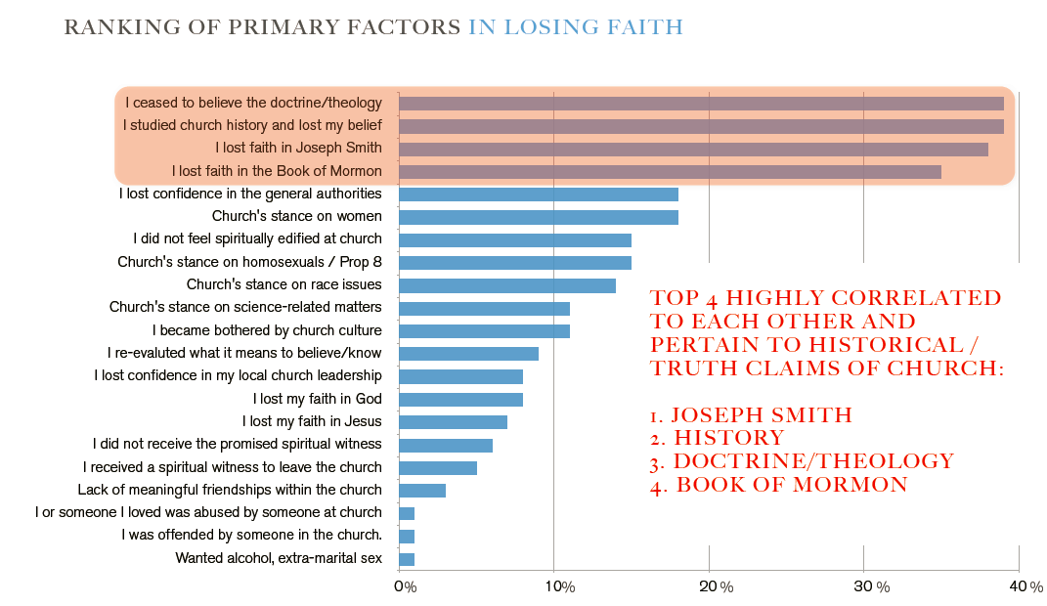
OVERALL ISSUES

Slide 33
TRENDING ISSUES
Historical issues
DNA & Book of Mormon
Book of Abraham
First Vision
Treatment of Women
Science

Slide 34
Myth #5
Studied anti-Mormon literature

Slide 35
Primary Sources
The scriptures themselves
  “Could the earth really be 6,000 years old?” (D&C 77:6)
  “Why are horses and steel in the Book of Mormon?”
  “Is polygamy still God’s new and everlasting covenant?” (D&C 132)
Journals of early church leaders
Church publications (Times and Seasons, Journal of Discourses, Ensign, Family Search, etc.)

Slide 36
“Anti-Mormon Literature”
“I never visited "anti-mormon" sites but rather sites maintained by members. With time, I simply could not accept the Church's official position on many historical issues.” Respondent 3074

Slide 37
So how does disaffection happen?

Slide 38
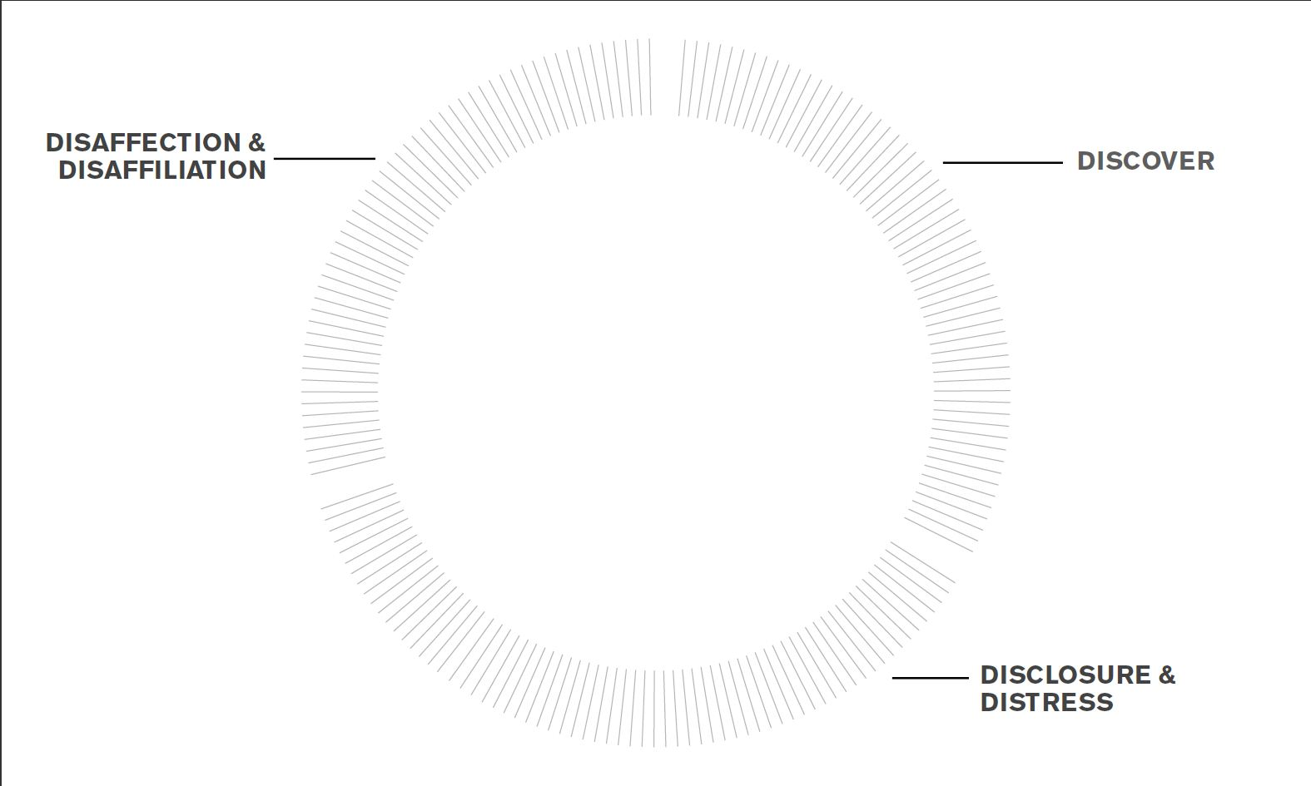

Slide 39
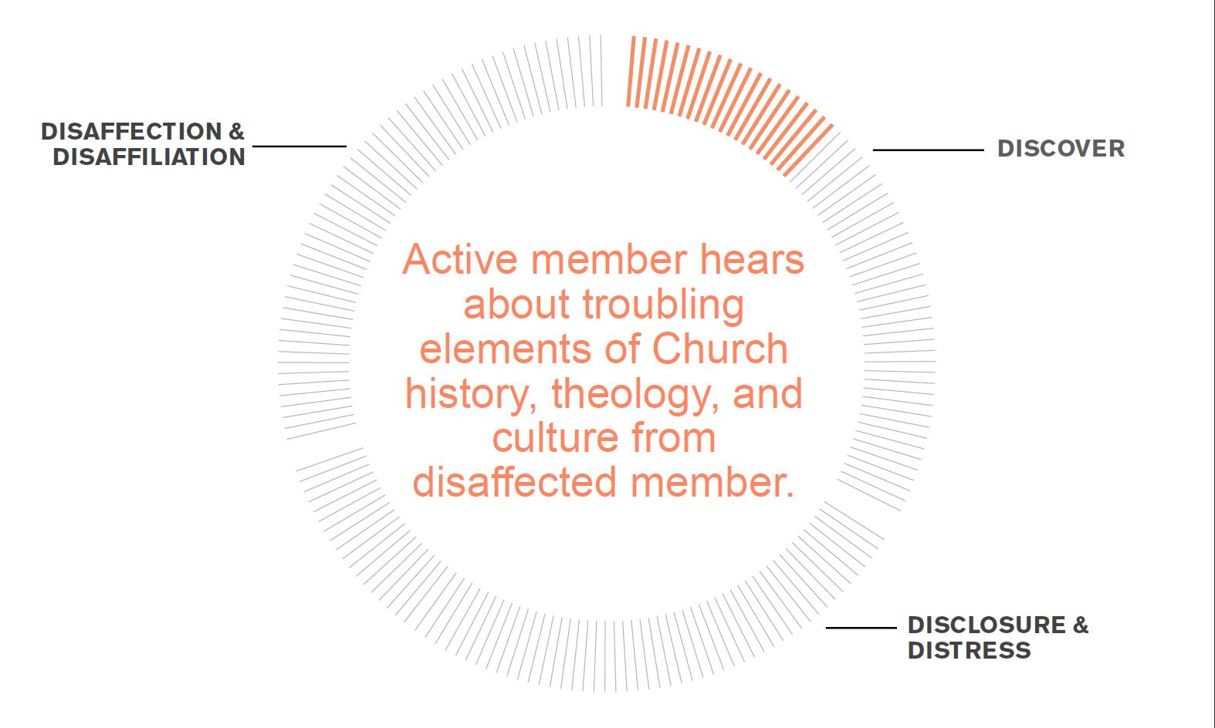

Slide 40
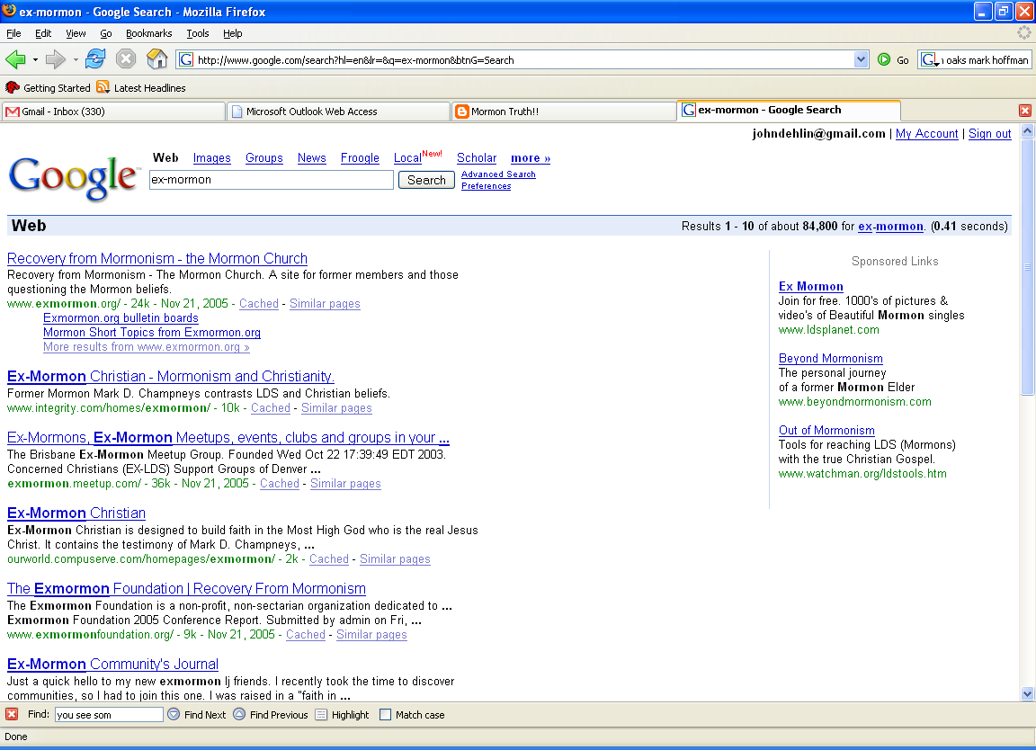
They go to Google

Slide 41
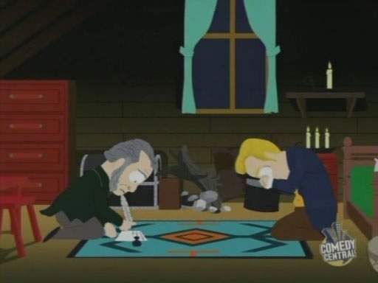
Southpark -- ”About the Mormons”

Slide 42
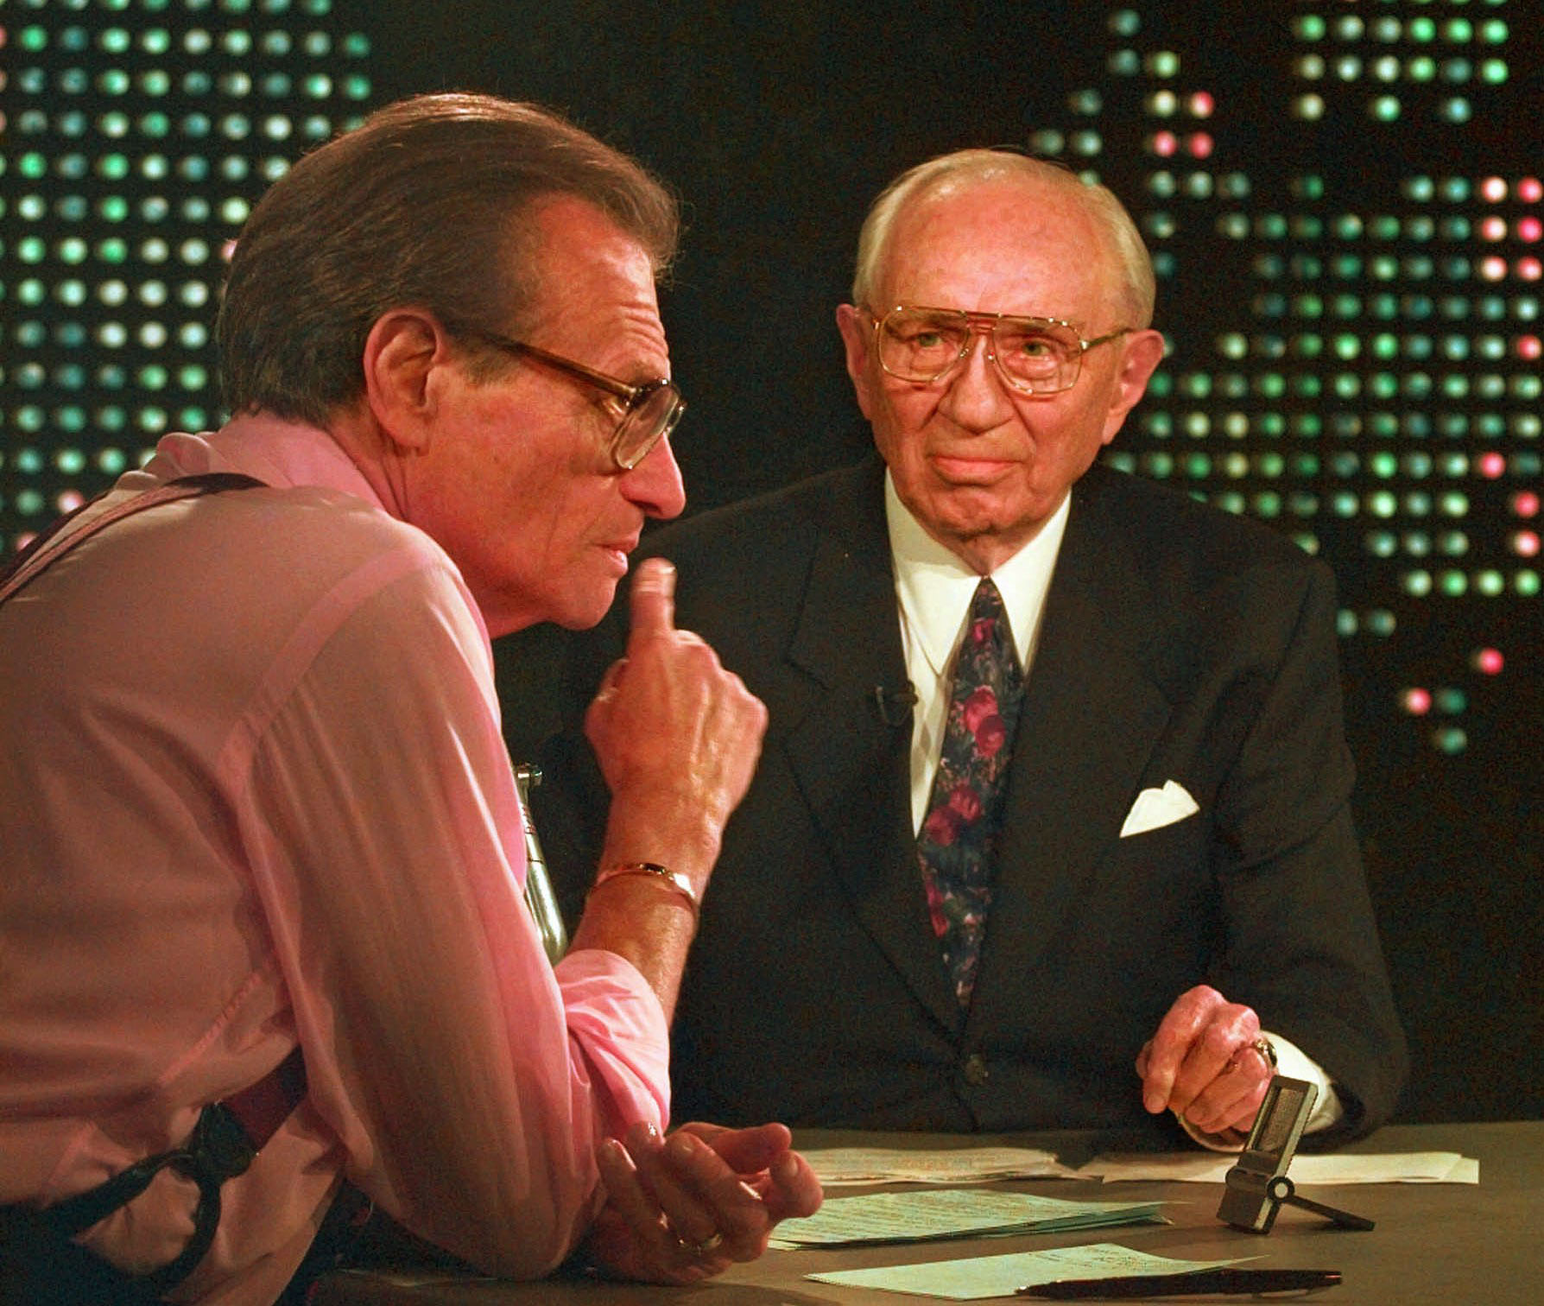
Larry King / Gordon B. Hinckley
On Polygamy: “It’s not doctrinal”
On God once being a man: “I don’t know much about it. I don’t know that we teach it.”

Slide 43
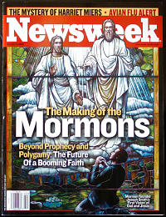
Newsweek
“After Smith ordered an antagonistic printing press destroyed …”
“By the end of his life, he had accrued some 30 wives, massive debt and hundreds of enemies. ‘I never told you I was perfect,’ he told his followers. “
"Decades of serious and honest scholarship have failed to uncover credible evidence that these Book of Mormon civilizations ever existed,"
--Southerton

Slide 44
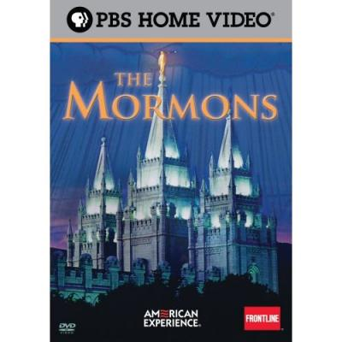
PBS Series on “The Mormons”

Slide 45

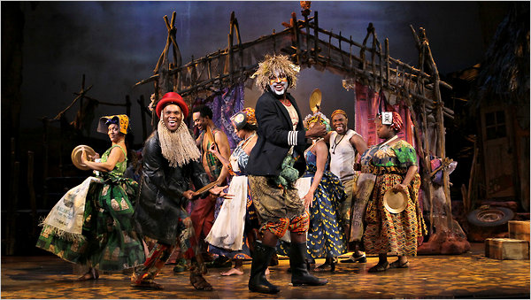
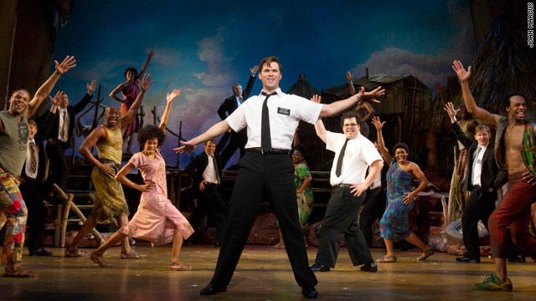

Slide 46
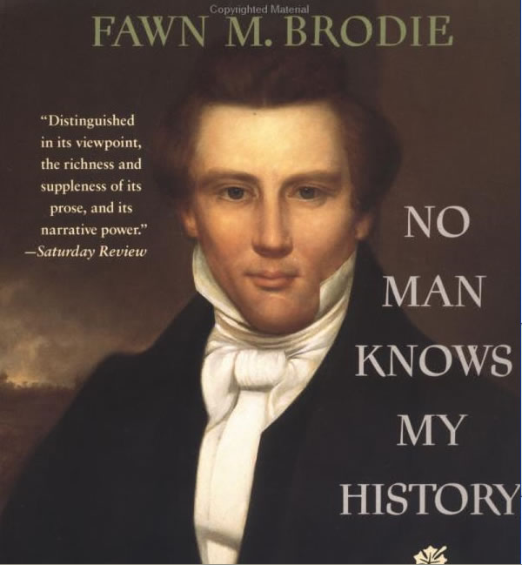
Written by David O. McKay’s Niece

Slide 47
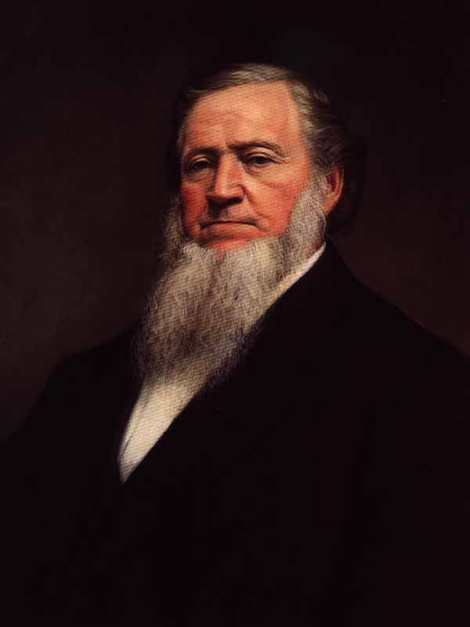
Brigham Young – Journal of Discourses
"You see some classes of the human family that are black, uncouth, uncomely, disagreeable and low in their habits, wild, and seemingly deprived of nearly all the blessings of the intelligence that is generally bestowed upon mankind. …the Lord put a mark upon him, which is the flat nose and black skin. Trace mankind down to after the flood, and then another curse is pronounced upon the same race — that they should be the 'servant of servants;' and they will be, until that curse is removed; and the Abolitionists cannot help it, nor in the least alter that decree"
--Brigham Young JOD v. 7 p. 290
"Shall I tell you the law of God in regard to the African race? If the white man who belongs to the chosen seed mixes his blood with the seed of Cain, the penalty, under the law of God, is death on the spot. This will always be so"
--Brigham Young JOD vol. 10, p. 109

Slide 48
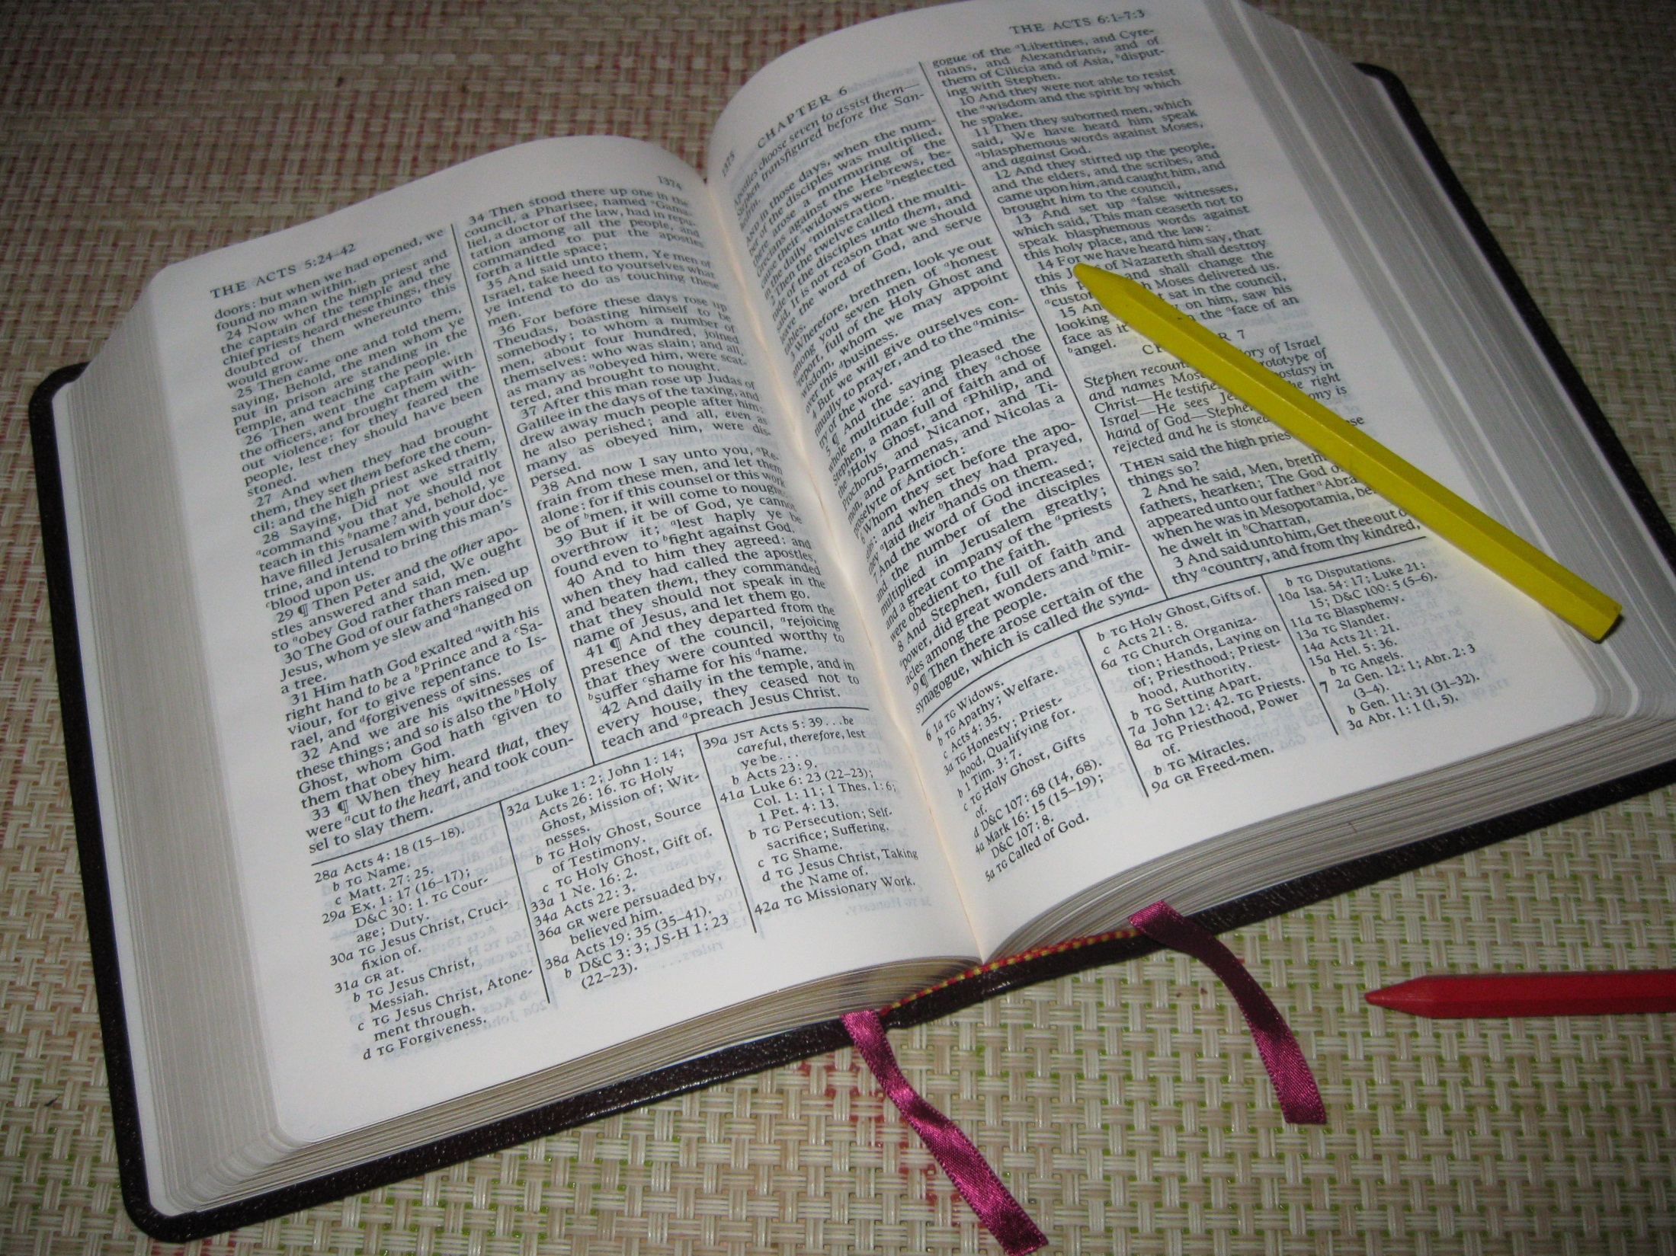

Slide 49
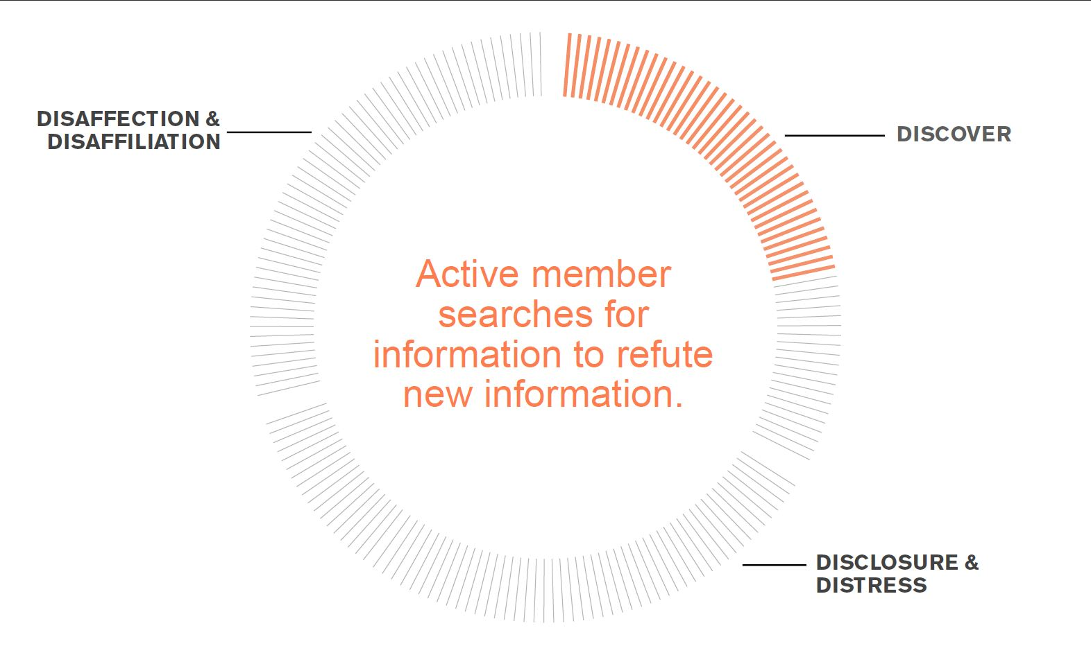

Slide 50
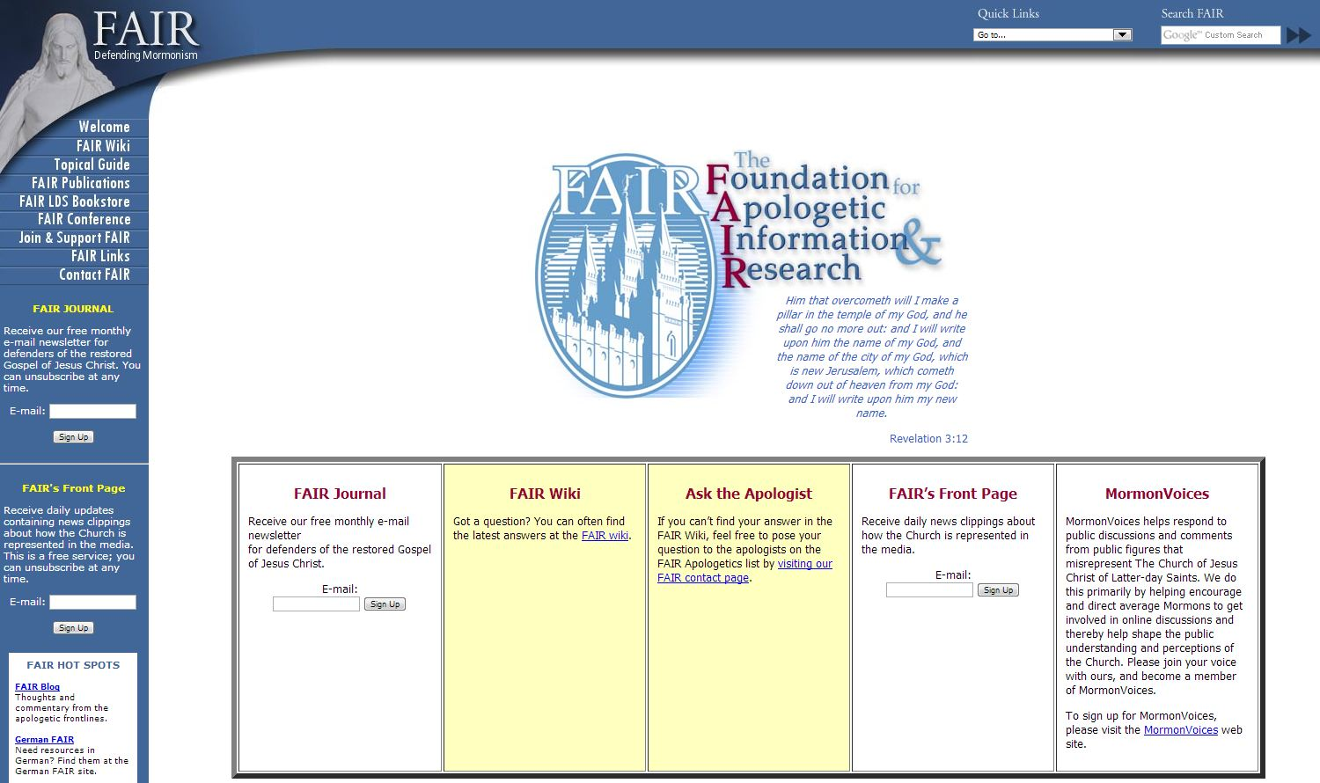
FAIRLDS.org

Slide 51
A few problems with FAIR
They legitimize the problems (unavoidable)
They introduce additional problems (unavoidable)
Many find their answers to be ultimately unsatisfying (unsure if this is avoidable)
Many also find their tone and tactics to be un-Christlike (definitely avoidable)

Slide 52
More on LDS Apologetics
From respondent 2844: “As I studied Church history and uncovered many controversial historical evidence, I would frequent LDS apologetic sites for answers (e.g. FARMS (now the Maxwell Institute), Shields, FAIR). I soon discovered those sites rarely dealt with the controversial evidences but rather often skirted or obfuscated the issue and frequently resorted to personal attacks on the individuals who were publishing historical information.”

Slide 53
More on LDS Apologetics
“…it was the apologetic attempts on FAIRLDS that helped convince [me] that the Church doesn't have a good explanation for its side.”
From respondent 2108: “I watched FARMS and FAIR apologists treat people horribly. For example, [one apologist] used to lurk on the Recovery from Mormonism site so that he could snatch up quotes from the people posting there, in order to humiliate them. This, coupled with the way apologists tend to treat critics (i.e., with ad hominem attack), was the lynchpin. I would encourage him/them to do something about the apologists. I think they are the worst aspect of the current Church.”

Slide 54
More on LDS Apologetics
From respondent 1746: “On honesty, stop leaving it to the apologetics. They are terrible and are doing more damage than good to people’s testimonies with their poor answers. For example....Book of Abraham.”
From respondent 1865: “Please stop the ridiculous apologetics. Their circular reasoning and logical fallacies do more harm than good.”

Slide 55
More on LDS Apologetics
“FAIR and their answers have done more to destroy their testimonies than any "anti-Mormon" sources could. For many members, the fact that the LDS Church is officially silent on many of these problems is a testament in itself that the church does not have any answers and are hiding behind unofficial apologists like FAIR for plausible deniability.”

Slide 56
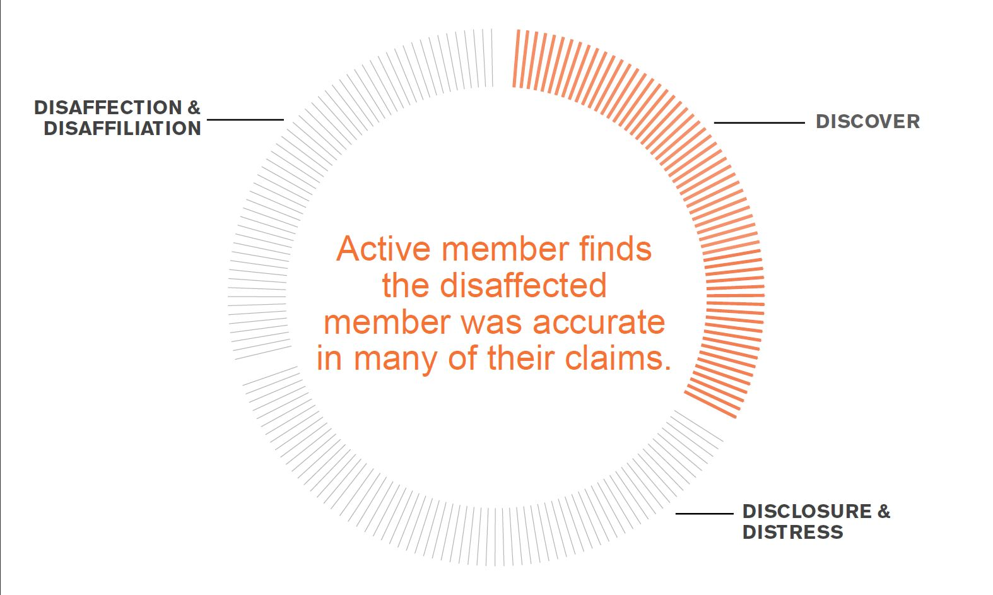
Active member finds out that the information was accurate.

Slide 57
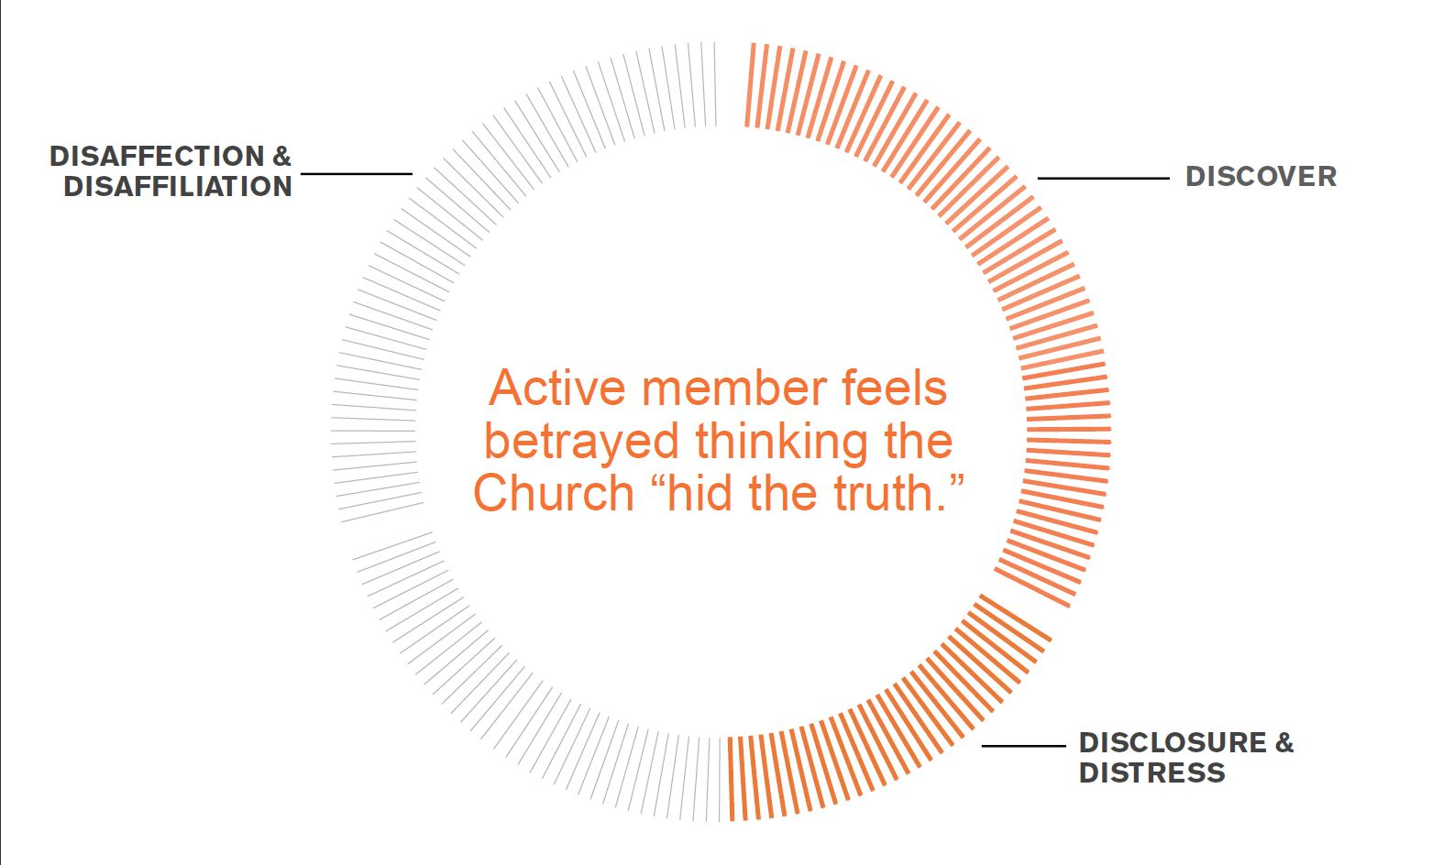

Slide 58
TRANSPARENCY AND BETRAYAL
“I defended the church to associates who brought up some historical issues. When I did my own research, I found they were true. My issue wasn’t that they were true but that my whole life I was never told about them…I felt betrayed by the church.”
Respondent #732, Female in her 40s

Slide 59
TRANSPARENCY AND BETRAYAL
“I feel like I cannot trust the general leadership on any spiritual issue because they cannot even be honest and open about our past.”
Respondent #597, Female in her 20’s

Slide 60
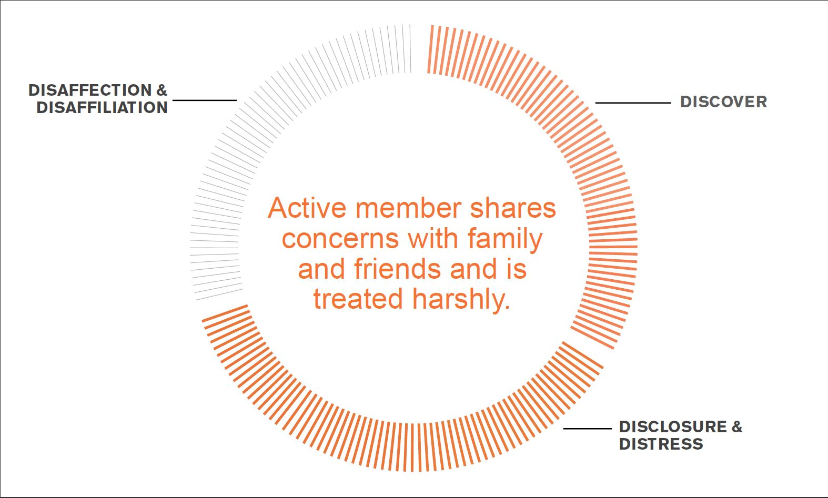

Slide 61
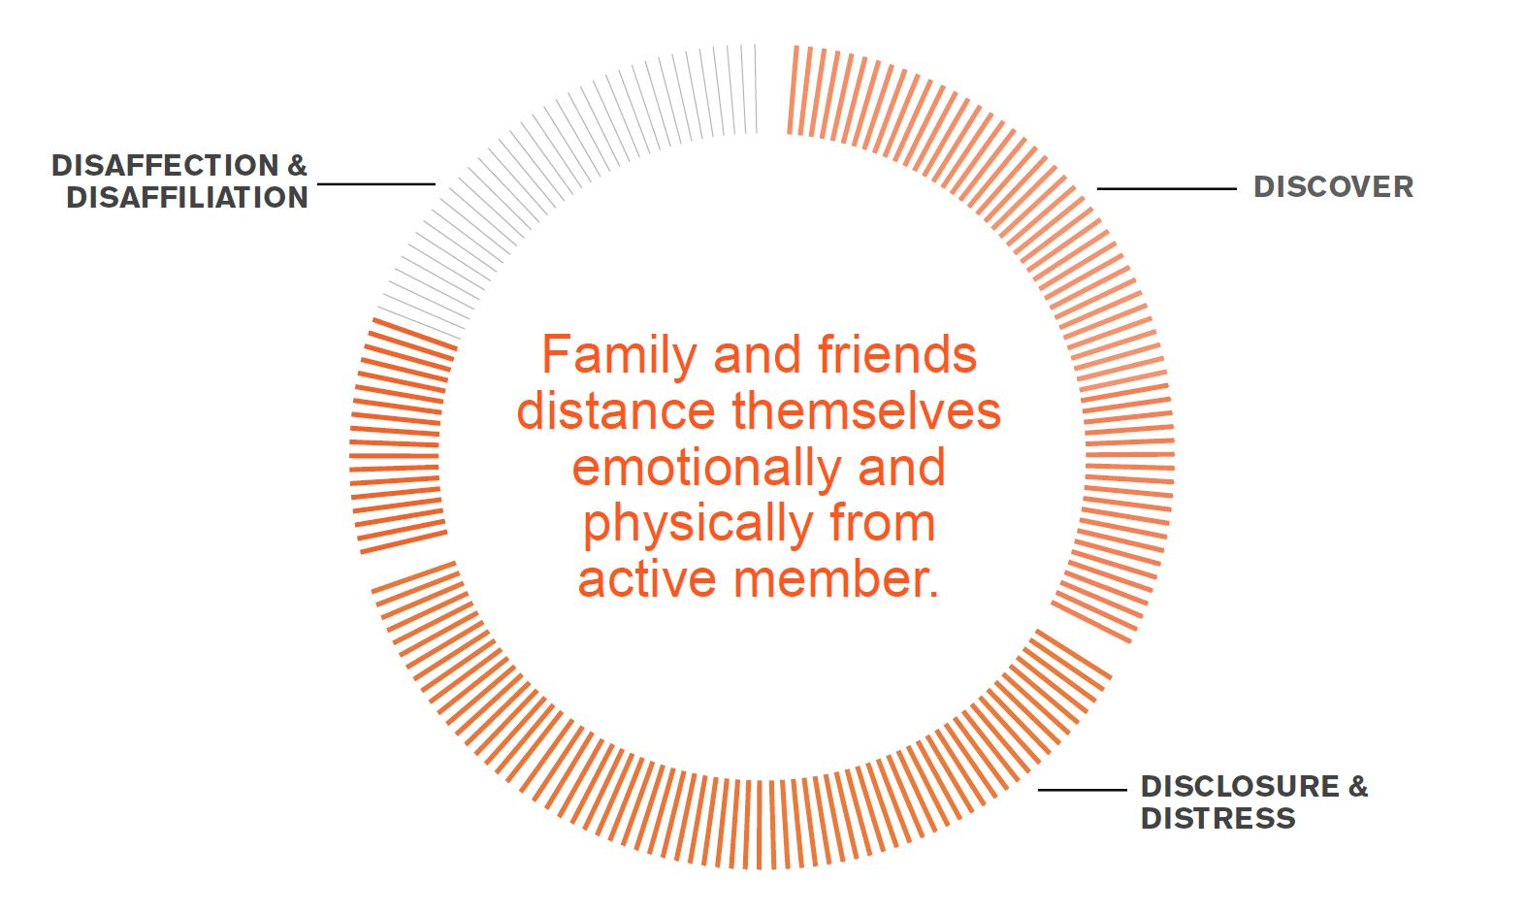

Slide 62
TRANSPARENCY AND BETRAYAL
“The Church needs to be honest with its history and contradictions…instead they make us who have discovered the complicating facts look like the evil ones. I am shunned by my family. They think I am a liar and a deceiver when it is the Church and general authorities who have deceived us.”
Respondent #701, Male in his 60’s

Slide 63
This is a major factor that leads ex-Mormons to call the church a “cult.”
It’s a natural reaction, but not at all Christ-like

Slide 64
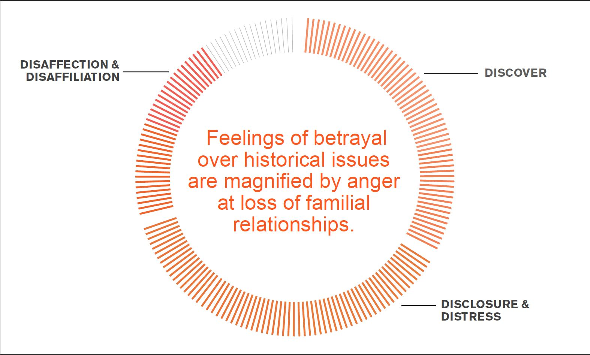

Slide 65
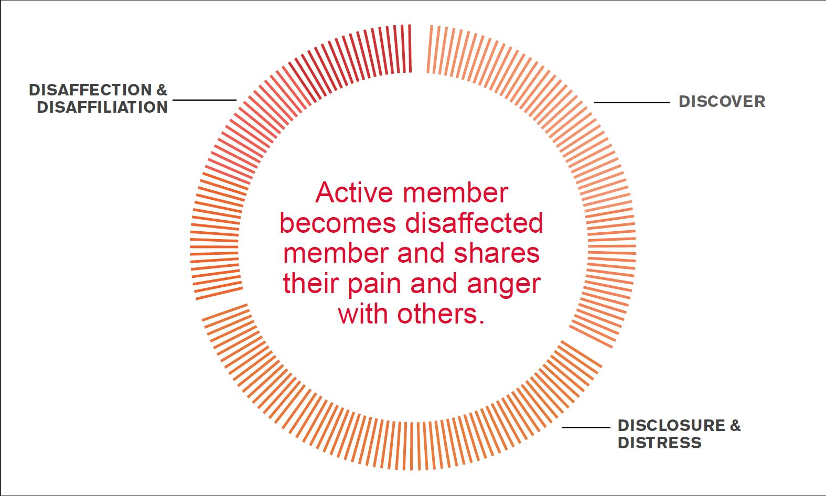

Slide 66
COSTS OF DOUBT AND DISCLOSURE
“Stop hurting marriages by driving a wedge between spouses on this issue. I have gone through hell and back and nearly divorced. We desperately need a General Conference address telling spouses to not divorce an otherwise good spouse over non-belief. I have several friends who have been divorced over primarily this issue, and my own marriage is still on the rocks due to it, even though I am fully active.” Respondent 438, Male

Slide 67
COSTS OF DOUBT AND DISCLOSURE
“Tell your bishops and leaders to tell their members to NOT divorce their spouse when they leave the LDS church. My husband was advised by his bishop to divorce me. We had 10 children. It was awful. The church that says families are the most important -- you should be ashamed of yourselves.”
Respondent 691, Female

Slide 68
So how can we help?

Slide 69
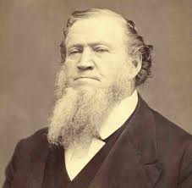
Brigham Young on “Apostates”
"If there is a despicable character on the face of the earth, it is an apostate from this Church. He is a traitor who has deceived his best friends, betrayed his trust, and forfeited every principle of honor that God placed within him. They are disgraced in their own eyes. There is not much honesty [within] them. They have forfeited their heaven, sold their birthright, and betrayed their friends."
-Brigham Young (JOD 12:94)

Slide 70
Not helpful

Slide 71
It’s “easy” to see them as….
“Dark” and sinful (“lost the spirit”)
Lost
Dishonest…breaking their covenants
Threatening and dangerous
Deceived by “Satan”
….but that’s often a matter of perspective…or flat out wrong.

Slide 72
They see themselves as….
Seeking truth, at any cost
  “Do what is right, let the consequence follow”
  “Oh say, what is truth? ‘Tis the fairest gem!”
Acting bravely, with integrity
Being more honest than ever before
Following the light…not darkness
Happy
These seem like values that Mormons should respect.

Slide 73
What should we NOT do?
Assume anything
Fall prey to any of the myths (sin, offended, lazy, never had testimony, anti-Mormon literature)
Preach at or lecture to them, guilt trips
Reduce the issue to “praying and reading the scriptures”
Refer them to “bad” apologetics sources
Judge or fear them
Avoid/ostracize them

Slide 74
Mormon on Charity
45 And charity suffereth long, and is kind, and envieth not, and is not puffed up, seeketh not her own, is not easily provoked, thinketh no evil, and rejoiceth not in iniquity but rejoiceth in the truth, beareth all things, believeth all things, hopeth all things, endureth all things.
46 Wherefore, my beloved brethren, if ye have not charity, ye are nothing, for charity never faileth. Wherefore, cleave unto charity, which is the greatest of all, for all things must fail—
47 But charity is the pure love of Christ, and it endureth forever; and whoso is found possessed of it at the last day, it shall be well with him.
-- Mormon 7:45-47

Slide 75
How can we help those who have left?
Listen to them, for a long time, even when it’s hard
Be kind…always. Love them unconditionally
Eliminate your agendas for them. Don’t try to re-convert them or call them to repentance
Do the work to understand where they are coming from. Find the truth in their concerns
Respect and honor their choices
Work with church leaders to become more informed and empathetic
Remember…without charity “ye are nothing”

Slide 76
Love them. Love them. Love them.

Slide 77
Resources

Slide 78
No official church books or website(s) at this time addressing these issues. Hopefully someday soon.

Slide 79
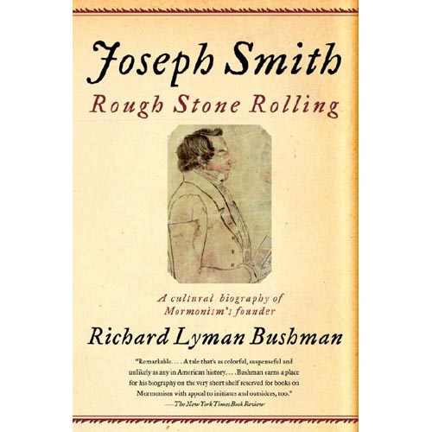
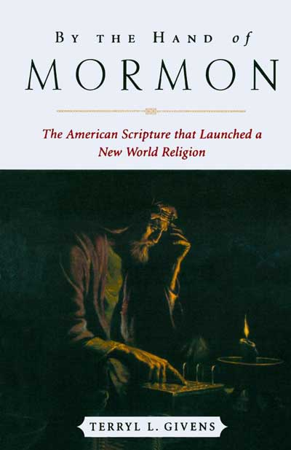
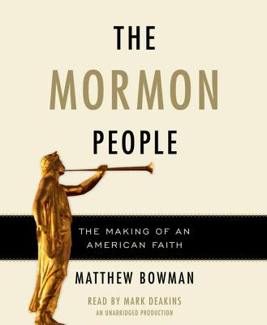
Faithful Books

Slide 80
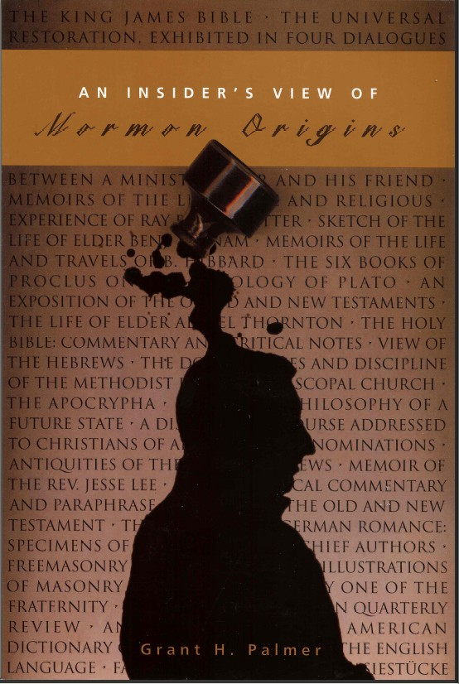
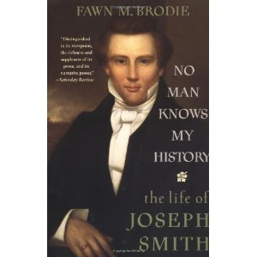
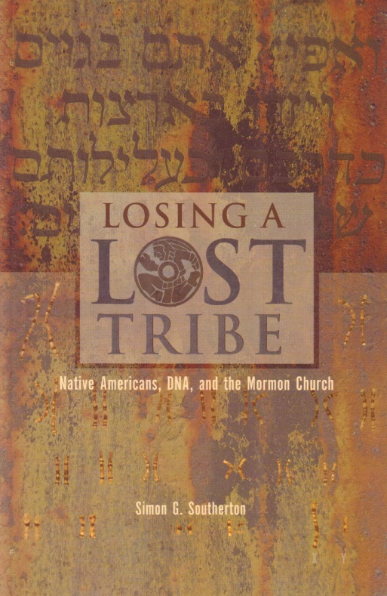
Skeptical Books

Slide 81
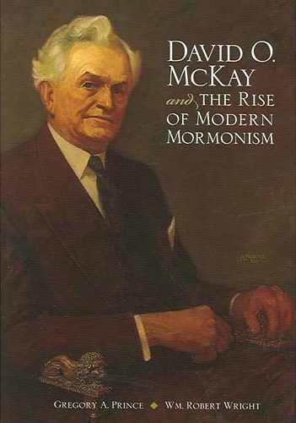
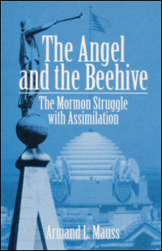
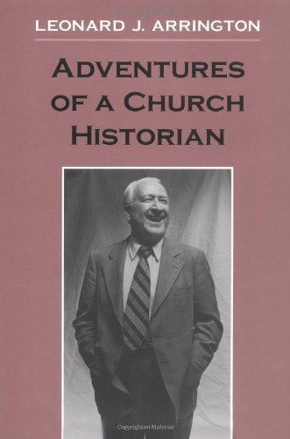
Classic Books

Slide 82
FAIRLDS.org

Slide 83
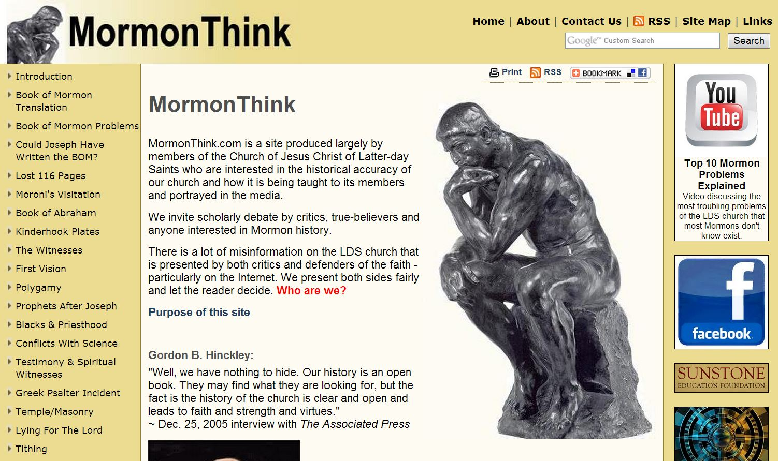
MormonThink.com

Slide 84
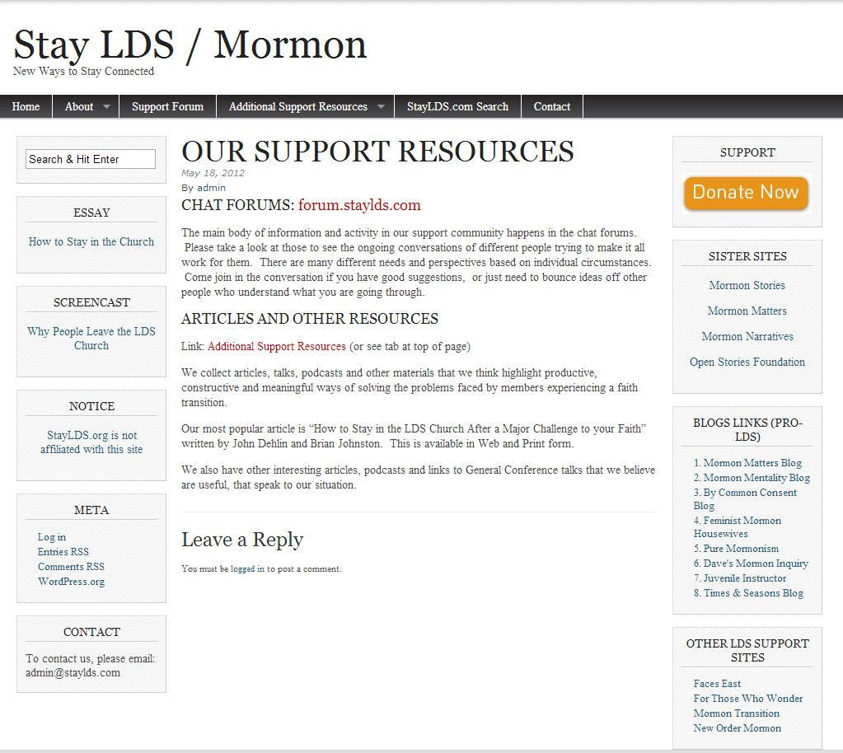
StayLDS.com

Slide 85
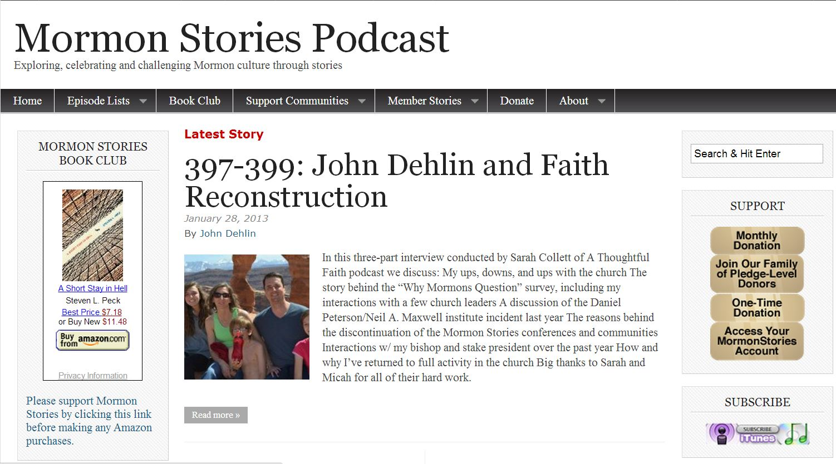
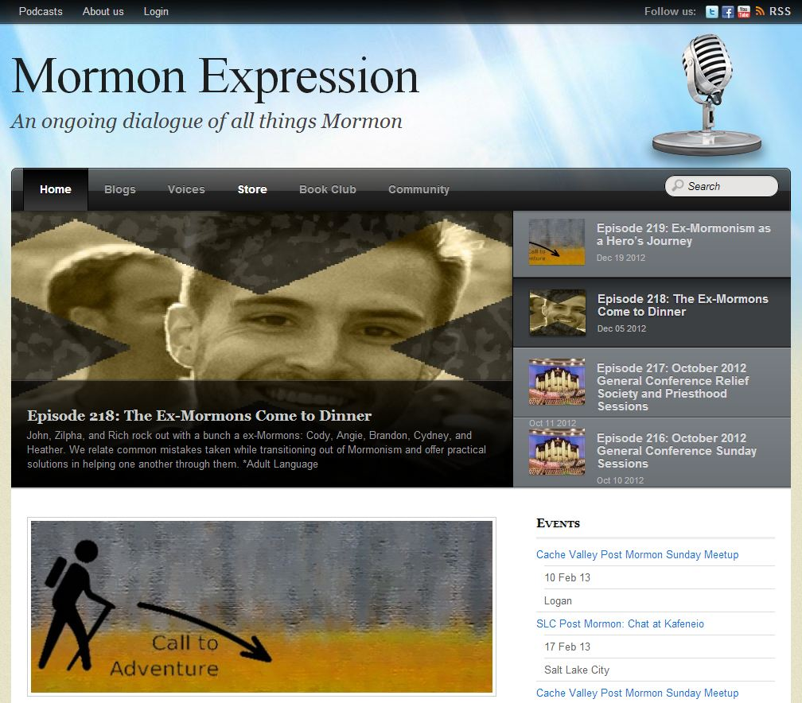
Mormon Stories, Mormon Expression

Slide 86
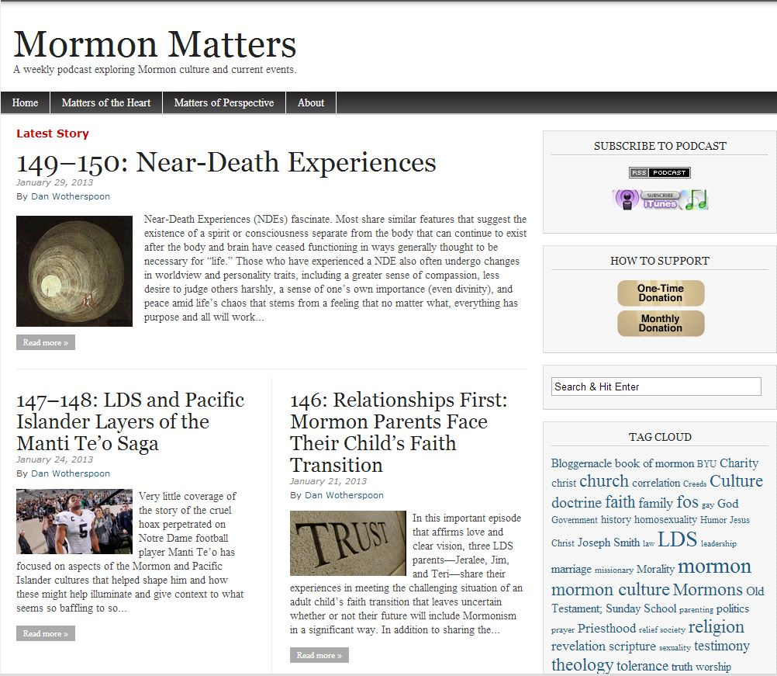
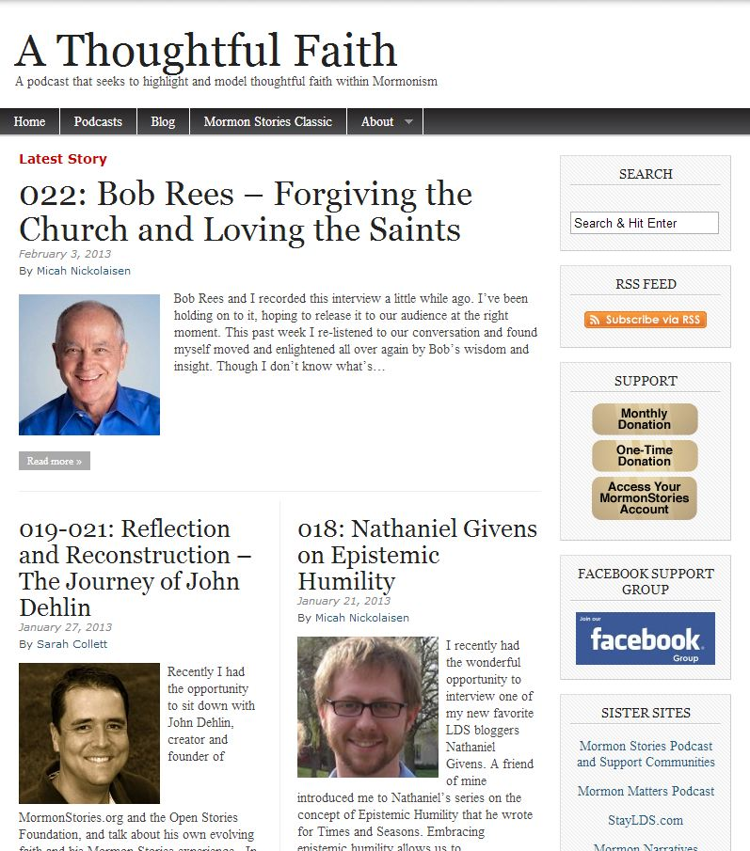
Mormon Matters and A Thoughtful Faith

Slide 87
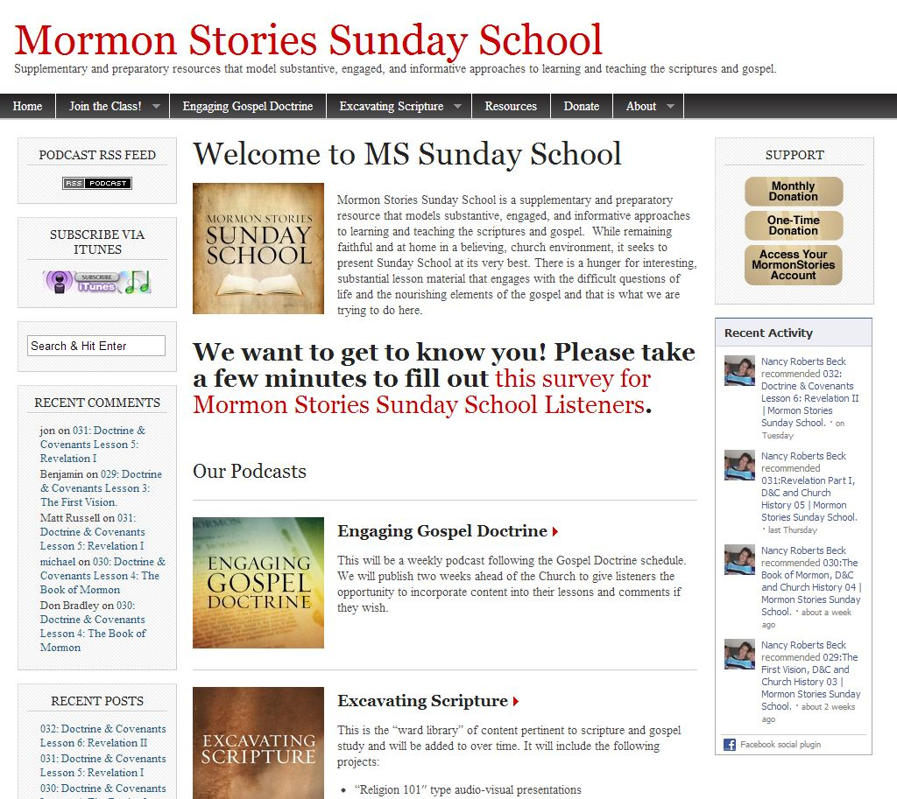
Mormon Stories Sunday School

Slide 88
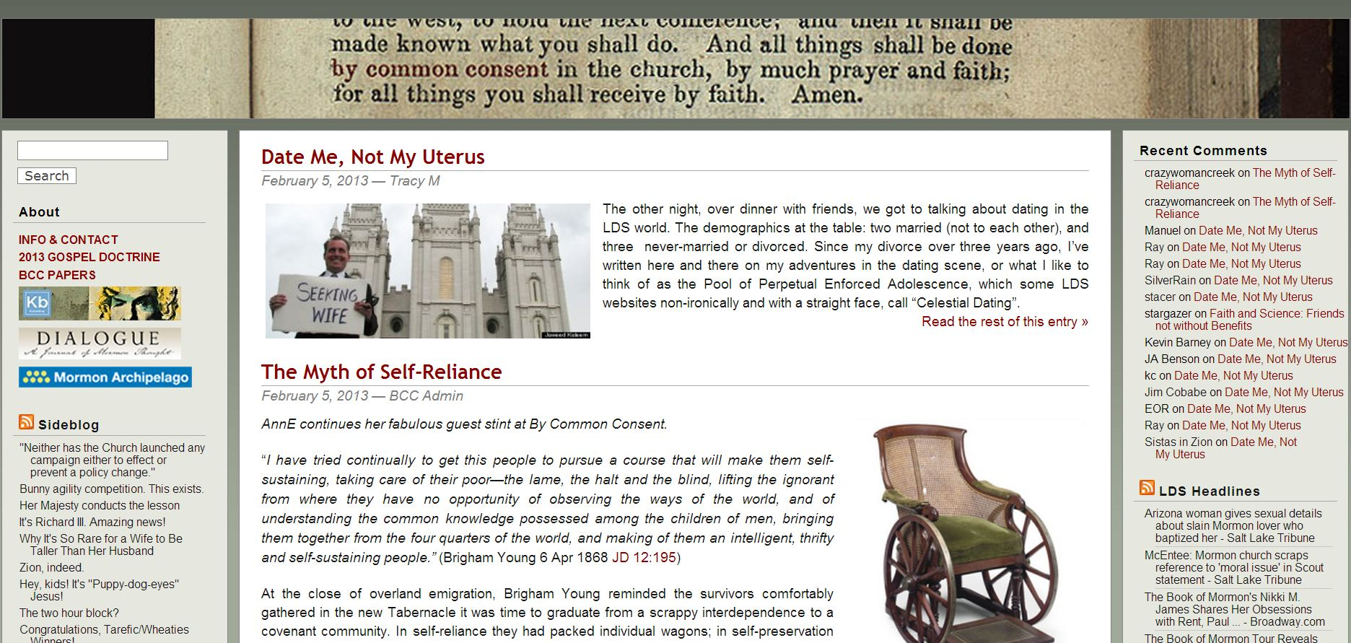
ByCommonConsent.com

Slide 89
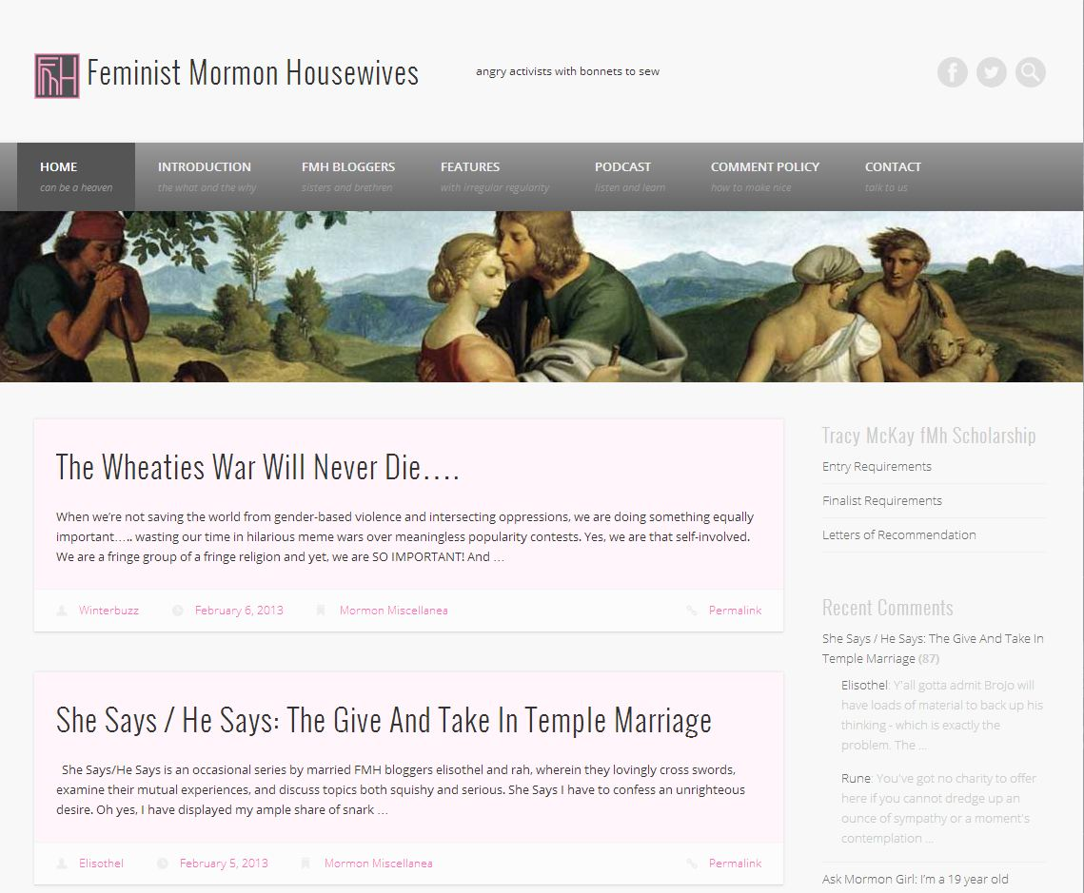
FeministMormonHousewives.org

Slide 90
What should I do now?
Call your loved one(s) and set up a time to talk
Listen, listen, listen. And love
Become more informed about the difficult issues
Share this presentation with other family members, friends, ward members, and church leaders
Remember that all things will work out in the end. In the mean time don’t forget that:
“…if ye have not charity…ye are nothing.”

Slide 91
http://mormonstories.org mormonstories@gmail.com

